Slide 1
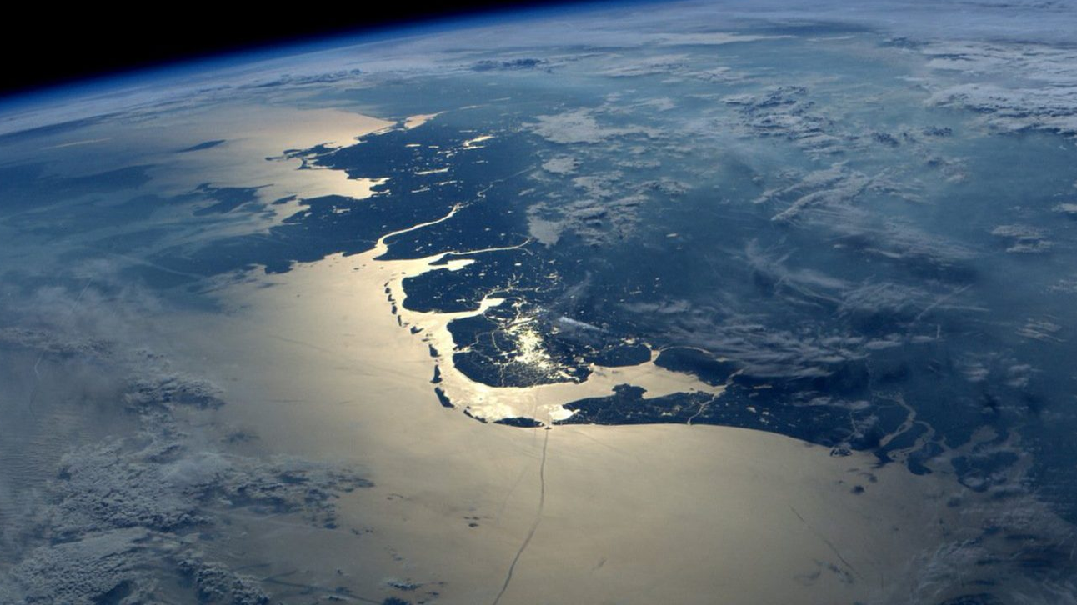

SPARK
WSA Conference ‘With whom (& for whom) do we learn?’
28-30 March 2022 Heleentje swart
Lunteren SPARK THE MOVEMENT, RCE FRIESLAND

Slide 2
PROGRAM
INTRODUCTION
ASPIRATIONS OF NORTHERN REGION OF THE NETHERLANDS & COOPERATION WITH CIRCULAIR FRIESLAND
SPARK APPROACH
MAPPING YOUR PARTNERS

Slide 3


The learning crisis is part of a broader challenge relating to the ability of conventional education systems to deliver the knowledge, skills and outlooks needed for children, young people and adults to excel in today’s world and contribute to sustainable, healthy and peaceful futures.
In the context of a global climate crisis, rapid technological change, profound changes in the world of work, lower levels of trust in public institutions, the erosion of democratic values and the rise of disinformation, intolerance and hate speech, UNESCO’s landmark report on the futures of education noted that ‘far too often, formal learning does not meet the needs and aspirations of children and youth and their communities’.
Reimagining our futures together: a new social contract for education, UNESCO 2021
https://en.unesco.org/futuresofeducation/

Slide 4
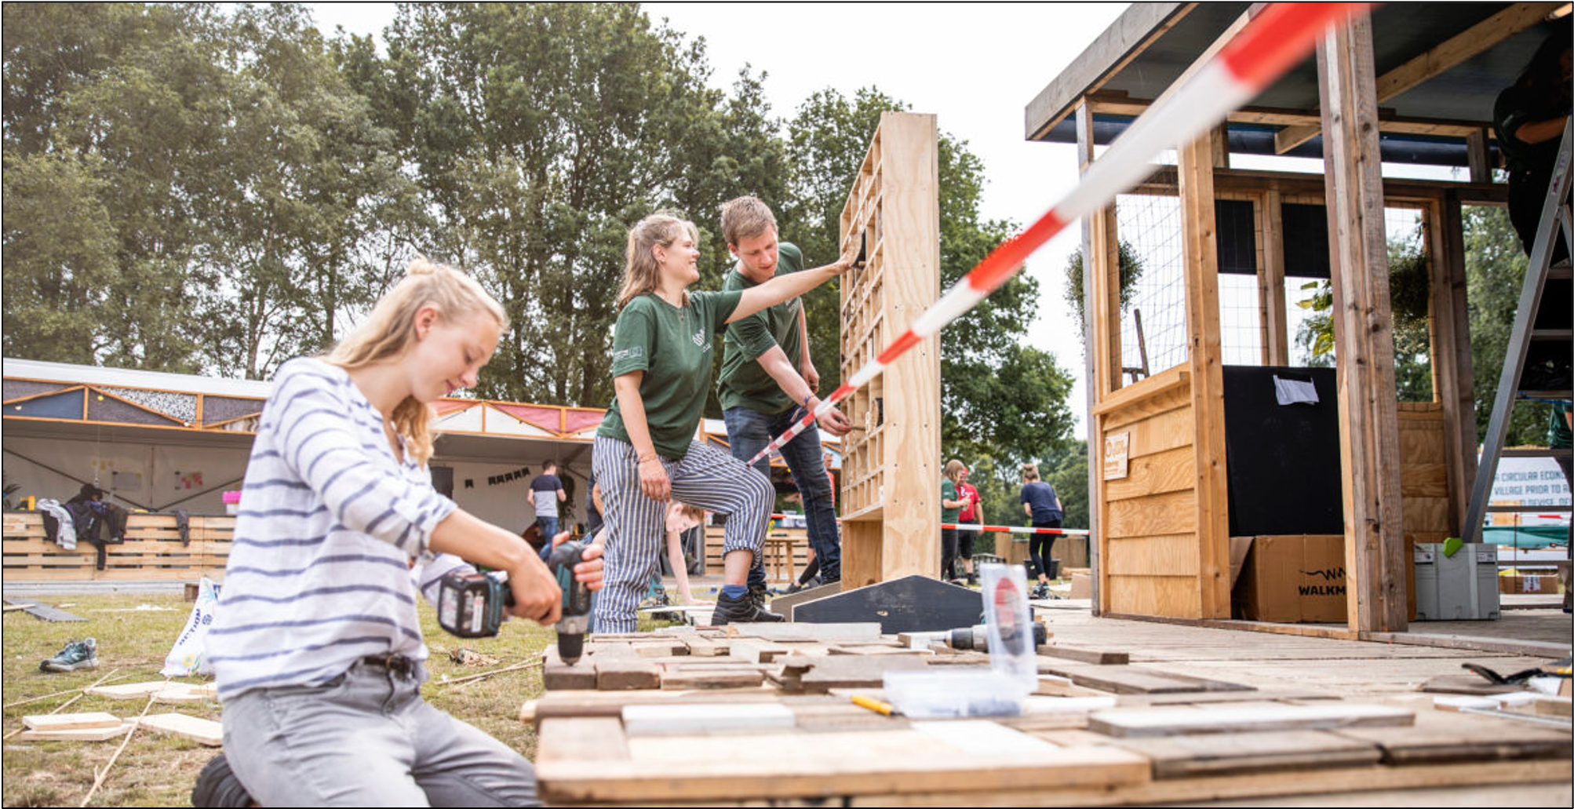
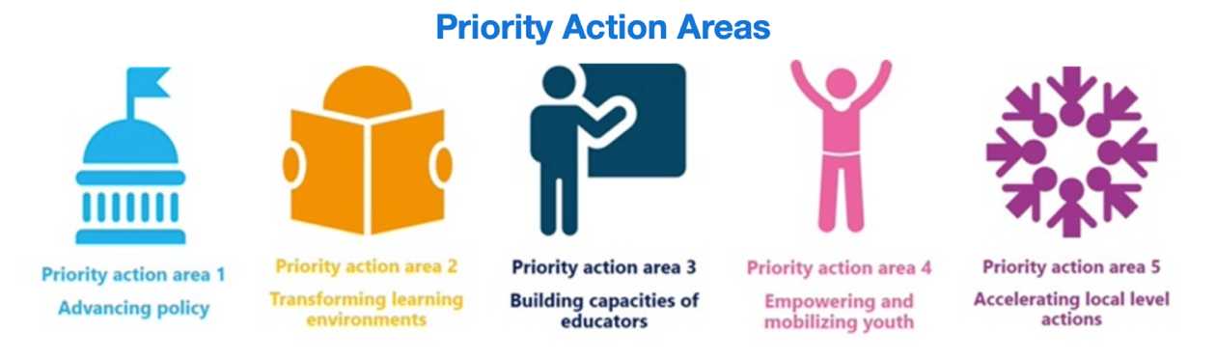

SPARK
IT TAKES THE REGION
TO EDUCATE A CHILD…
https://en.unesco.org/themes/education-sustainable-development/toolbox
Notes:
https://www.youtube.com/watch?v=jADfZ5VQwqg

Slide 5



EDUCATION
LEARNING FOR BROAD PROPSERITY
POLICY
GOVERNANCE FOR BROAD PROSPERITY
MISSION BASED TRANSITION in the REGION
ART & CULTURE
IMAGINATION & COMMUNITY BUILDING FOR BROAD PROSPERITY
ECONOMY
CIRCULAR BUSINESSES FOR BROAD PROSPERITY
http://www.bluedelta.world
Notes:
Broad prosperity = beyond GDP : also social & ecological value – Gross domestic product

Slide 6



















































































Notes:
Gestart in ‘16 door 25 ondernemers die nadachten over wat vraagt de wereld van ons in de 21e eeuw – wat wil ik met mijn bedrijf betekenen in deze tijd? Gaat verder dan geld verdienen – we hollen de wereld uit, we willen op een andere manier naar ons businessmodel, naar onze economie kijken. Dat is een goed verhaal, wat een ongelofelijke hoeveelheid duurzame energie oplevert: nu meer dan 100 leden. Die niet kletsen, maar doen: op 10 thema’s al tientallen projecten. Werkt als een multiplier. Wadden plasticvrij; afwegingskader biomassa, 10 stappenplan natuur inclusieve lb + Friese voedselbeweging, nergens zoveel energie coöperaties als in Fr, Testcentrum Kunststoffen en de Fossylfrije Weken. + in het onderwijs meer dan 200 projecten en voorbeelden waarmee we jongeren laten zien: het doet er toe om je in te zetten voor een leukere wereld! Het kan, het werkt en het levert een hoop plezier op. – www.sparkthemovement.nl

Slide 7
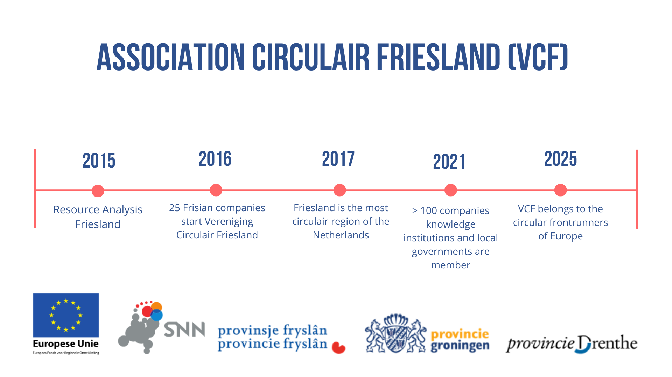

Slide 8
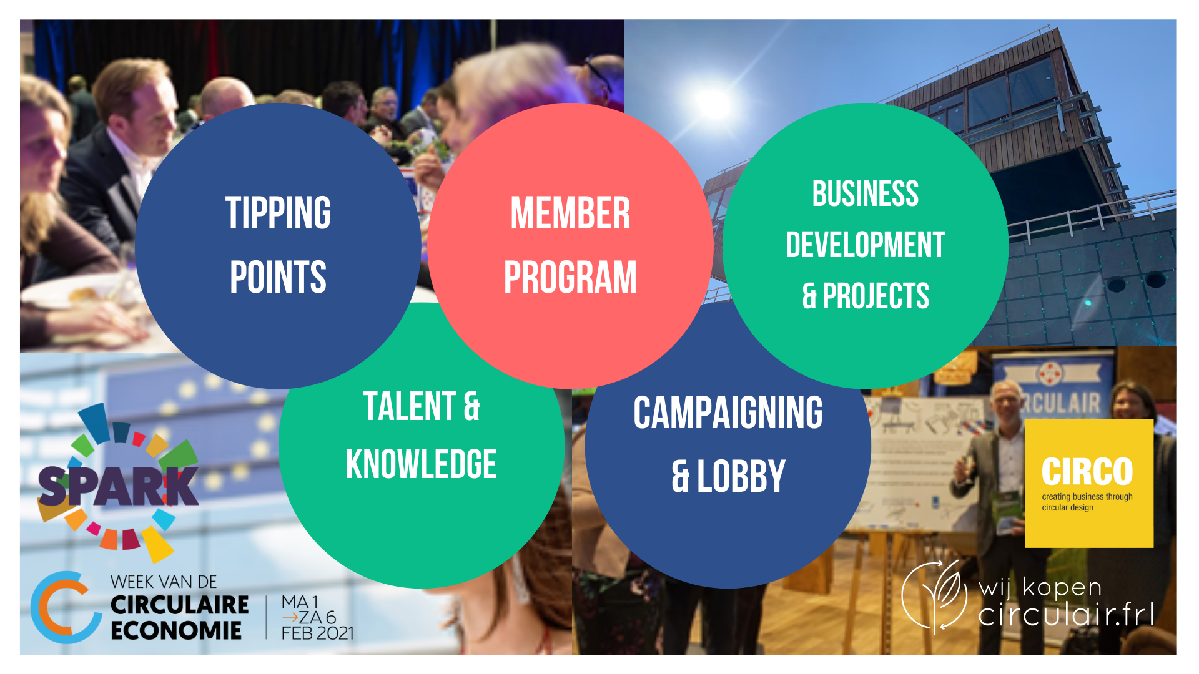

Slide 9
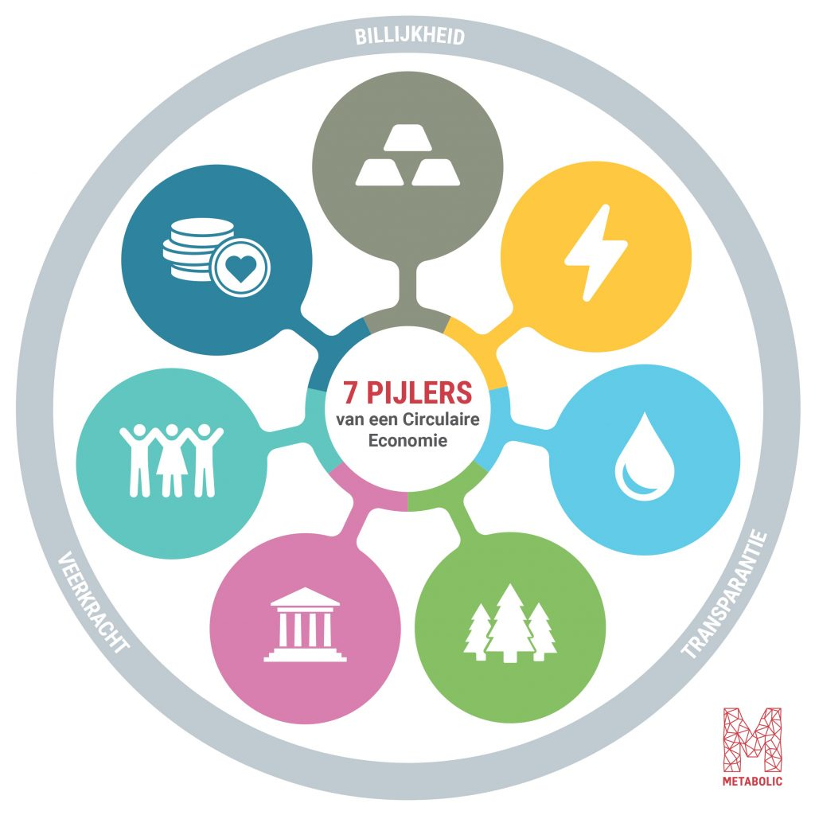
7 DESIGN PRINCIPLES FOR A CIRCULAR ECONOMY

Slide 10

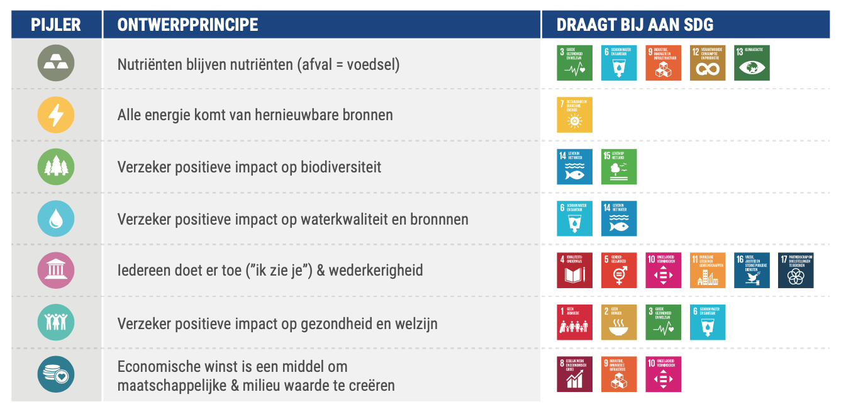
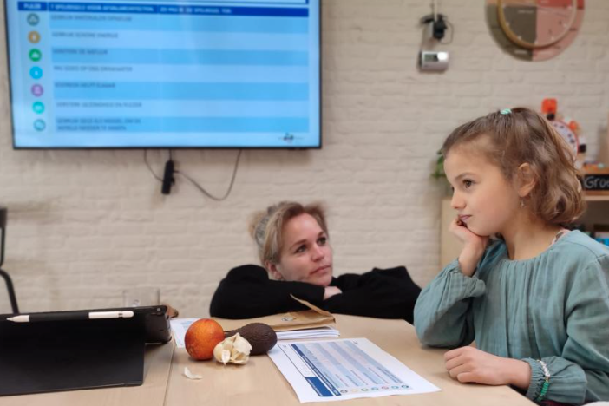
MAKING SURE NUTRIENTS STAY NUTRIENTS
USING 100% SUSTAINABLE ENERGY
STRENGTHENING BIODIVERSITY
KEEPING WATERSOURCES CLEAN
STRENGTHENING INCLUSIVE SOCIETY
STRENGTHENING HEALTH & HAPPINESS
STRENGTHENING LOCAL ECONOMIES
FOR BROAD PROSPERITY

Slide 12
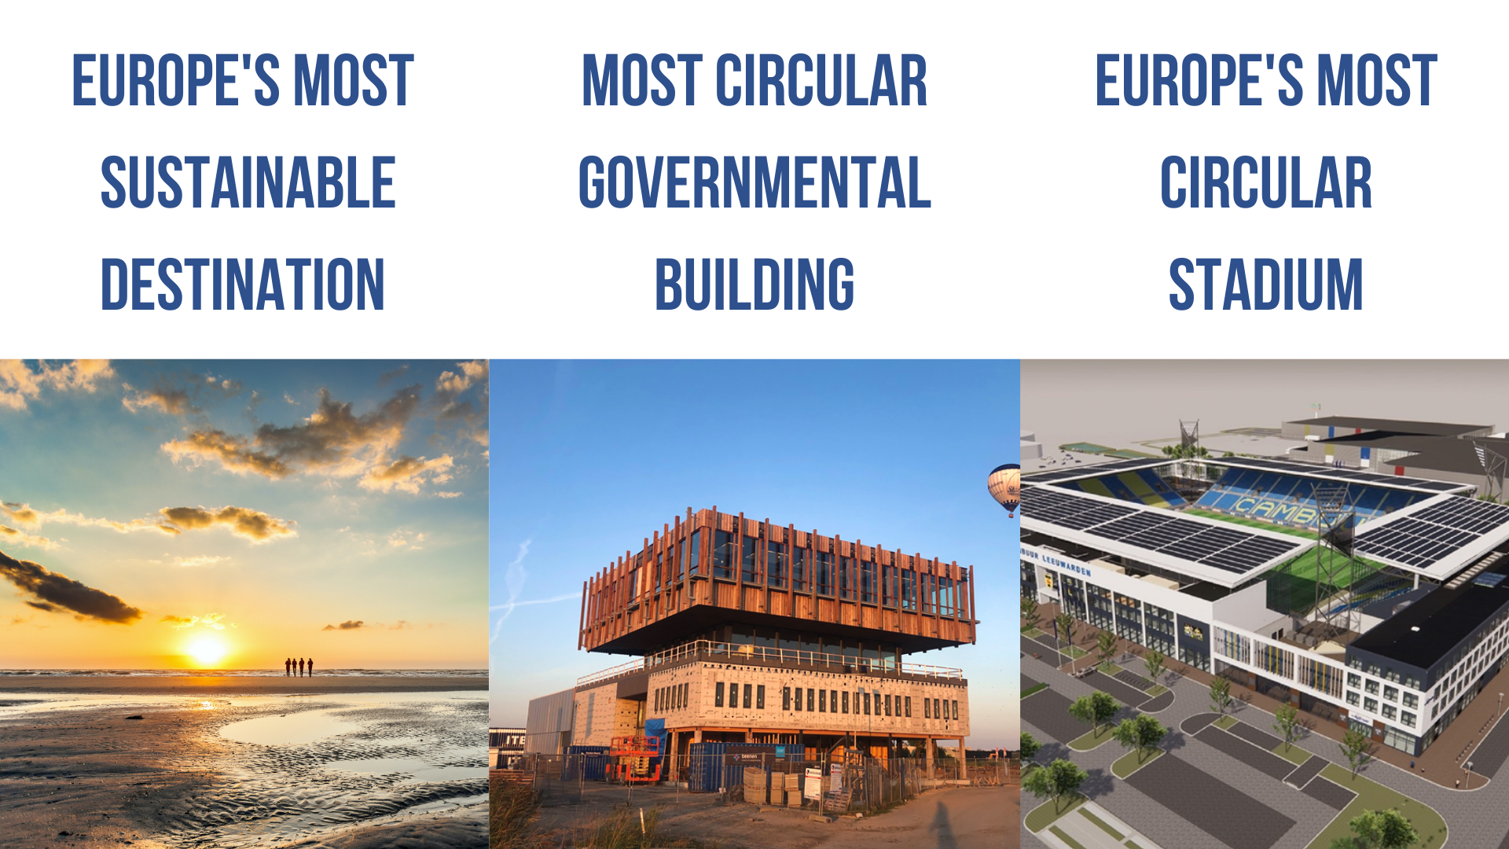
Notes:
Fryslân woont Circulair
Bedrijventerreinen
…

Slide 13
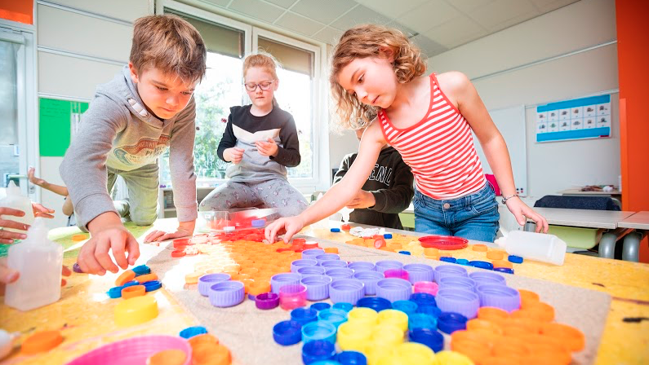
SPARK INSPIRES AND SUPPORTS ALL EDUCATION IN THE REGION
TO LEARN FOR A CIRCULAR ECONOMY AND A SUSTAINABLE SOCIETY
In Friesland, a growing group of companies, governments and citizens is working to realize a circular economy and a sustainable society. These networks are increasingly well organized and ambitions are taking shape: by 2025 we want to be one of the innovative leaders in Europe.
SPARK offers all levels of Frisian education the inspiration, expertise and tools to learn together with regional partners how broad prosperity can be achieved.
We achieve triple added value when young people develop the knowledge, skills and attitudes that contribute to broad prosperity: for themselves, for a social and ecological sustainable region, and for a meaningful, futureproof proposition of the northern economy.
BE A SPARK, JOIN THE MOVEMENT!

Slide 14
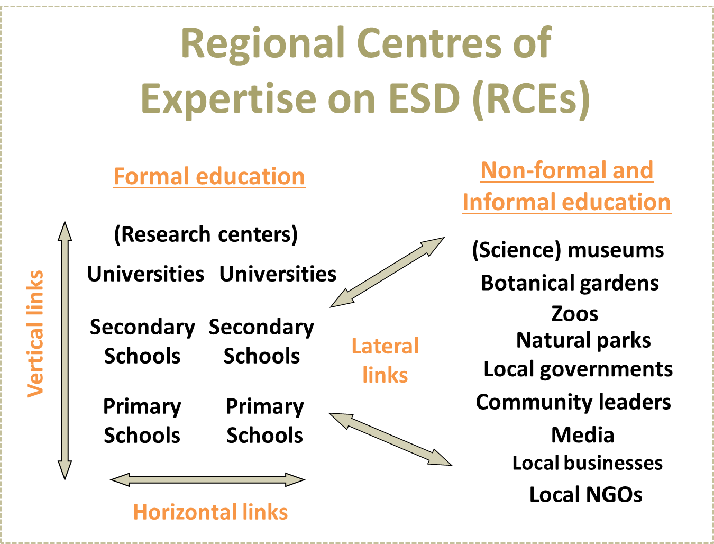

THE MOVEMENT
Notes:
By analogy of an African saying…

Slide 15
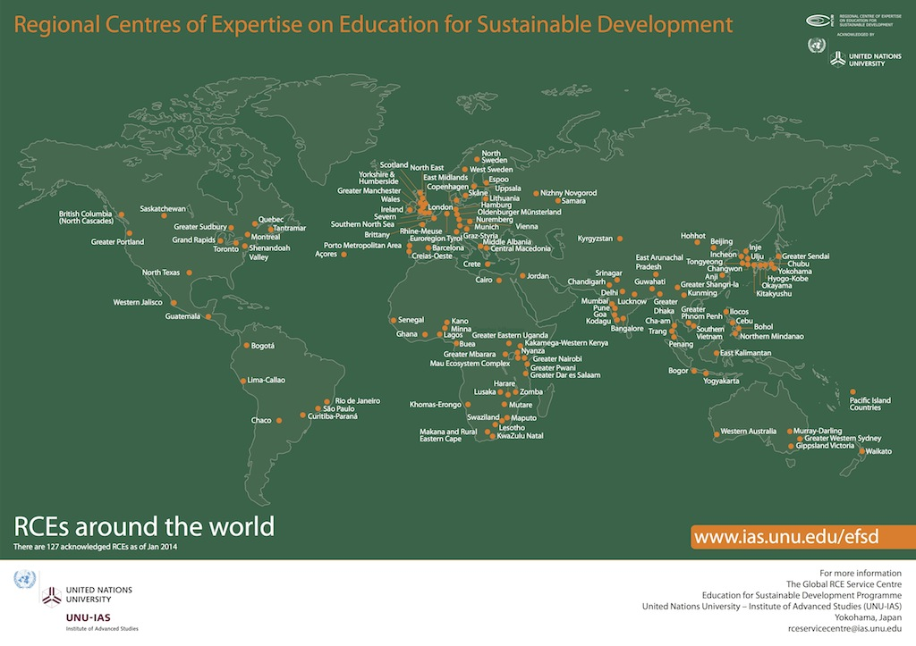
Notes:
FINLAND
RCE Helsinki Metropolitan
AUSTRIA
RCE Graz-Styria
RCE Vienna
IRELAND
RCE Dublin
PORTUGAL
RCE Creias-Oeste
RCE Porto Metropolitan Area

Slide 16
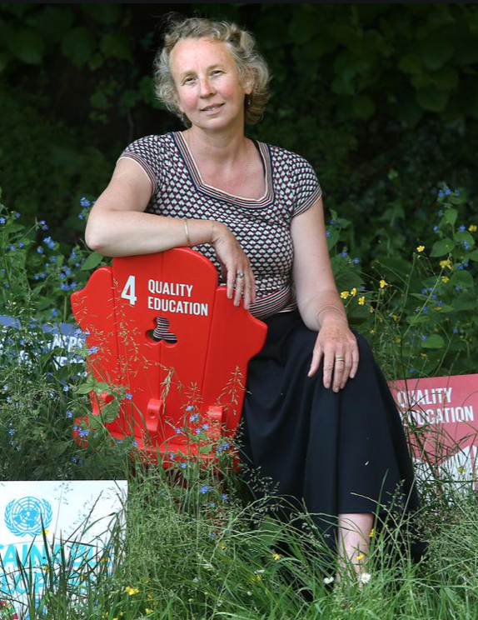
HOW DO WE DO THAT?
https://www.youtube.com/watch?v=9_M3BMuL6O4

Slide 17
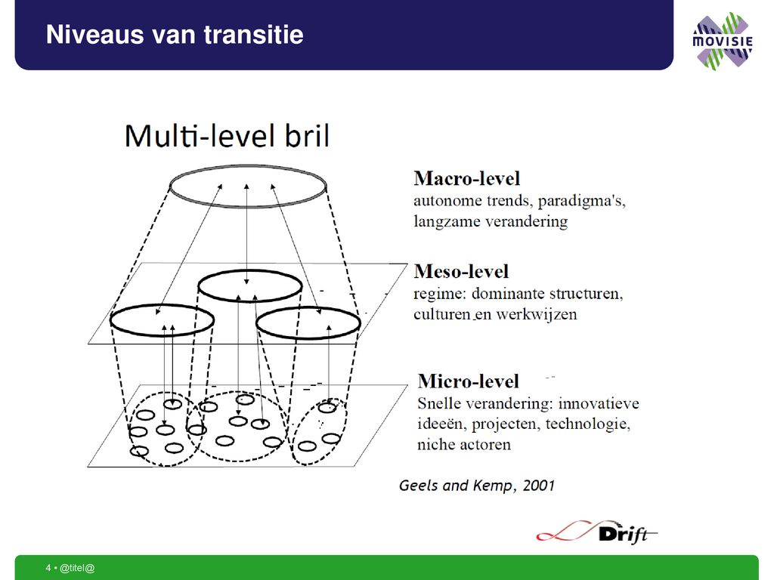
MODEL FOR TRANSITION
GLASSES
LANDSCAPES
THRIVING REGION
INTERNATIONAL
NATIONAL
REGIONAL
REGIMES
ORGANISATIONS
NICHES
CLASSROOMS

Slide 18
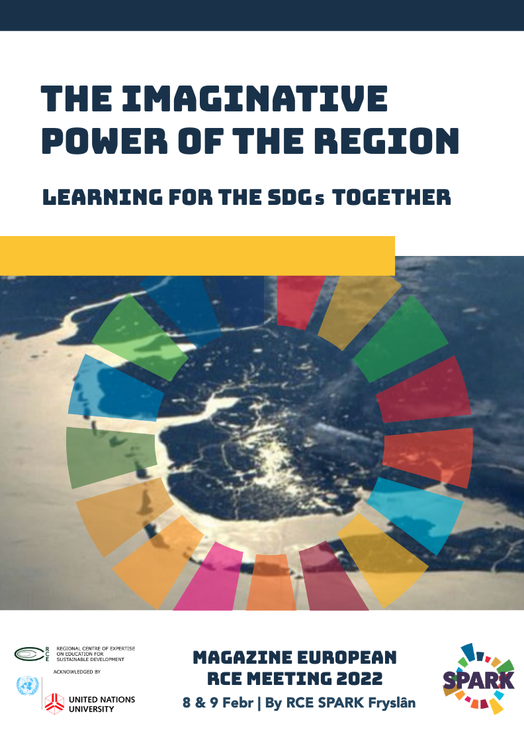
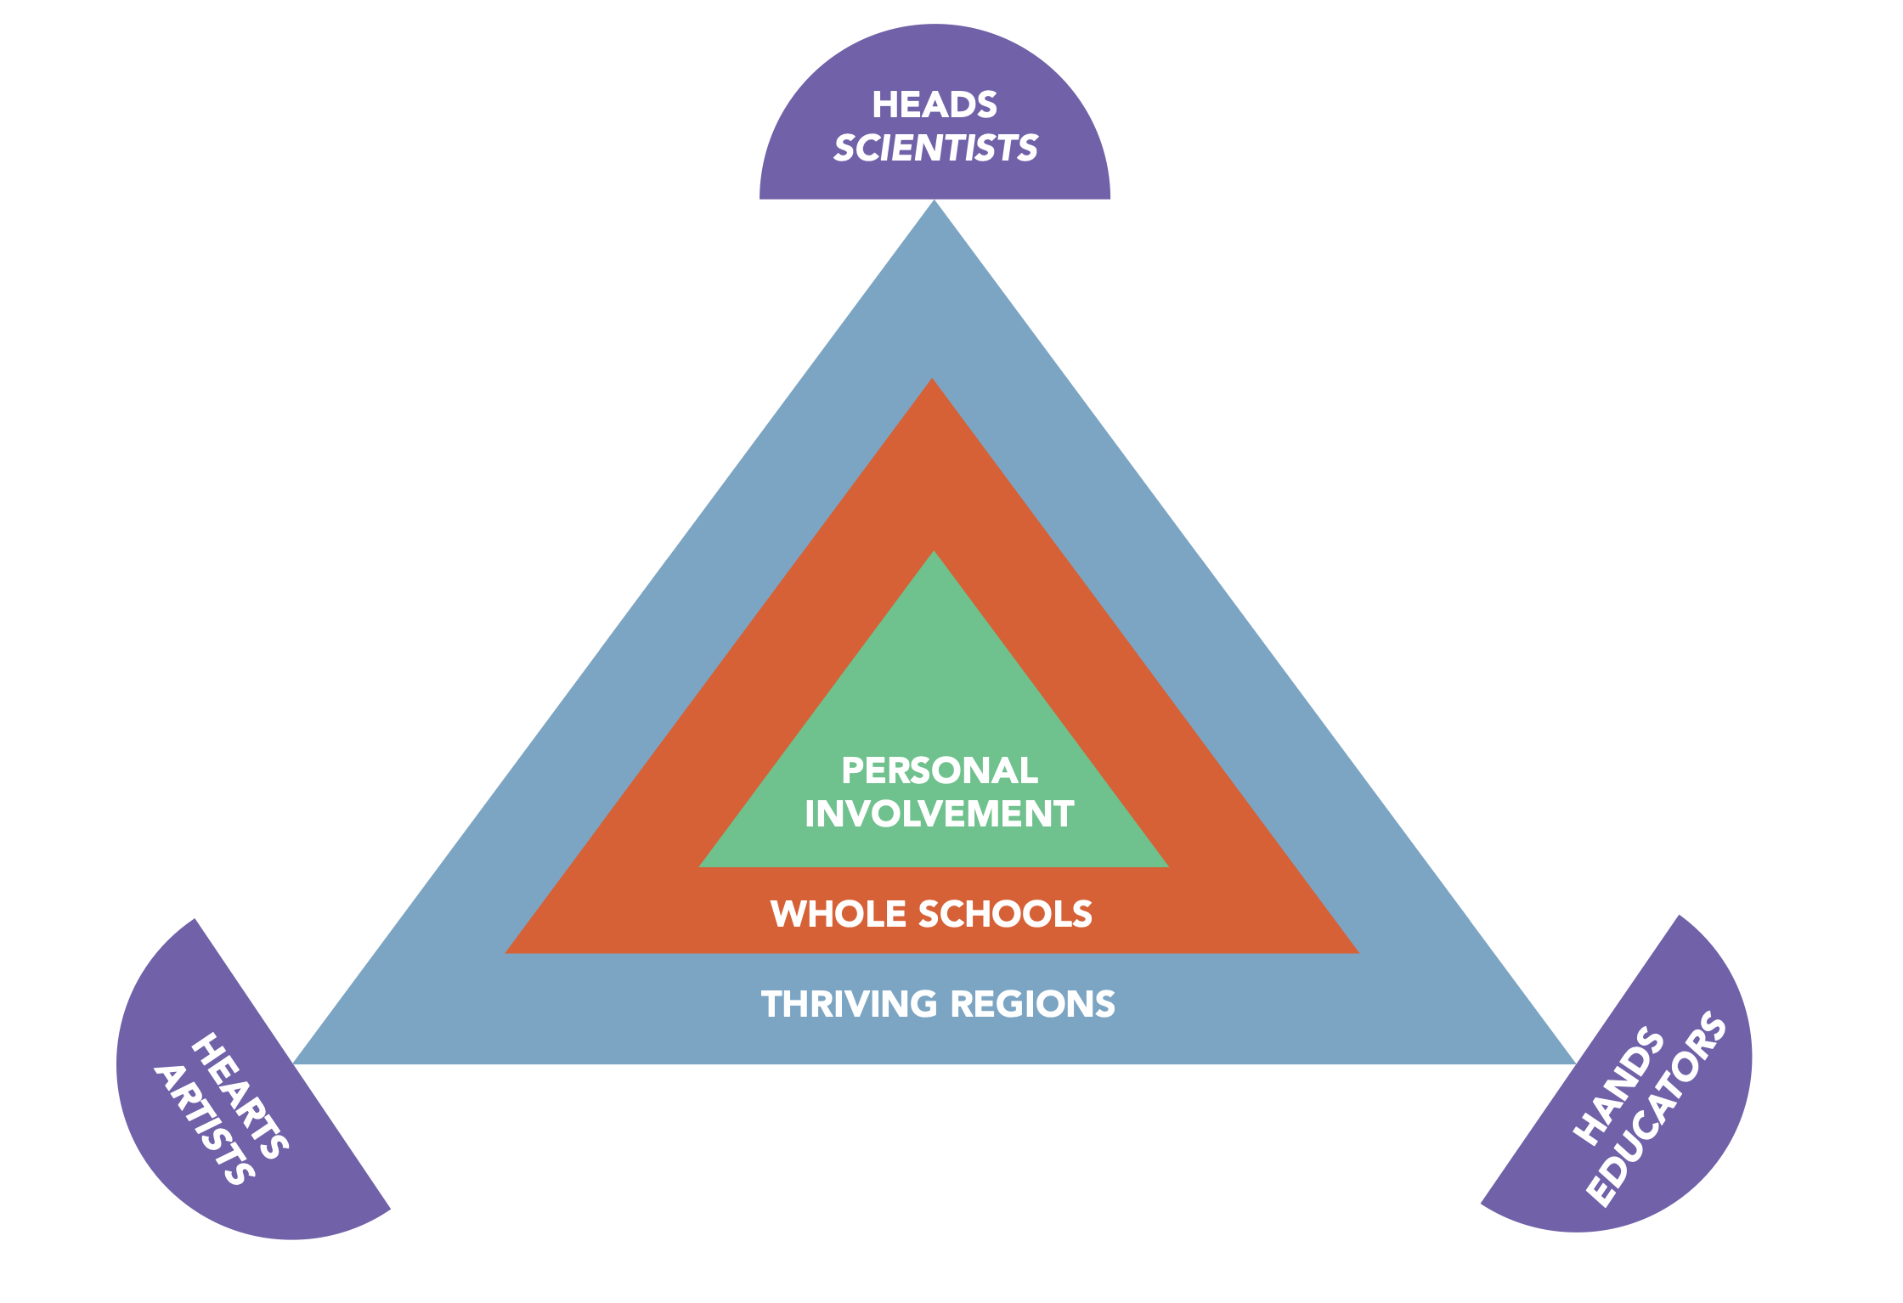
THE SYSTEM, THAT IS US!

Slide 19


WHAT HAS BEEN ACHIEVED?
> 400 SPARKS;
> 2500 FOLLOWERS ON SOCIAL MEDIA & NEWSLETTERS
> 100 COOPERATIVE PROJECTS, CHALLENGES, ASSIGNMENTS, ETC.
NIEDERSACHSEN 75 YEAR –> VOICE OF DUTCH & GERMAN HIGH SCHOOL STUDENTS ● MANIFESTO ON CLIMATE & INDUSTRY FOR KINGS’ COMMISSIONERS
EU PROJECT GLOBAL ROOTS -> COOPERATION WITH ONGOING SUSTAINABILITY LEARNING LINE WORTELS & VLEUGELS ● OOSTSTELLINGWERF
COP 26 -> FRISIAN STUDENTEN VISIT GLASCOW ON BIKE AND MODERATE THREE DIALOGUE SESSIONS WITH EUROPEAN COALITION ON CLIMATE EDUCATION (GREEN DEAL)
CULTURAL CAPITAL LEGACY -> ARCADIA
WWW.SPARKTHEMOVEMENT.NL

Slide 20

MORE EXAMPLES
EDUCATIONAL AGREEMENT FRIESLAND
AANSLUITINGSNETWERK VO-HO
CIRCULAR LEARNING PART OF STRATEGY CIRCULAIR FRIESLAND
NATIONAL INVOLVEMENT WHOLE SCHOOL APPROACH
CIRCULAR SKILLS
GREEN DEAL FLAGSHIP PROJECT EDUCATION
for CLIMATE COALITION
RCE SPARK FRYSLAN
  OFFICIALLY ACKNOWLEDGED BY THE UN
  WWW.SPARKTHEMOVEMENT.NL

Slide 21
WHAT IS THE NEXT STEP?
CONTINUE TO DEVELOP THE SYSTEMIC CHANGES NEEDED FOR THE SDGS BASED ON UNESCO’S 5 PRIORITY ACTION AREAS
> HOW TO MAKE GLOBAL IMPACT IN A REGIONAL CONTEXT
TRANSFORMING THE EUROPEAN EDUCATIONAL LANDSCAPE
> CONNECT MISSION-BASED LEARNING ON ALL EDUCATIONAL LEVELS, IN ALL EU REGIONS

Slide 22
WHAT IS THE NEXT STEP?
HOW THE STAKEHOLDER GROUPS IN YOUR REGION ARE ORGANISED?
HOW CAN THEY CONTRIBUTE TO CHANGE THE EDUCATIONAL SYSTEM?
  GOVERNMENTAL INSTITUTES; COMPANIES; NGOs; MUSEA; LIBRARIES ETC
  OTHER SCHOOLS
  IS YOUR RELATIONSHIP WITH THESE PARTNERS STRENGTHENING YOU IN YOUR AMBITIONS?
  ++ STRONG & POSITIVE
  + - NEUTRAL
  - - HINDERING & NEGATIVE

Slide 23
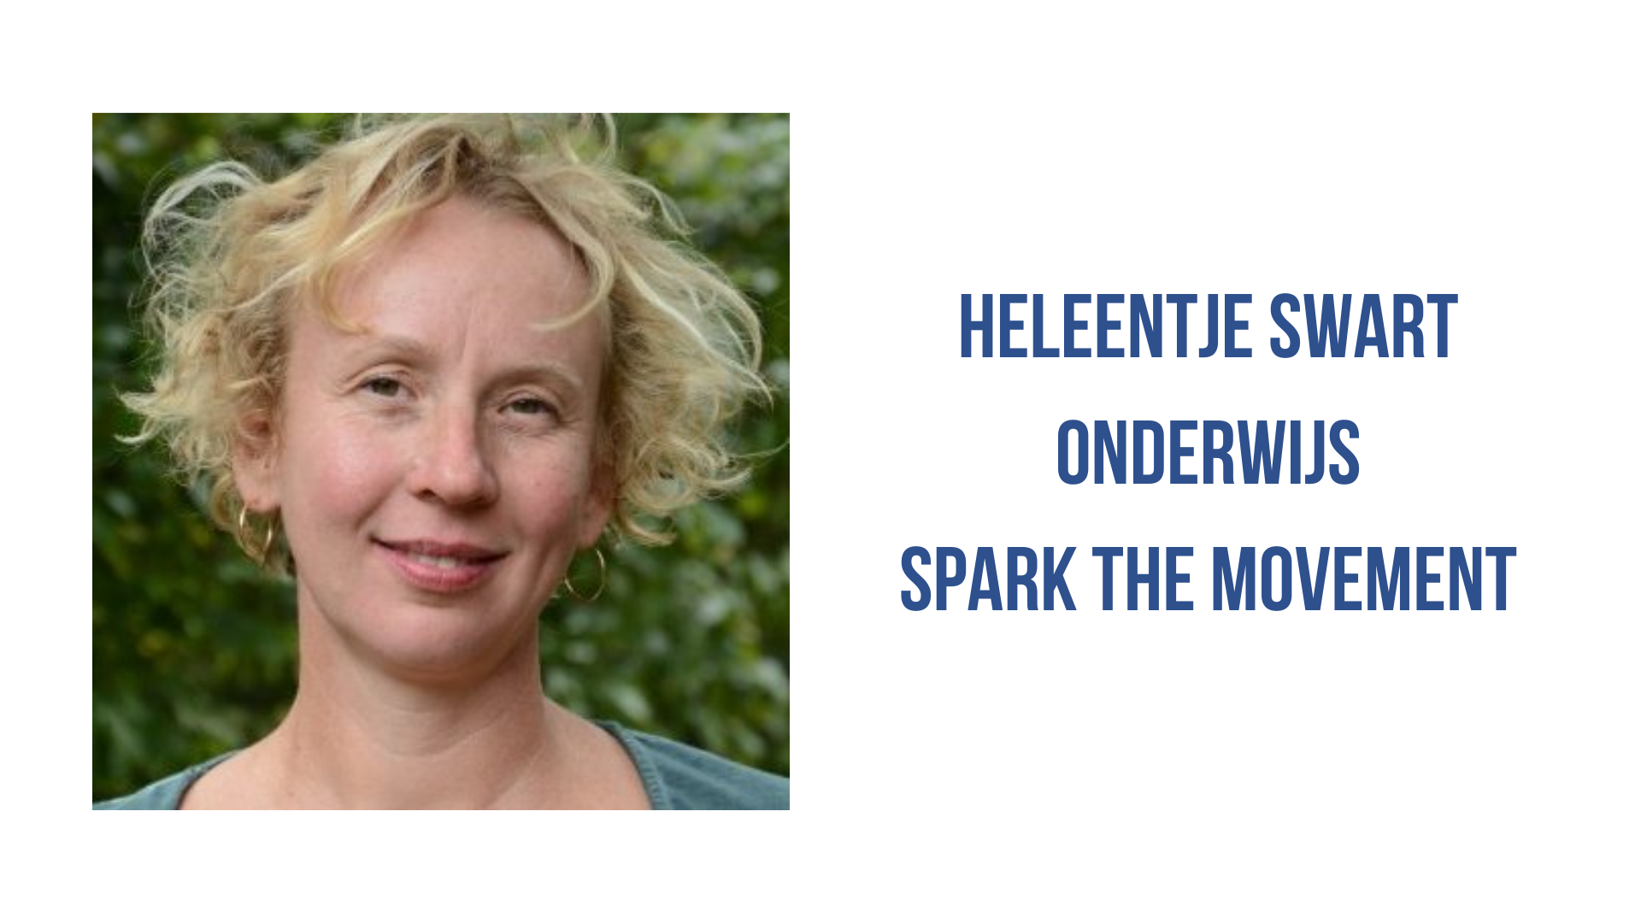
THANKS FOR LISTENING, THANKS FOR YOUR CONTRIBUTIONS!
info@sparkthemovement.nl
www.sparkthemovement.nl

