Slide 1
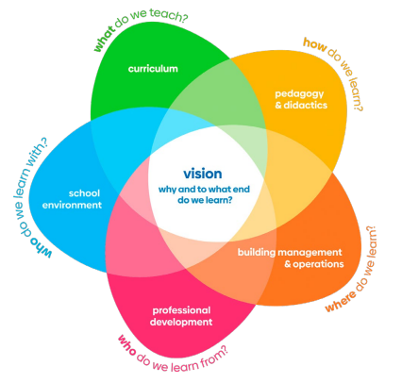


Garden song
C F C F C
Inch by inch, row by row, gonna make this garden grow
F C (b) Am D G All it takes is a rake and a hoe and a piece of fertile ground
C F C F C Inch by inch, row by row, please bless these seeds I sow
F C (b) Am D G C Someone warm them from below, 'til the rain comes tumbling down
Pulling weeds and picking stones, man is made of dreams and bones Feel the need to grow my own 'cause the time is close at hand Grain for grain, sun and rain, find my way in nature's chain Tune my body and my brain to the music of the land Plant your rows straight and long, temper than with prayer and song Mother Earth will make you strong if you give her love and care Old crow watching hungrily, from his perch in yonder tree In my garden I'm as free as that feathered thief up there Inch by inch, row by row, gonna make this garden grow All it takes is a rake and a hoe and a piece of fertile ground Inch by inch, row by row, someone bless these seeds I sow Someone warm them from below, 'til the rain comes tumbling down
(David Mallet 1975)
Notes:
Welkom, Gerben de Vries, Acting Manager of Duurzame PABO. 16 years in primary, 26 years in teacher training, over 20 years in ESD; officially retired, unofficially very busy. More info on LinkedIn.
Those who know me, also know I try to be musician; so we’ll start with a song. Following Alexander Leichts advise to appeal the social-emotional domain.
For Covid reasons, I might sing alone, just t get you the idea.

Slide 2
Notes:
This is where our short meeting is all about: the Whole School / Institution approach, in which we focus on TEACHERS: who do we learn from; and a little bit on pedagogy and didactics, in a special way.

Slide 3
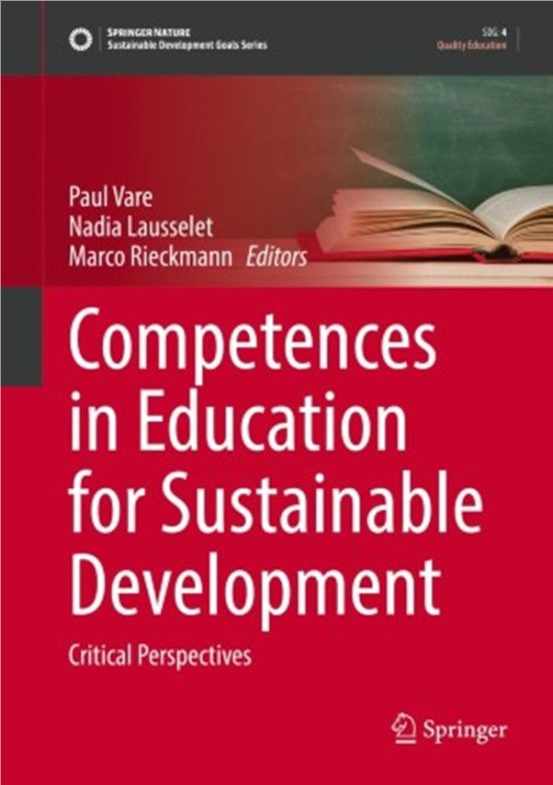
https://aroundersenseofpurpose.eu
Notes:
We do so, using the outcome of an Erasmus+ project in which Duurzame PABO participated for six years and that had it’s closure last year. The core outcome of the project is a competence profile of who is a competent esd teacher. Including indicators, qualification criteria etc. It is all on the website. What does a person need, be able to, ‘be’? And what does this person wants to achieve with his students, pupils? That comes close to a notion of citizenship…. For a quick overview you might want to check the website. For detailed info you might wanna buy the book; it costs about 150 euro’s hardcopy; I am not getting paid for your purchase. You might wanna find a library that has it….

Slide 4
Understanding wicked problems | Envisioning change | Achieving change
Integratation
Connection Knows that everything is connected with everything, so are you. | Imagining futures Discusses possible futures and what these mean for people. | Participate Actively participates with others in improving ‘living together’.
Involvement
Awareness Discusses improvements for the future and the importance of doing so. | Empathy Is empathic towards all learners and is able to share feelings. | Connected Feels connected with every child and encourages learners to be likewise.
Practice
Cooperate Is cooperating with people in order to improve the future. | Innovation Is looking for possible improvements in the learning proces, together with learners. | Action Focusses on critical thinking and works actively on improvements in society.
Reflection
Evaluate Is able, together with learners, to judge what is true and what is false, fake. | Responsability Feels personnally responsable for personal work and acts likewise. | Decisive Encourages to act decisively and in time, even in unsure situations.
Gerben de Vries – Learningfor22@gmail.com
Notes:
The model is based on, an abstract from, some other models: Unece, Wiek, Rdesfia+D, among others. We did use Unece in lectures; and they proved to be too many. What might make this RSP model rather unique, is the fact that it has been subject of research in a Delphi sequence, for several years. Here, PRACTICE SUPPORTS THEORY, like our collegue from Malta yesterday argued. We ended up with these twelve. The official twelve are to be found in the book; and on the website. Here we see a simplified version, which proved to be very useful in Teacher Training situations.
Now who does this profile apply to? Intentionally to teachers; and to their students; and more: considering informal education and it is about us, about me learning from you right at this moment; and vice versa. That connects to citizenship.
Now, what we are looking at, is a picture. A very photo shopped picture, a kind of an ideal picture of an ESD teacher, student, citizen. We do not go into a scientific discussion about methodology behind it. That is not why we made them. The are a starting point for thinking, not carved in iron and concrete.
We gonna play around a bit with this profile…
Printjes van het model uitdelen!
Inch by inch….
We continue where Sanne Tromp van SLO left you yesterday.
What is your strength? ‘THIS IS ME’….. Choose max 3…
Proof? Explain to your partner.
Partners report.
Changez…
What might be subject for improvement? (me: cooperating); just one (or more)…. (professionally; perhaps personnally)
Can you live with it or do you like to change? (does it bother you, does it bother others, do you get regular feedback on it?)
What might be a good plan for change on this?
And what part of the plan do you start with right now?
Explain to your partner….
Partners report

Slide 5
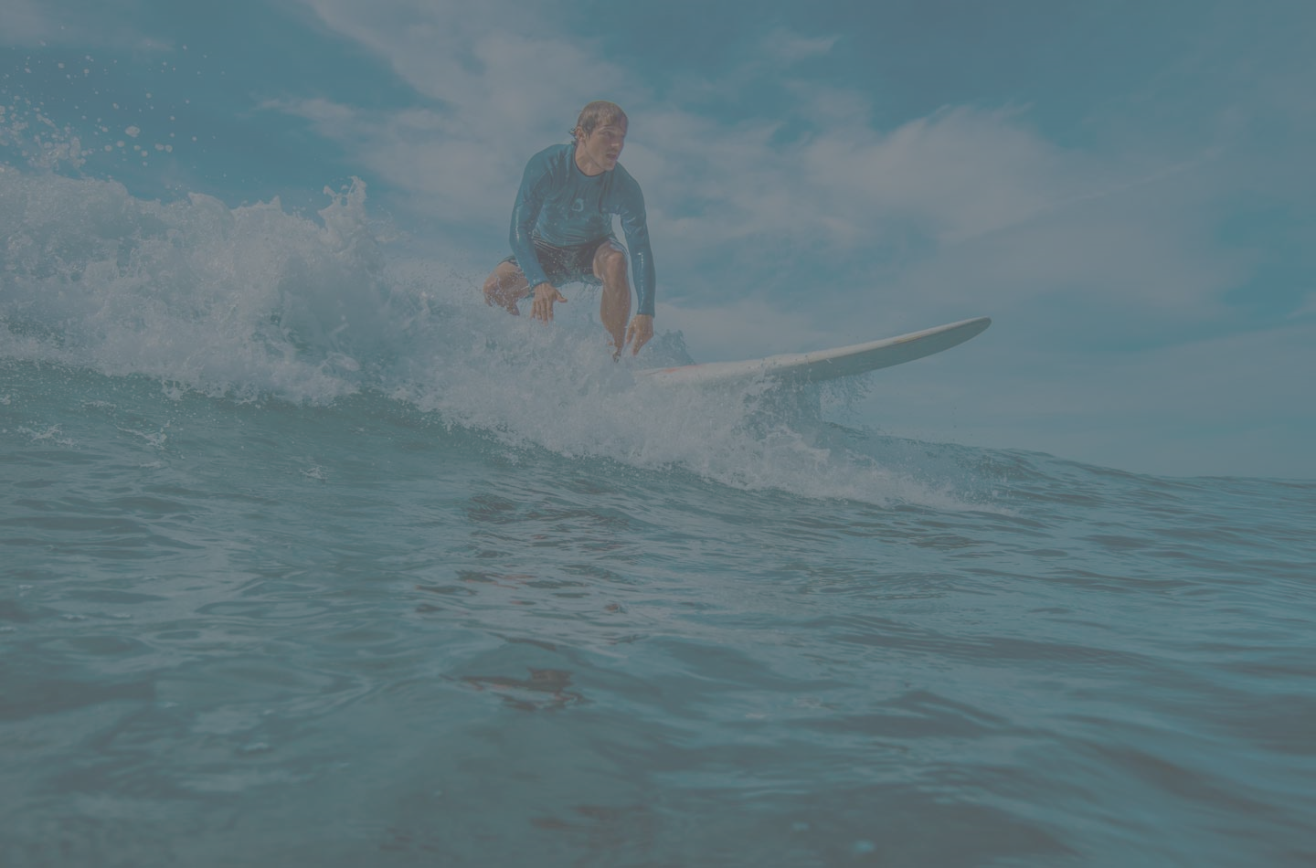
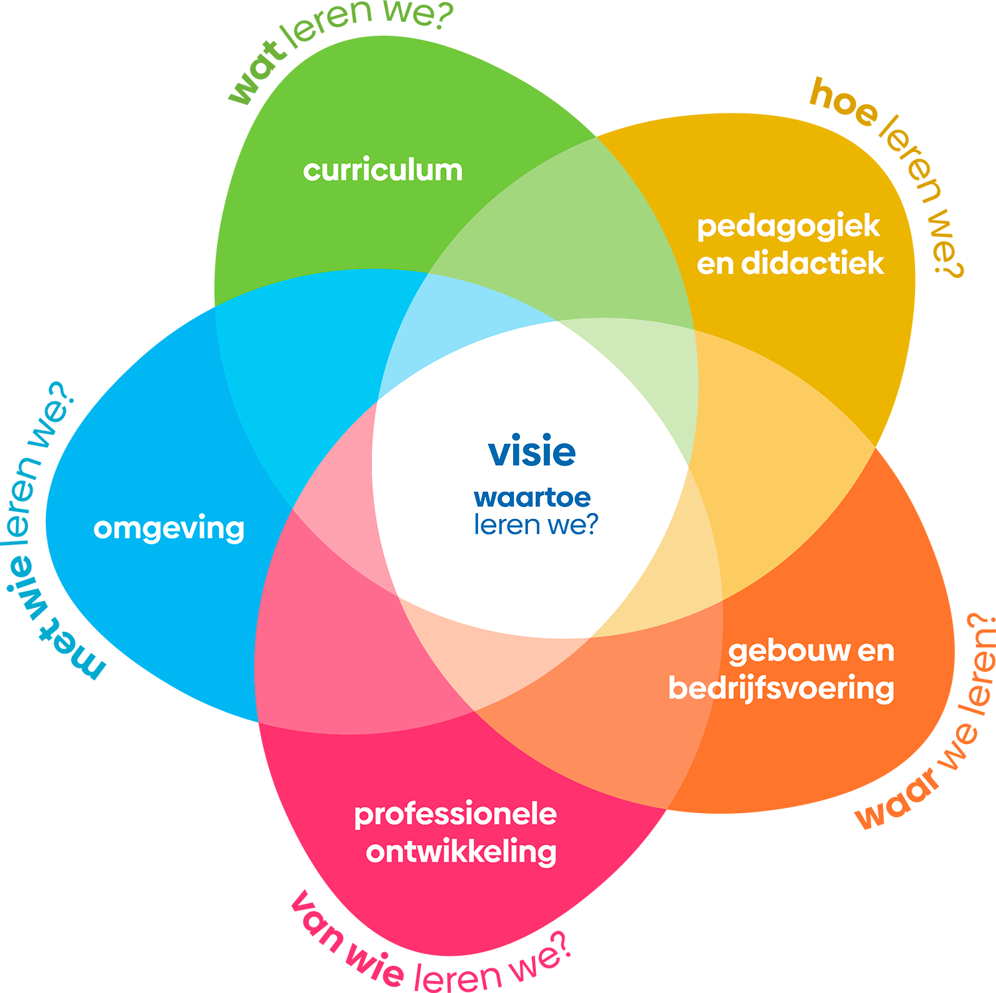

Some suggestions for approaches…
De Vries / De Hamer (2010)
Methodology of ESD
= Pedagogy of ‘to meet the other’ (Levinas 1969)
+ Pedagogy of ‘to choose’
+ HOTS+Bloom+21st century skills
+ Values, morality (Levinas 1969, Sacks 2020)
ESD is a process, a verb….
Education Learning for Sustainable Development (ESD LSD)
(Learning for Sustainable Development? LvDO…)
Wals (2012)
Learning methodology
participatory/collaborative learning, problem-based learning,
disciplinary learning,
multi-stakeholder learning,
critical thinking based learning, discovery learning,
transmissive learning.
Stella van der Wal-Maris (2020)
Future-focused education/Social Entrepreneurship
Why (explaining the past) / To what purpose (explaining the future)
‘Lev’ learning line (Levinas, lev..)
Perspectives and scenarios
Contribute…
10 teacher training colleges PrEd in The Netherlands
Notes:
In the RSP team, from time to time we discussed the question whether we were riding the wave or causing the wave; to what extent are we part of a movement that is much bigger than us…. Here we find some approaches for further pedagogy. We can compare these with the model….. Those who are interested in Stella’s approach: there is an excursion to Marnix in the program.
Can you give a personal example of you causing the wave? Or riding it?

Slide 6

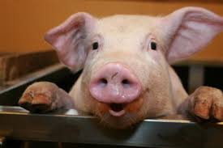
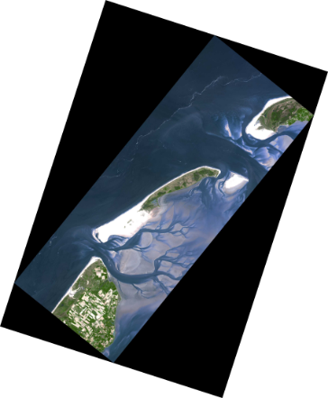
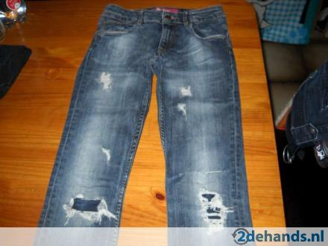
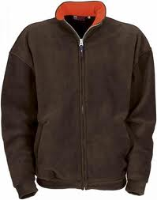


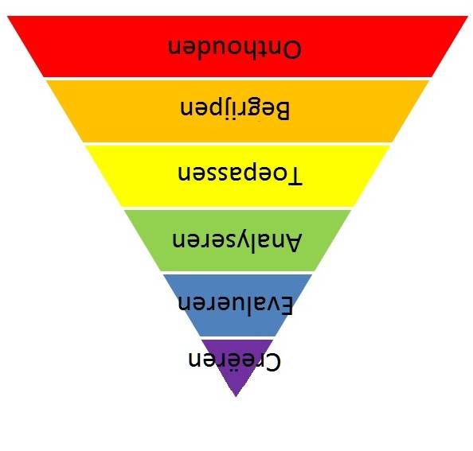
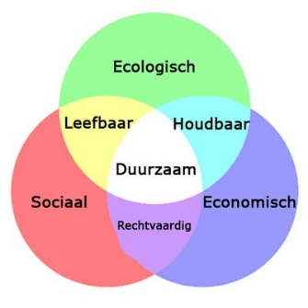
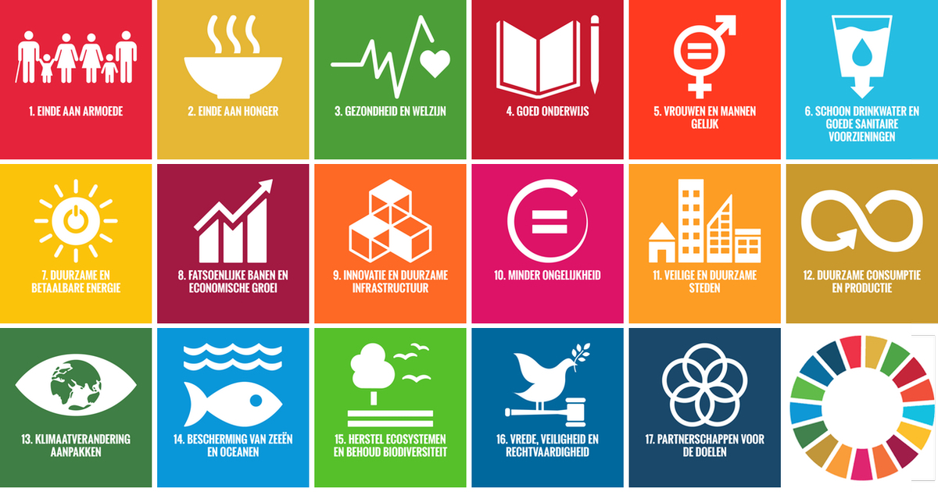
Gestaltungscompetenz (De Haan 2008), how to work on that?
1 raise attention (emo) and pre-knowledge (cogni)
2 use enquiry approach
3 use multiperspectivity (f.i. People-Planet-Prosperity)
4 combine perspectives;
5 use scenario thinking (if-then-which causes-results-alternatives- etc – 5 times tree);
6 choose, based on arguments (vision development);
7 evaluate/reflect, make it personal meaningful.
(De Vries / De Hamer, Praxis January 2010; interesting to compare this with the RSP framework 2021)
Bloom
Notes:
As an educator, working for years on a teacher training college, I know that students like chablones, pre-fab steps, to cover up their uncertainty.
Using the theories of HOTS, Bloom and some 21st century thinking skills, we came up with this, in 2010.
This kind of pedagogy was –in those days, at most schools- rather unusual. The textbooks most of the time covered the first three steps (here in black).
And the still are, Sanne yesterday explained. So, for Dutch TTI’s, here is a challenge….
The ‘higher order thinking skills’ were not challenged!
And –again- we might want to compare this way of working with the RSP table and see what competencies are worked on.
Take care, it is a chablone, a pre-fab step; that has the danger of becoming a dogma; it is A way, not THE way.
The bad news is that SLO –at least until last year- does not see these as educational aims, but as educational processes. Which is another brick in the wall.
Ok, as a closure….

Slide 7
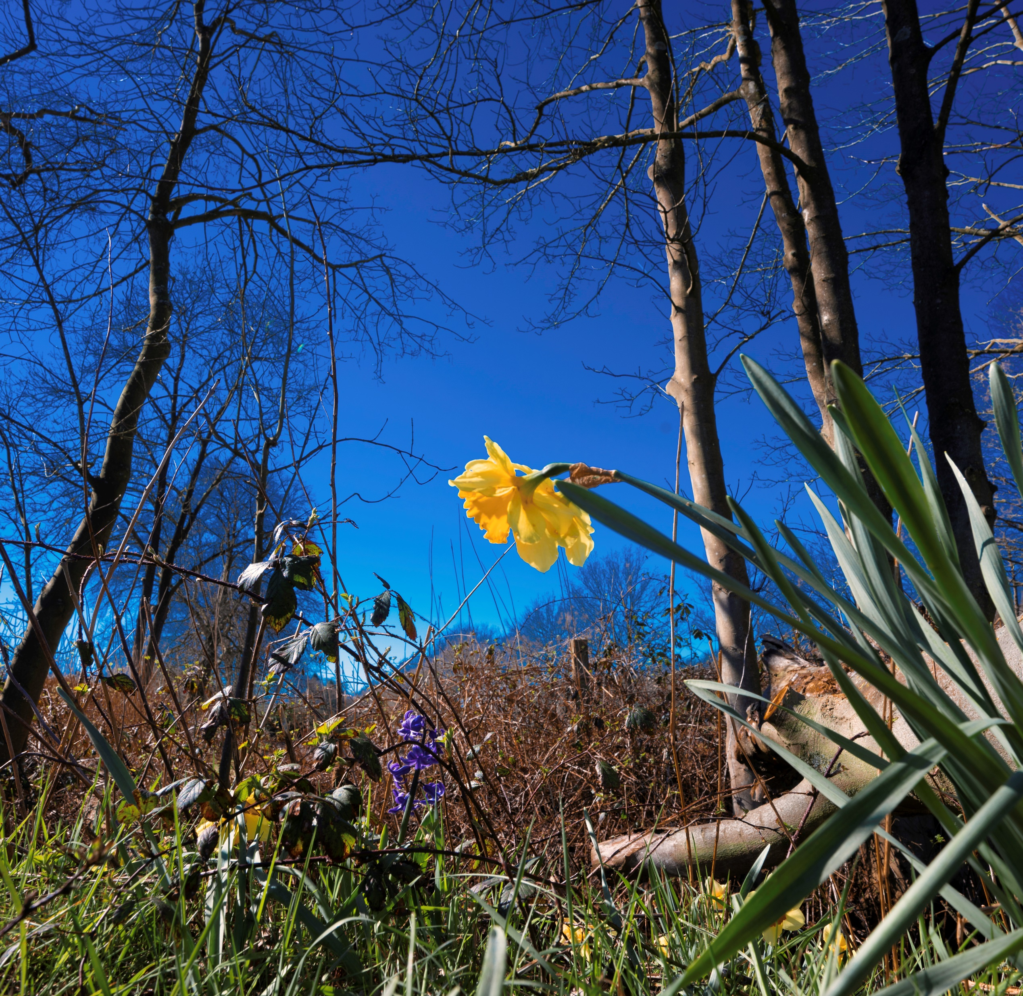
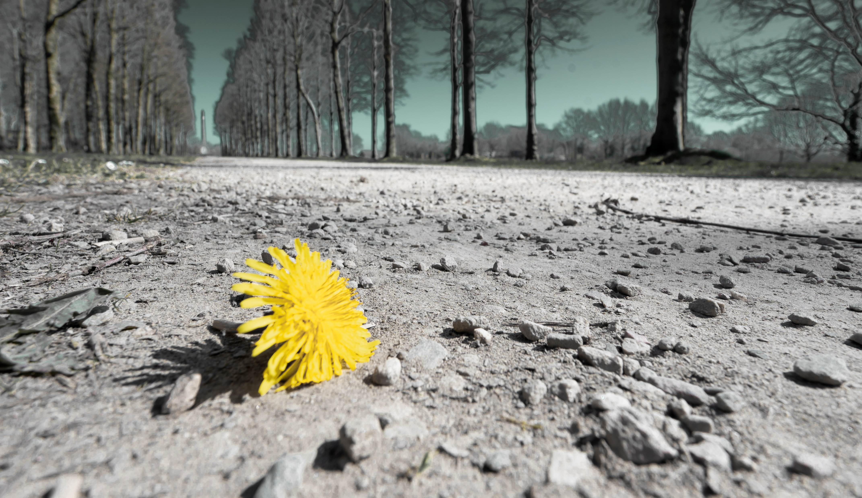
Notes:
I took this picture last Sunday, on a afternoon walk. It reminded me of a small story, told by a fantastic former colleague, Hans Smink. He worke in primary; a pupil came to him, very enthousiasticcally, Look, how beautiful this flower is that I have in my hand!
Yes, it is great and indeed beautiful! Can you please put it back now?
The boy looked up, surprised; and said: but that is impossible….
Waaw, in one minute Hans used almost all of the 12 competencies!
And a second picture, a picture of hope: the big tree was blown down by the big storm some weeks ago. And look how beautiful these flowers are….
….. Thank you for your attention…

Slide 8

Thank you for being with me today.
Please be with each other….
Gerben de Vries – Learningfor22@gmail.com
Notes:
….. Thank you for your attaention…

