Slide 1
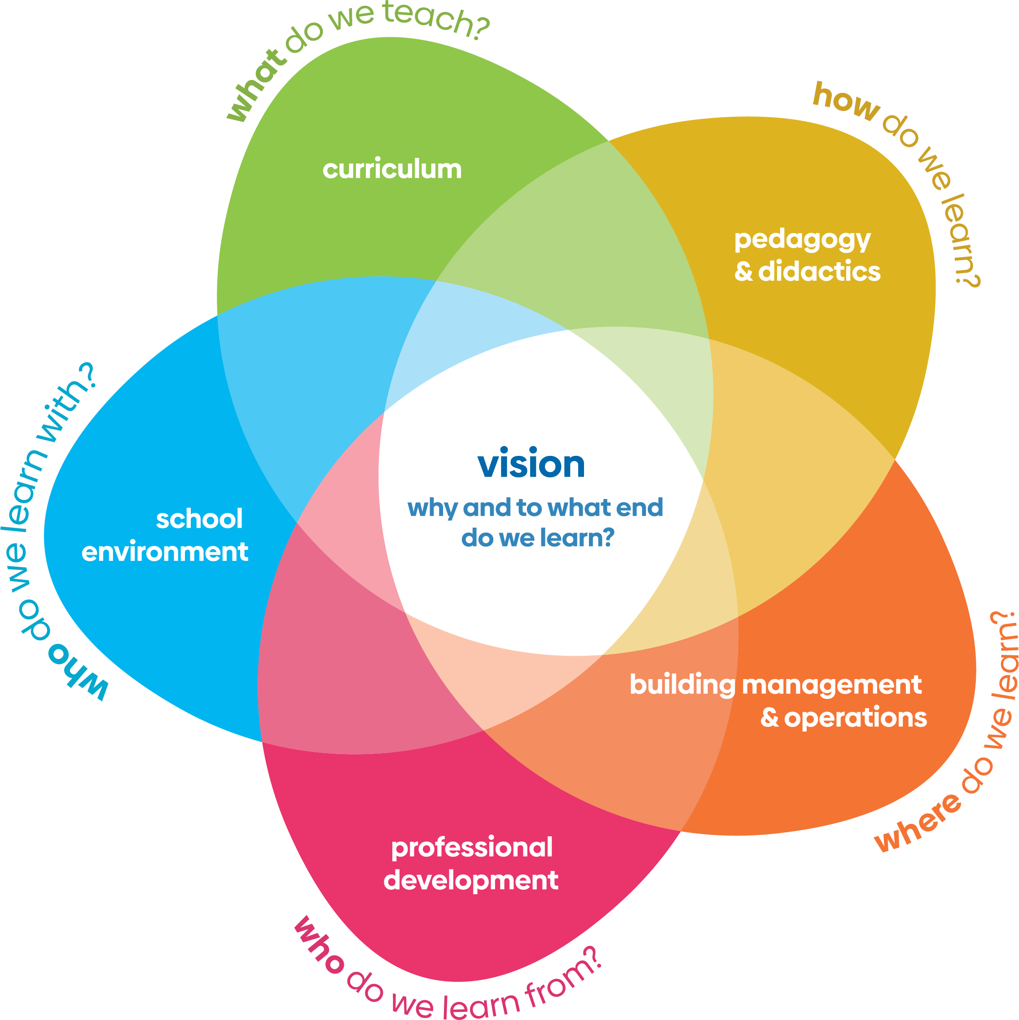
Reflections on the different aspects of the WSA/WIA ‘flower’
Dr Paul Vare
University of Gloucestershire, UK

Slide 2
Are these the ‘right petals’ – and does it matter?
Curriculum – Campus – Community (Forum for the Future)
Curriculum – Campus – Community – Culture
(Centre for Sustainable Futures)
Curriculum – Campus – Community – Culture – Communication
(Metanoia)
And remember – ‘C’s have a tendency to flow into each other.

Slide 3
Vision
Includes culture and communication
Crucially this asks ‘why’ and…
…‘what is education for?’
Shifting the purpose of education – in a non-authoritarian manner – is the hardest thing to achieve yet perhaps the most impactful change we can make to the system.

Slide 4
Vision
Includes culture and communication
Crucially this asks ‘why’ and…
…‘what is education for?’
Shifting the purpose of education – in a non-authoritarian manner – is the hardest thing to achieve yet perhaps the most impactful change we can make to the system.

Slide 5
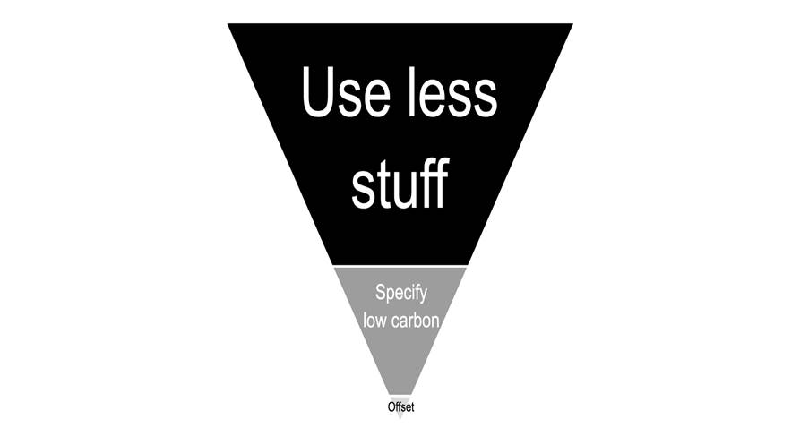
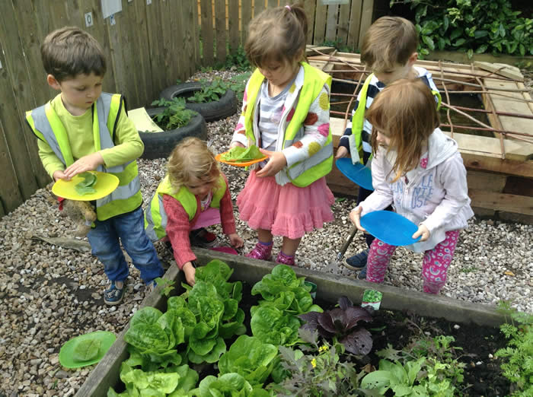
Building management & operations (Campus)
The poorer the state of your campus, the more learning opportunities you have…
…and if you’ve already got a great WSA flower, sow seeds!
(Talk to neighbouring institutions)
(Tim Ibell, University of Bath)

Slide 6
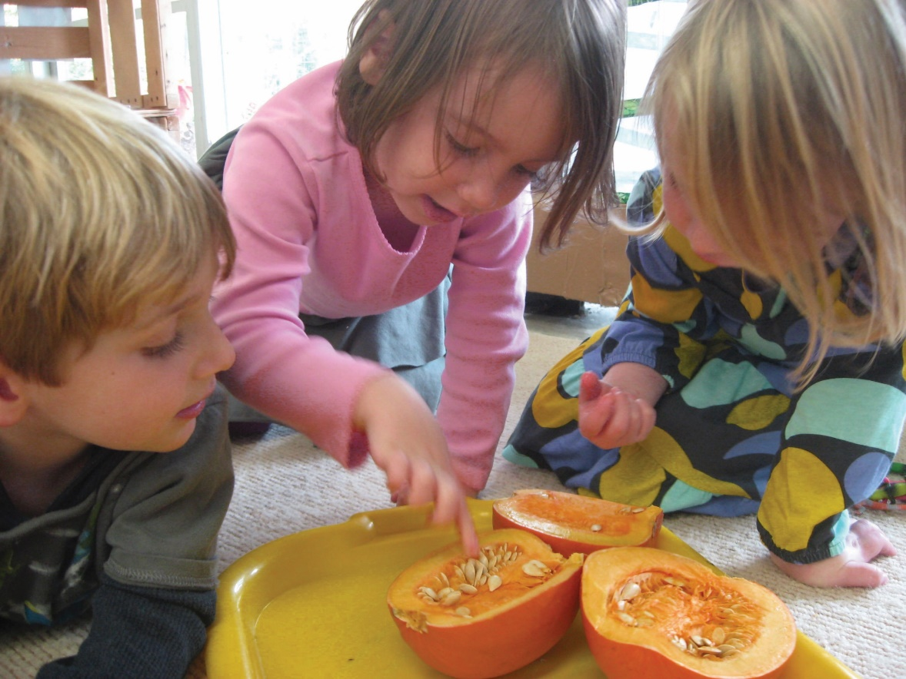
Pedagogy & didactics
(So much more than the curriculum)
Get out more
Inquire
– with others
– for change
Stare – “Don’t just do something; stand there”
(Martin Gabel - apparently)
Toolkits can be useful but beware of those that present learning as uninterrupted linear development.

Slide 7
Professional development
Thinking Holistically
Envisioning Change
Achieving Transformation
aroundersenseofpurpose.eu

Slide 8
Curriculum
Pick a theme – and pose three questions for investigation:
Why is it an issue?
What are the impacts (now and projected)?
What can ‘we’ do about it?

Slide 9
Sustainability-related issues have many facets…
Notes:
Paul

Slide 10
Art
History
Mathematics
Physics
Geography
Music
Languages
There will always be a need for discipline-based expertise but…
Notes:
Paul

Slide 11
…is it in our teachers’ job descriptions to facilitate
inter-disciplinary working?
Notes:
Paul

Slide 12
Inter-disciplinary working can still leave people out of the picture
Notes:
Paul

Slide 13
Trans-disciplinary boundary-crossing brings in more voices
This brings us to…
Notes:
Paul

Slide 14
School environment – the wider community
Teachers don’t have time for all this! Others would love to help – both within and beyond the school…
…and they respond best to a clear lead,
which takes us back to…

Slide 15
The question of vision – and purpose – is critical… …not just for an educational institution but for the ‘institution’ of education itself
Shifting the purpose of education is the hardest thing to achieve yet perhaps the most impactful change we can make to the system.

Slide 16
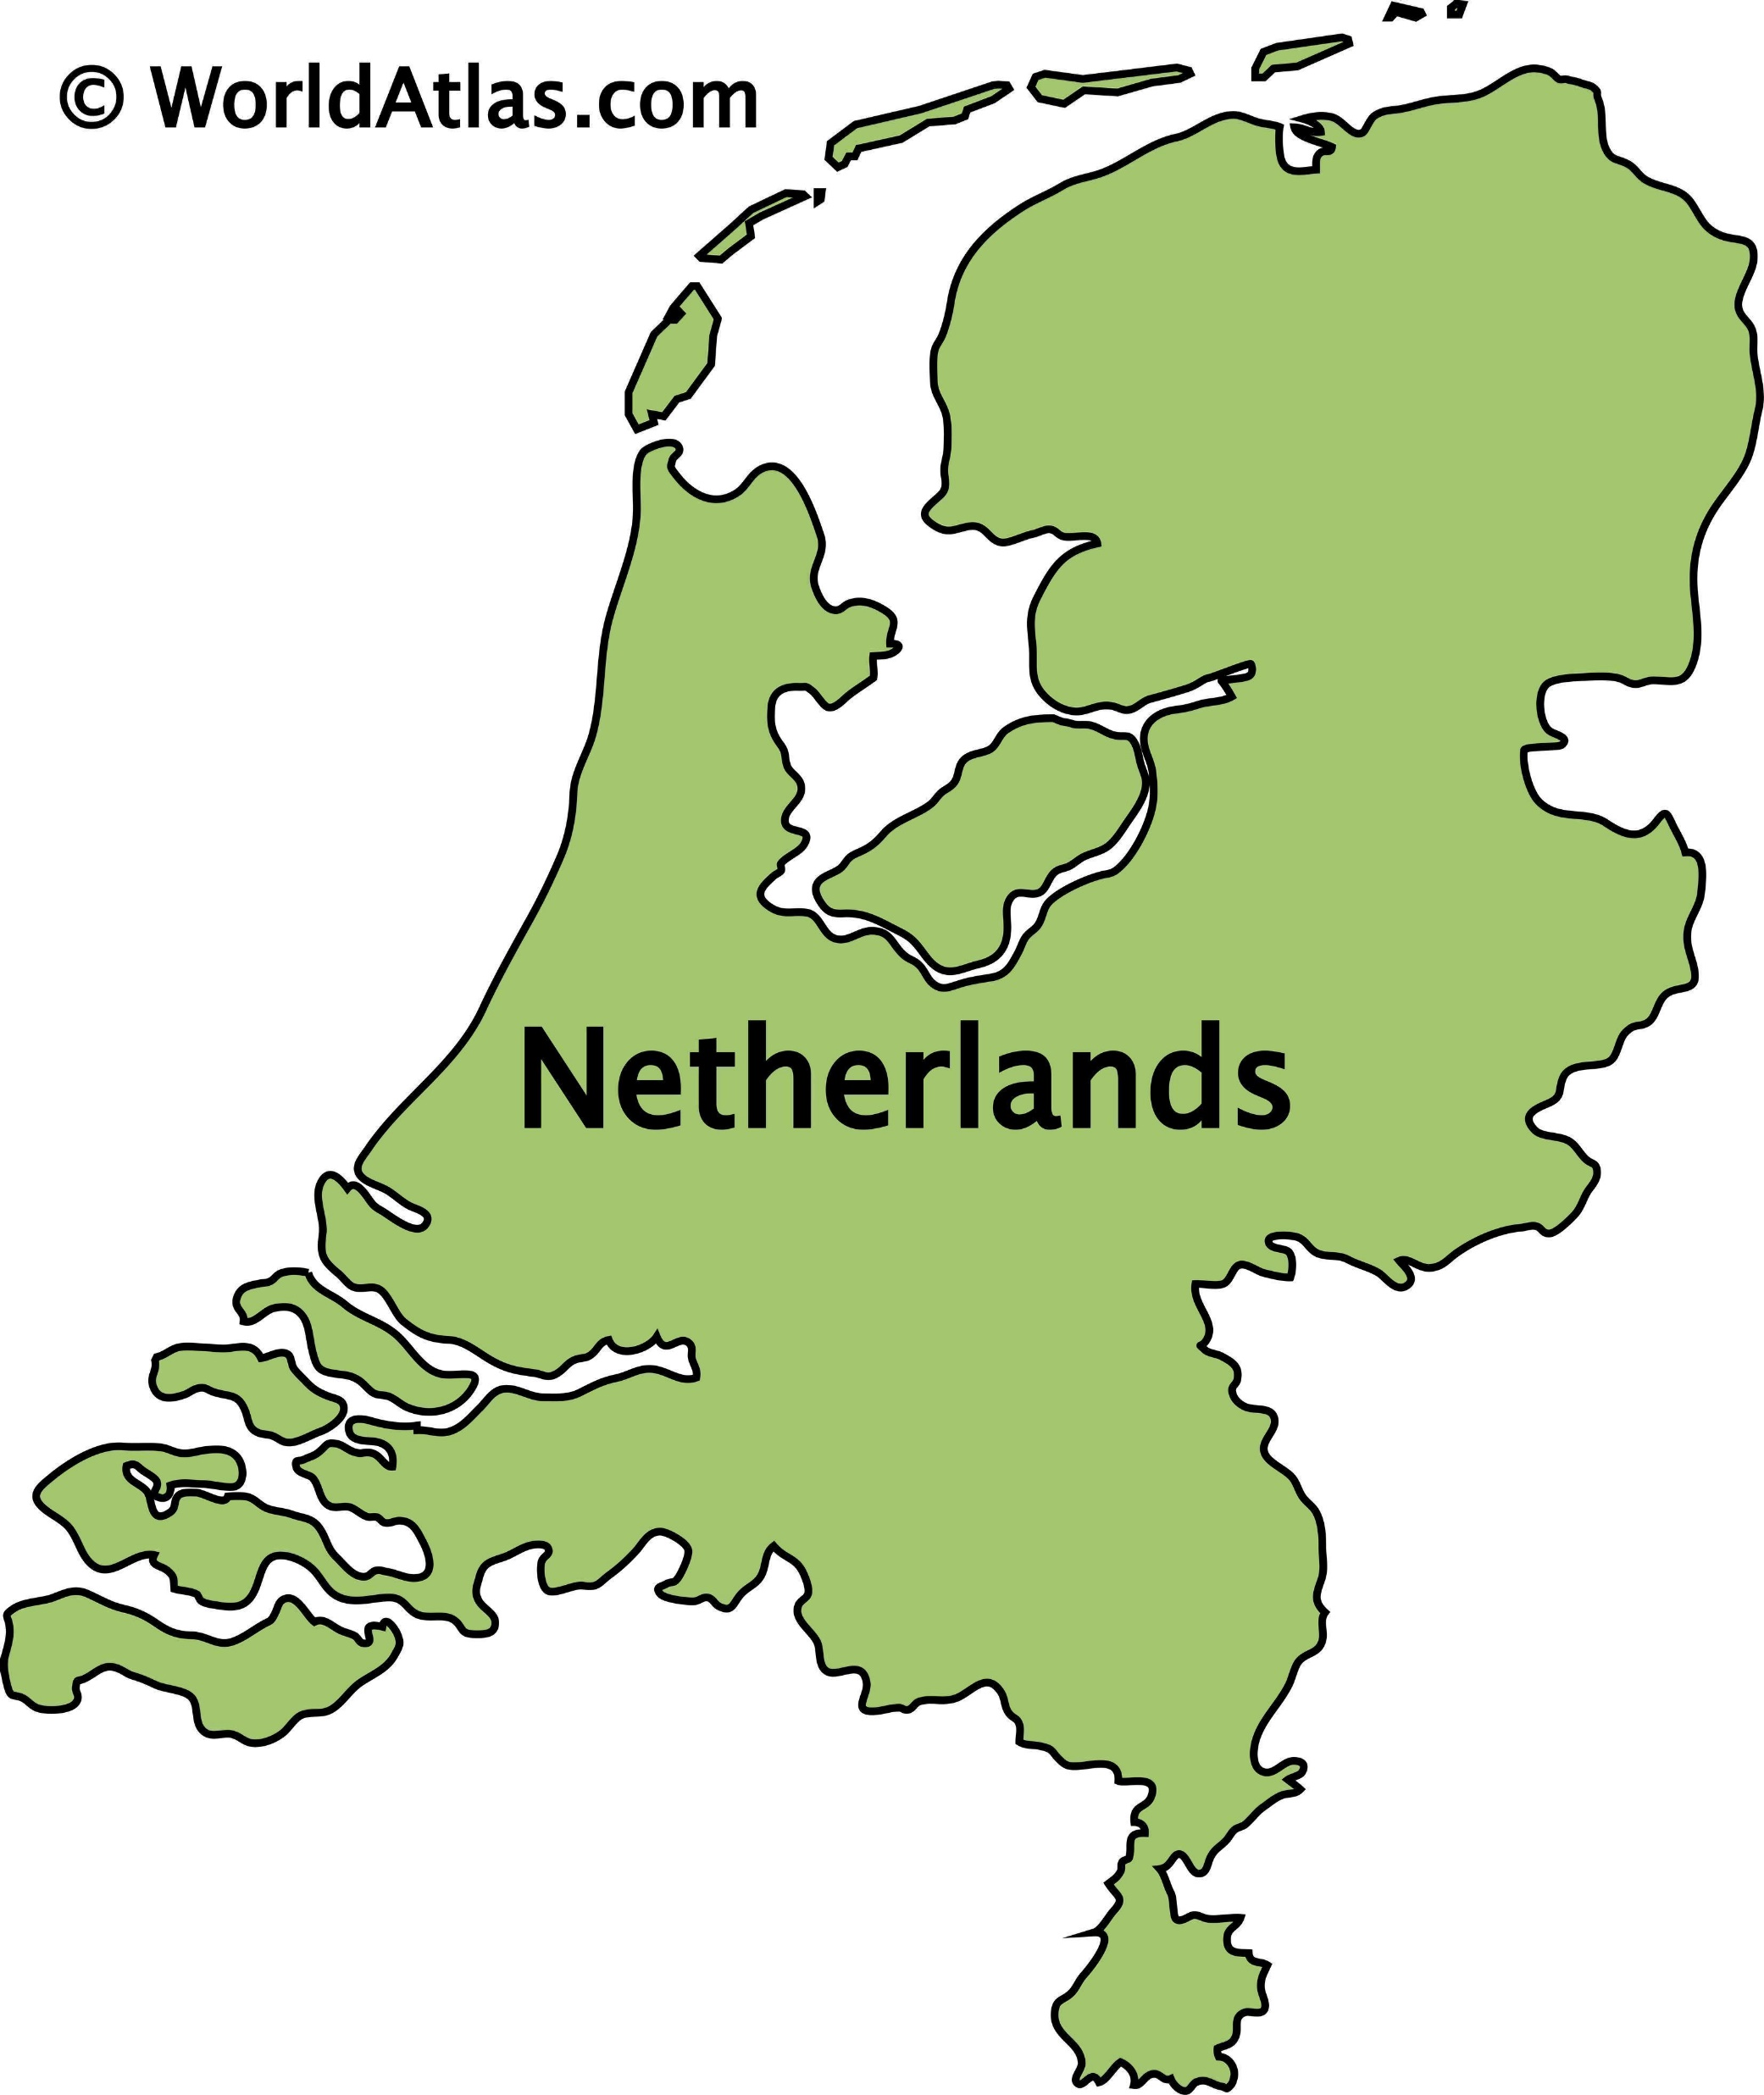

Slide 18
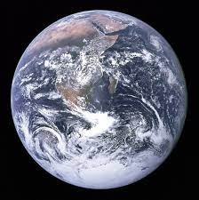

Slide 20
This could be contagious!

Slide 21
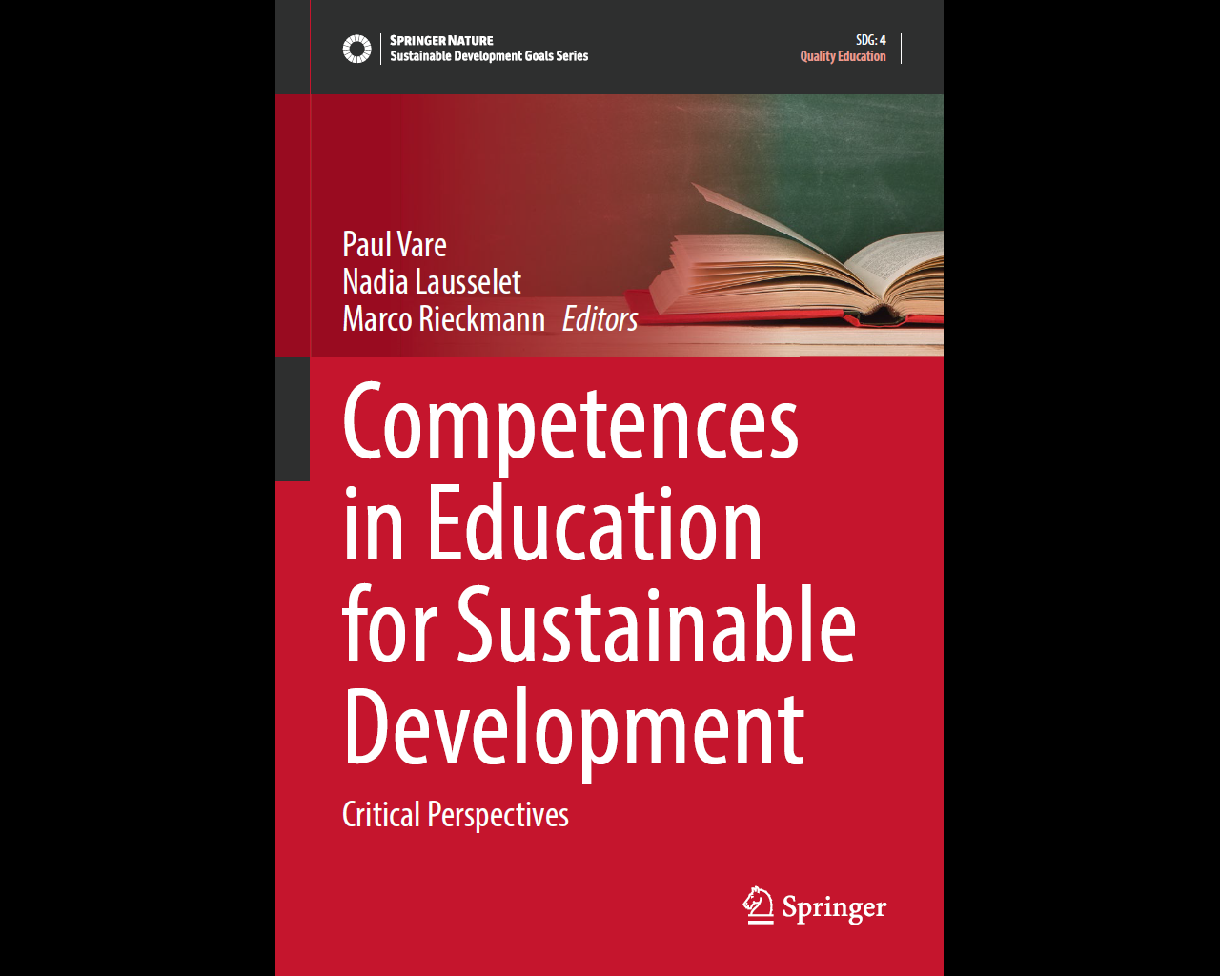
pvare@glos.ac.uk
Thank you!
pvare@glos.ac.uk

