Slide 1
EU
28-3-2022 SLIDES
2022

Slide 3
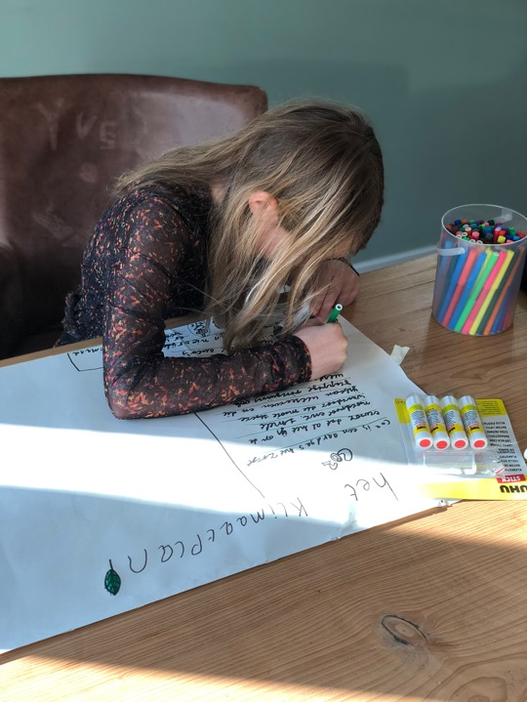
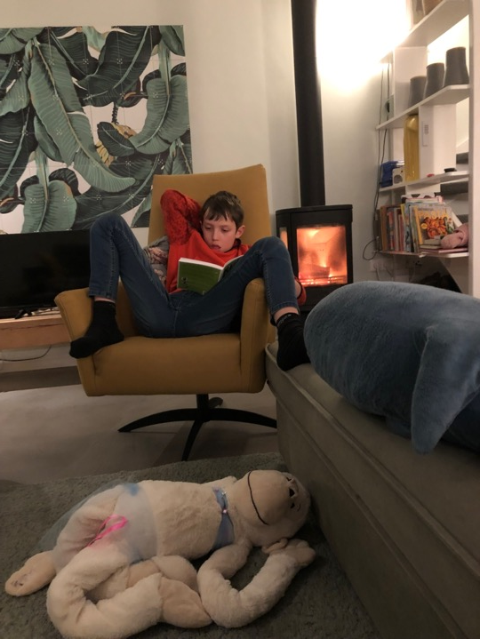

Slide 6
Currently 60+ academics in a co-creative community
Global presence : US - Asia – South America –
Canada – European Union and UK
Supported by prominent business schools worldwide
Potential reach of 1 billion students in business
and engineering curricula all over the world
Prelaunched in February 2021 without paid promotion
Positive reviews: ‘A succesful example like Interface is a must
for students to learn about. This is how transformation works
You cannot learn it in a book’ – Andre Nijhof, Nyenrode.
Other reviews of Academics in our (temporary) website:
http://beyondzerofilm.com/teach-this-story/

Slide 9
Clip 1 : https://vimeo.com/haveypro/beyondzerocop26

Slide 10
Clip 2 : https://vimeo.com/654989215/7412c37094

Slide 11
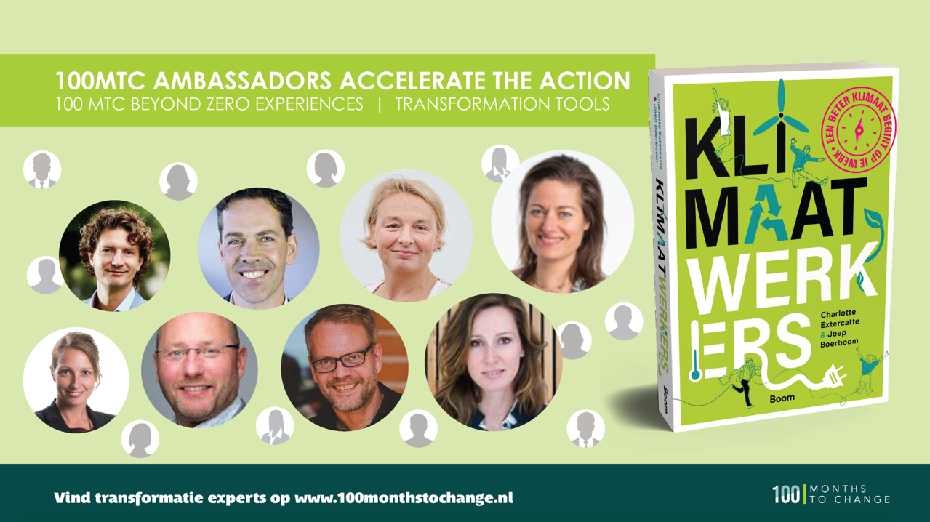

Slide 12
Lessen van Klimaatpioniers

Slide 14
Clip 2 : https://vimeo.com/531455572 (leiders)

Slide 15
Introduction | June 2021

Slide 17
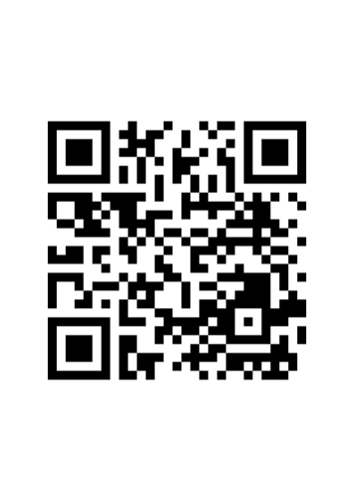
CALL FOR ACTION
Welk gevoel roept 100MTC en Beyond Zero bij je op?
Welke inspiratie haal jij uit deze film voor jouw onderwijsbijdrage | WholeSchool
Welke extra klimaatactie zou jij in jouw onderwijsrol concreet willen realiseren in 2022 ?

Slide 18
CALL FOR ACTION
Volg ons op LinkedIn
Voeg je bij de Educate Beyond Zero Groep
Film volledig kijken?
Stuur ons je mailadres op contact@100monthstochange.nl

