Slide 1
The Whole Institution Approach: best practice in Germany
Presentation from the youpaN: the Youth Panel for ESD
Martin Hagemeyer
Jeanine Marie Rühle

Slide 2
Overview
German ESD Action Plan and the ESD national implementation structure in Germany
Characteristics of the German WIA Approach
youpaN – the German Youth Panel
The German ESD Awards and the ESD Map

Slide 3
German ESD Action Plan and the ESD structure in Germany
National Platform on ESD has adopted the National Action Plan for GAP implementation
130 objectives and 349 measures
Coordinated by the German Federal Ministry of Education and Research
Aim: ESD in all areas and at all levels → WIA
participatory multi-stakeholder process

Slide 4
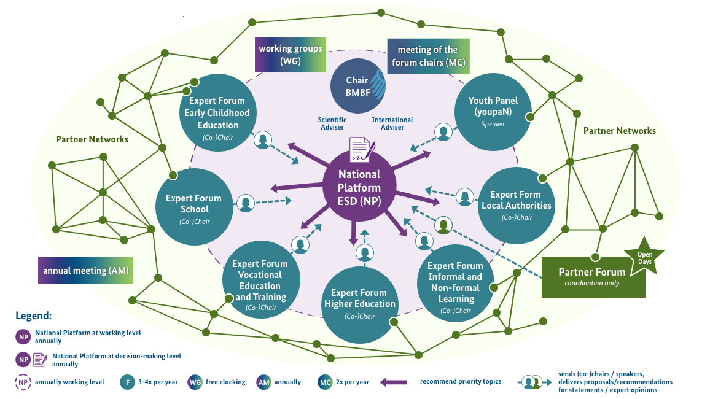
German ESD Action Plan and the ESD structure in Germany
Six Expert Forums and a Youth Panel consult the National Platform in developing and implementing a National Plan of Action:
Early Childhood Education
School
Vocational Education and Training
Higher Education
Informal and Non-Formal Learning
Local Authorities

Slide 5
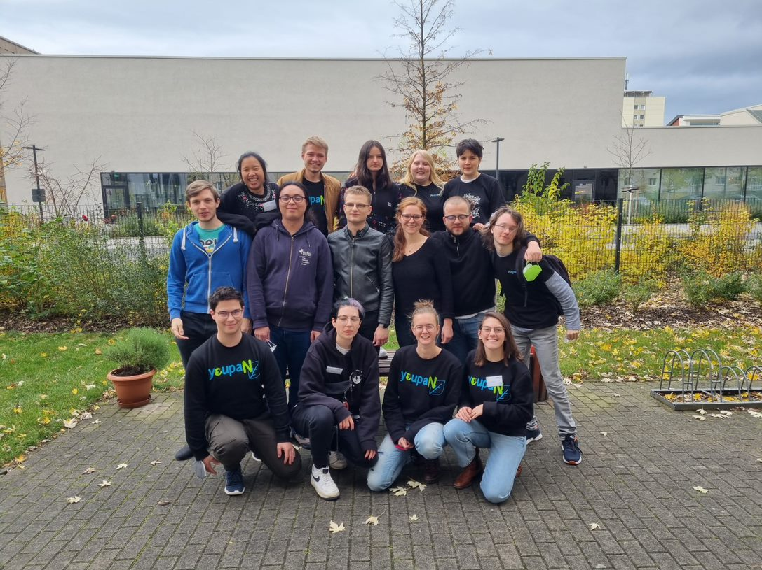
Characteristics of the German WIA Approach
youpaN is a Youth Panel made up of 30 young people aged 16 to 27 who participate in the implementation of the German National Action Plan on ESD

Slide 6
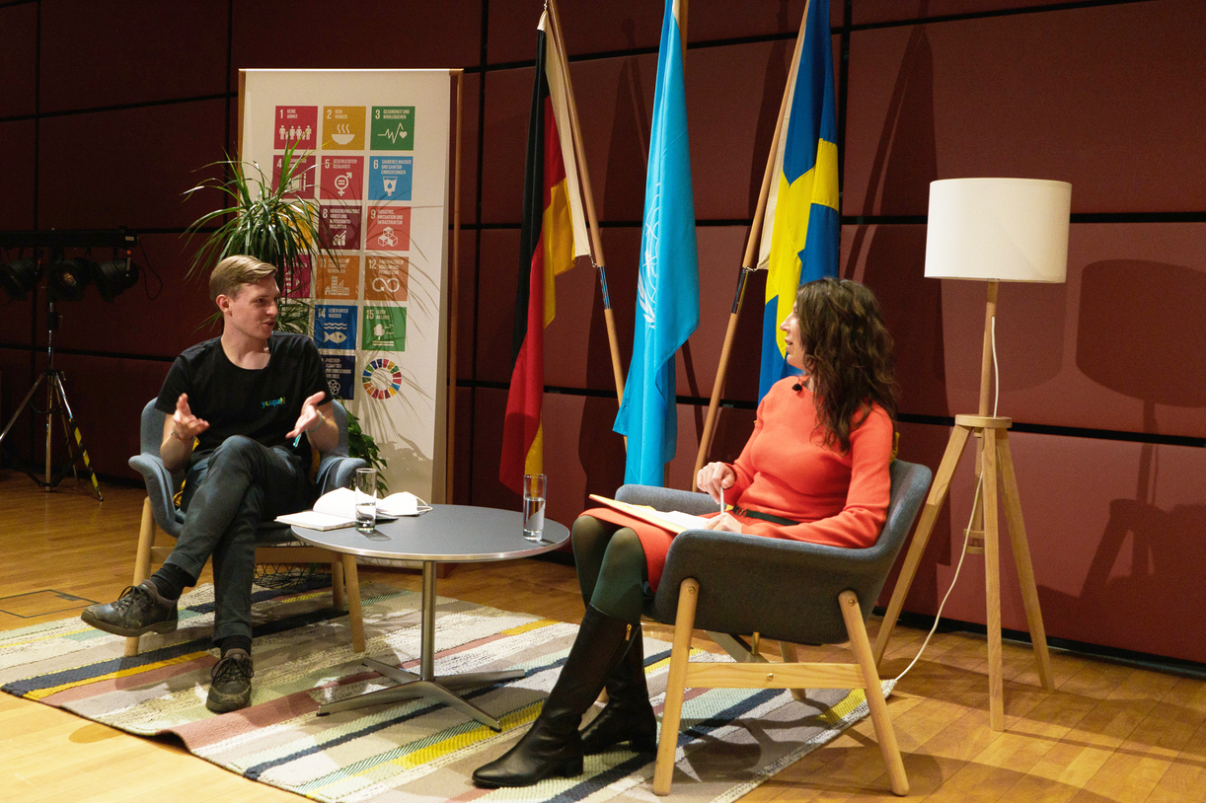
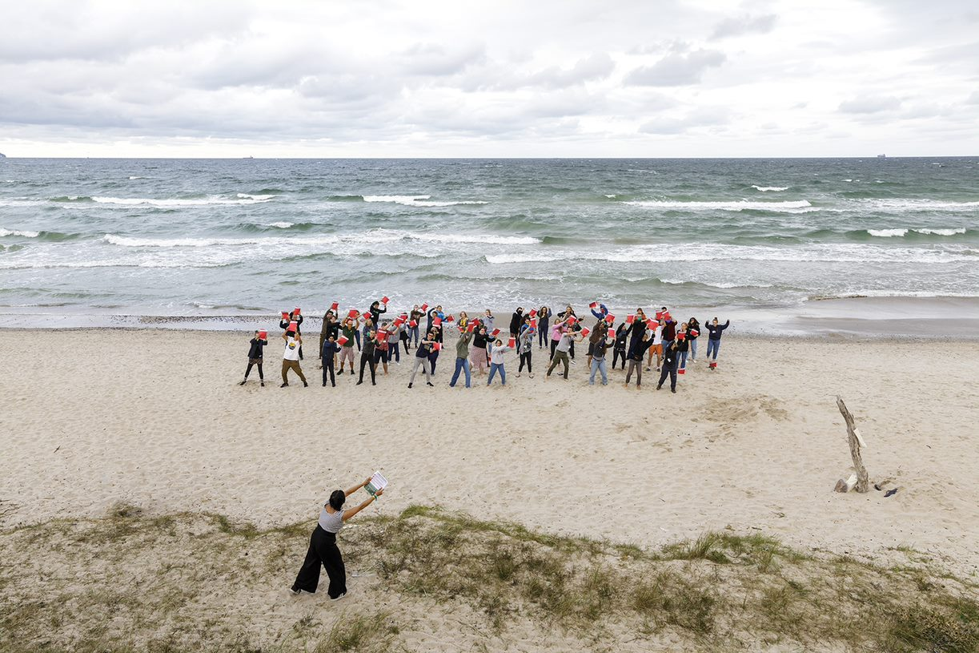
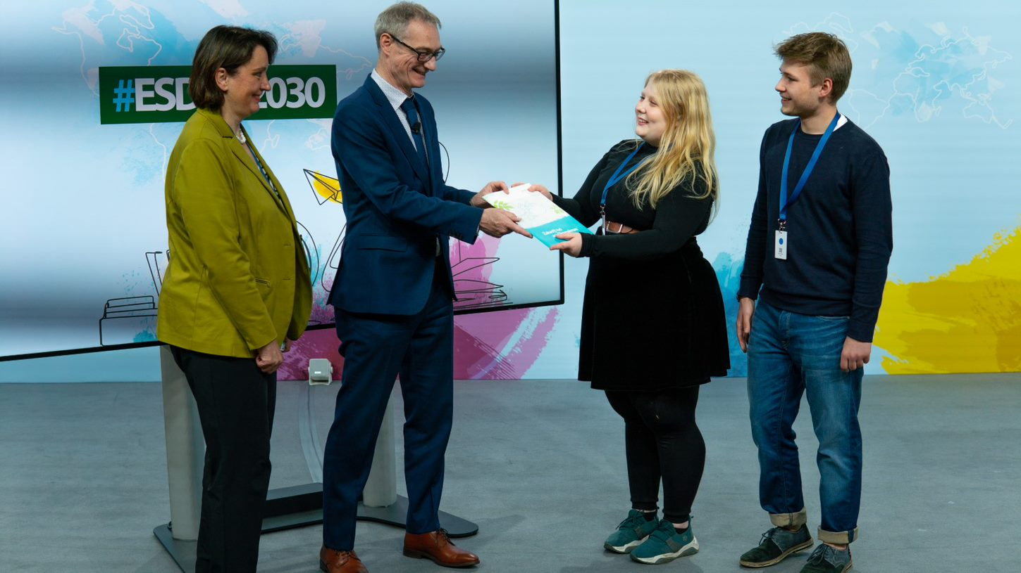
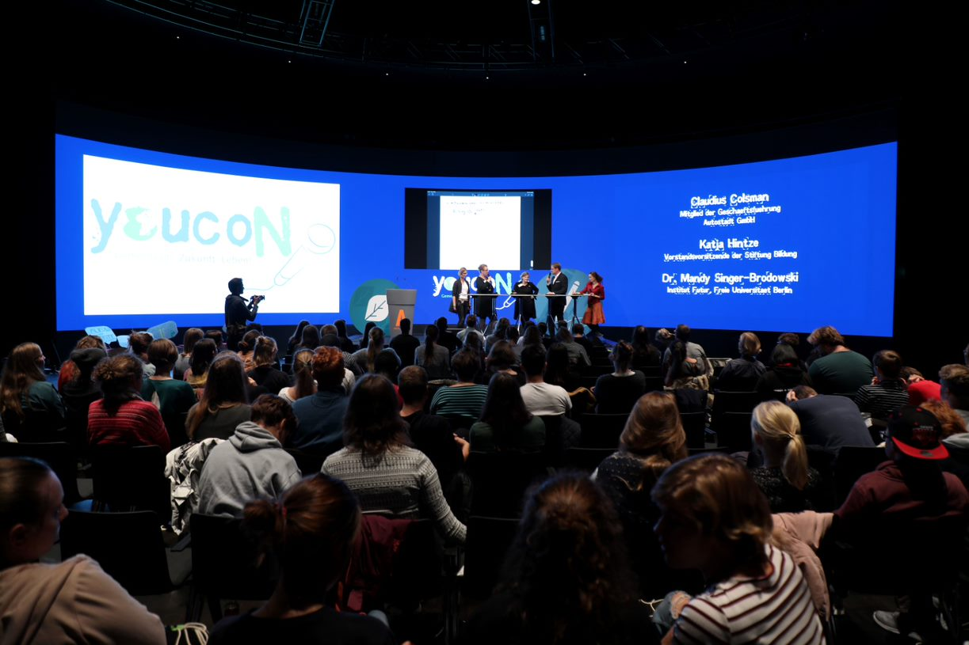
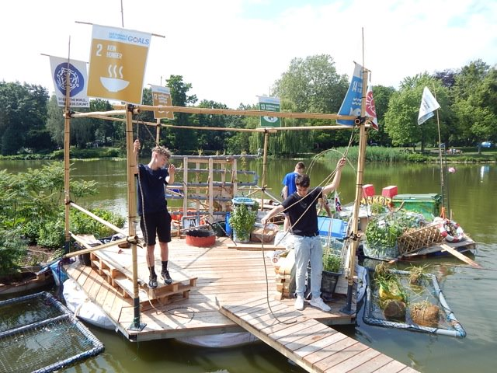
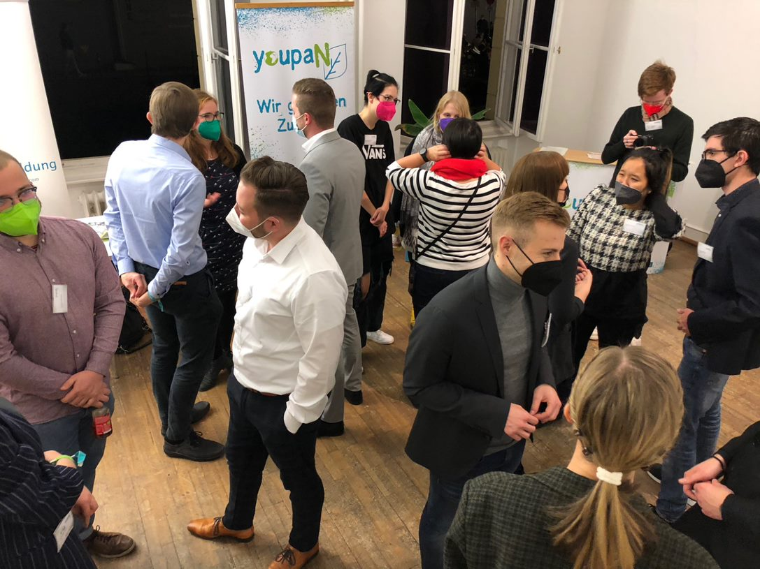
youpaN – the German Youth Panel
Event of the Swedish Embassy at the UNESCO World Conference on ESD 2021
youcoN 2021 in Prora
UNESCO World Conference on ESD 2021
youcoN 2019 in Wolfsburg
youprOs – ESD Micro Projects
parliamentary evening

Slide 7
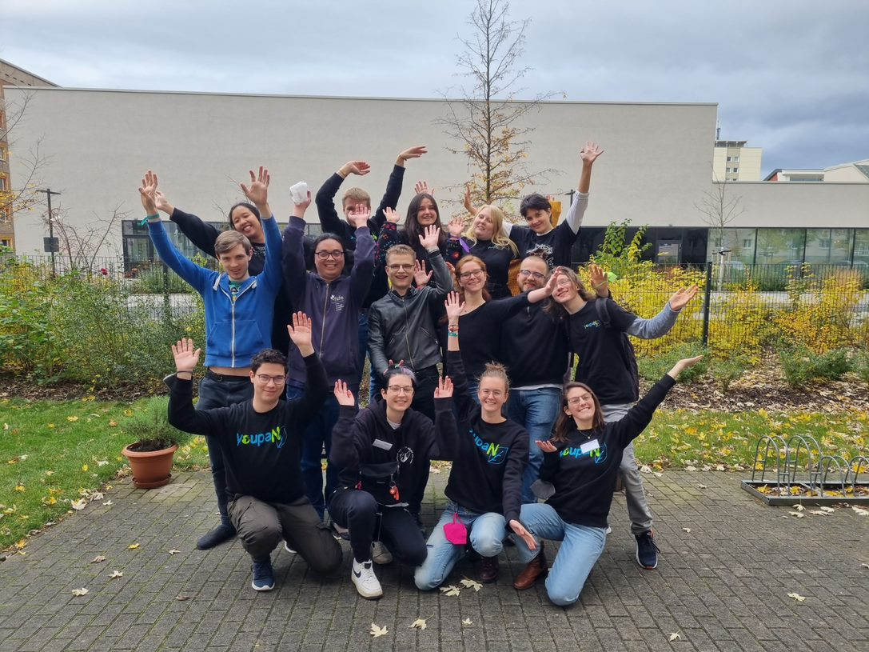
youpaN – the German Youth Panel
Our demands:
Improve youth participation
youpaN until at least 2030
ESD as a leading principle
Further ESD training for decisionmakers and stakeholders from the education sector
SDGs as educational opportunities
Research for sustainability
Reducing discrimination in educational institutes
10 % of GDP for education

Slide 8
Characteristics of the German WIA Approach
The German ESD Awards and the ESD Map: Examples of good ESD practice in Germany
awarded by German Federal Ministry of Education and Research and German Commission for UNESCO
Aims:
to offer outstanding ESD stakeholders and initiatives a platform and more visibility in order to broadly transfer ESD to learners of all generations and local levels

Slide 9
The German ESD Awards and the ESD Map
Source: „Solid structures: Award-winning ESD up to close“ by the German Commission for UNESCO
Notes:
6:42 (3 Minutes)

Slide 10
The German ESD Awards and the ESD Map
Source: „Solid structures: Award-winning ESD up to close“ by the German Commission for UNESCO
Notes:
6:42 (3 Minutes)

Slide 11
Conclusion
ESD implementation is a long-lasting process, especially in the education of prospective teachers
Often depends on the engagement of individuals
Different progress in the different federal states
WIA very strong instrument for a structural implementation of ESD and strongly institutionally located
Non-decision-making structures are not always confronted with ESD
Enormous progress
→especially regarding youth participation and ESD awards

Slide 12
Contact us:
Team fuer Jugendbeteiligung | Stiftung Bildung
Palais am Festungsgraben
Am Festungsgraben 1
10117 Berlin, GERMANY
jugendbeteiligung@stiftungbildung.org
Martin Hagemeyer: martin.hagemeyer@youpan.de
Jeanine Marie Rühle: jeanine.ruehle@youpan.de
www.youpan.de
www.bne-portal.de/bne/en
www.unesco.de/en

