Slide 1
Learning for Sustainability
A Whole School Approach
Daniel Barrie
Education and Learning Manager
Nation

Slide 2
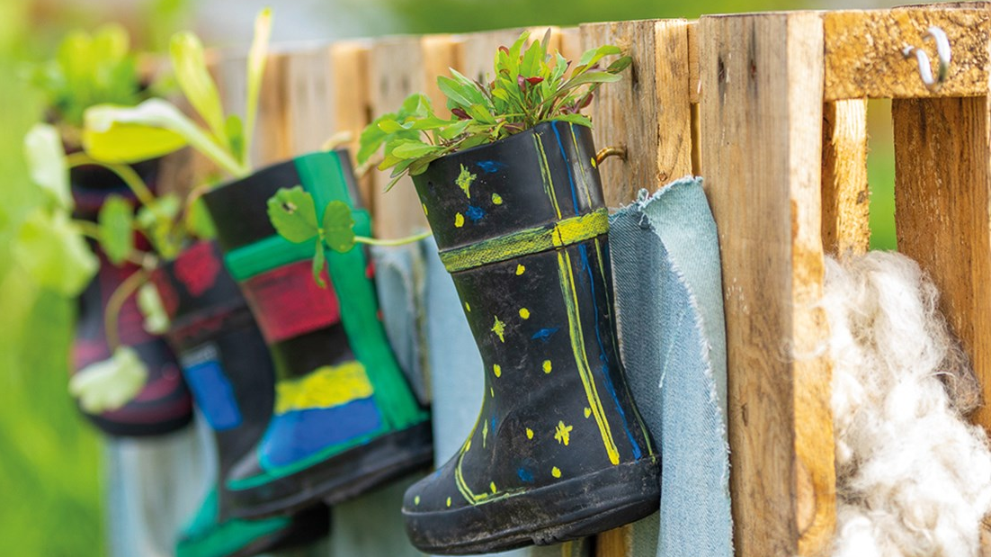
An approach to learning, life and work.
Enables learners, educators, schools and their communities to build a socially-just, sustainable and equitable society.
Whole-school and community approach to LfS weaves together global citizenship, sustainable development education, outdoor learning and children’s rights.
Fully embedded in the General Teaching Council for Scotland’s Professional Standards.
Learning for Sustainability

Slide 3
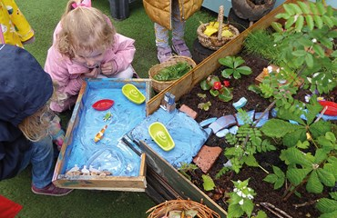
All children and young people are entitled to experience:
a broad general education, including well planned experiences and outcomes across all the curriculum areas.
An understanding of the world and Scotland’s place in it and understanding of the environment.
Building the Curriculum 3 – A Framework for Learning
Curriculum for Excellence

Slide 4
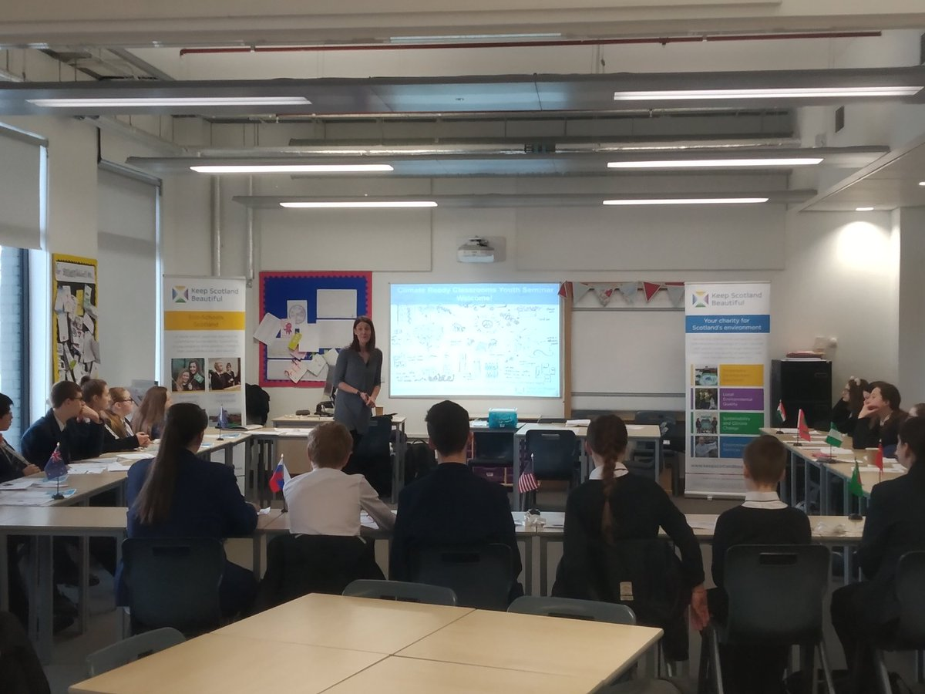
“Making a professional commitment to learning and learners that is compatible with the aspiration of achieving a sustainable and equitable world embodies what it means to become, be and grow as a teacher in Scotland.”
LfS must be evidenced by teachers in Scotland across all 5 professional standards:
Standard for Provisional Registration
Standard for Full Registration
Standard for Career Long Professional Learning
Standard for Middle Leadership
Standard for Headship
GTC Scotland Professional Standards

Slide 5
Keep Scotland Beautiful and Learning for Sustainability
Eco Schools
Climate Ready Classrooms
Young Reporters for the Environment
One Planet Picnic
Pocket Garden
Upstream Battle
Climate Action Week
Continued Professional Learning

Slide 6
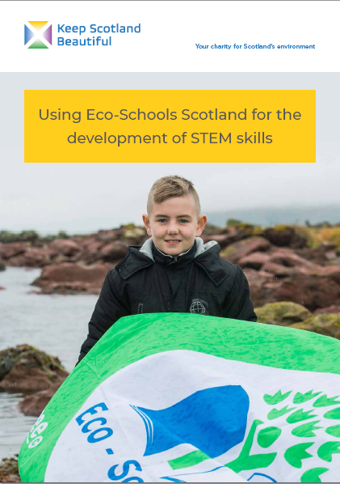
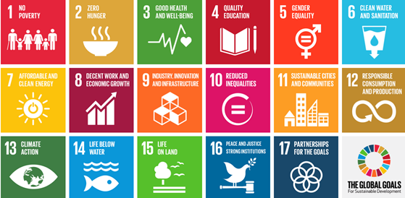

Slide 7
Climate Ready Classrooms
Helps young people navigate the science behind climate change and reducing their carbon footprint.
Creates a national network of carbon literate ambassadors acting on climate change issues in their schools and communities.
Encourages young people to start a conversation about climate change.
A one-day accredited Carbon Literacy training course designed for young people.

Slide 8
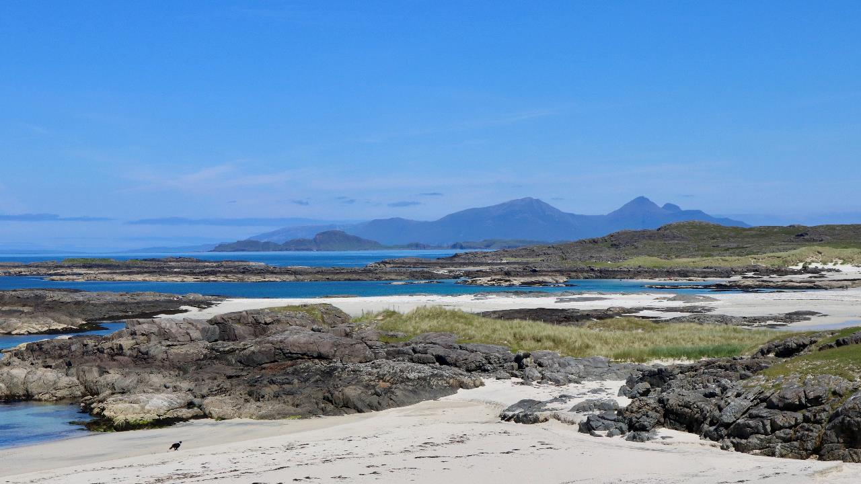
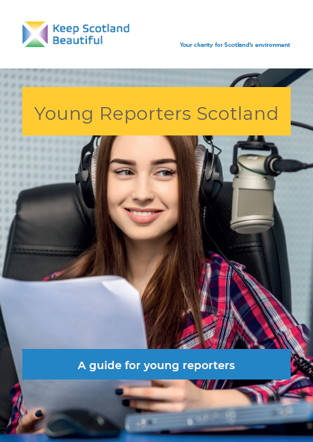
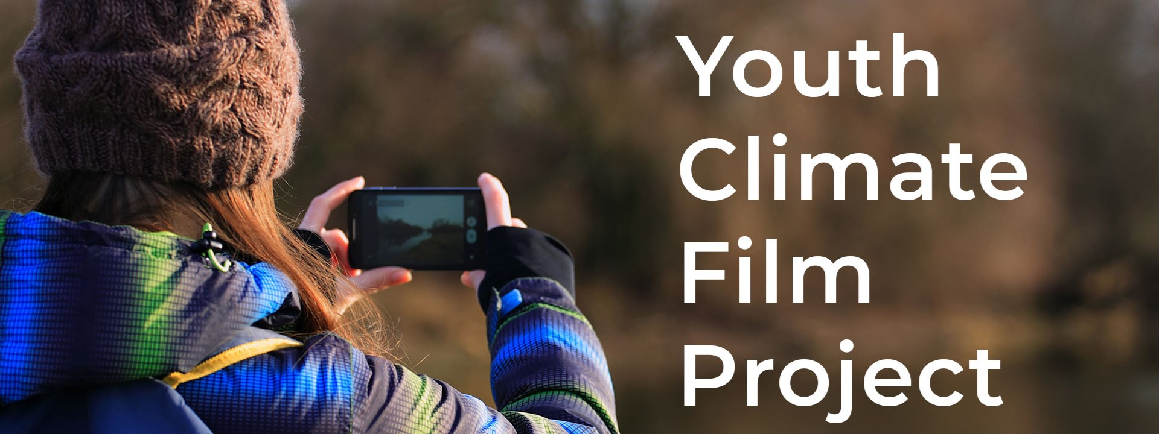

Slide 9
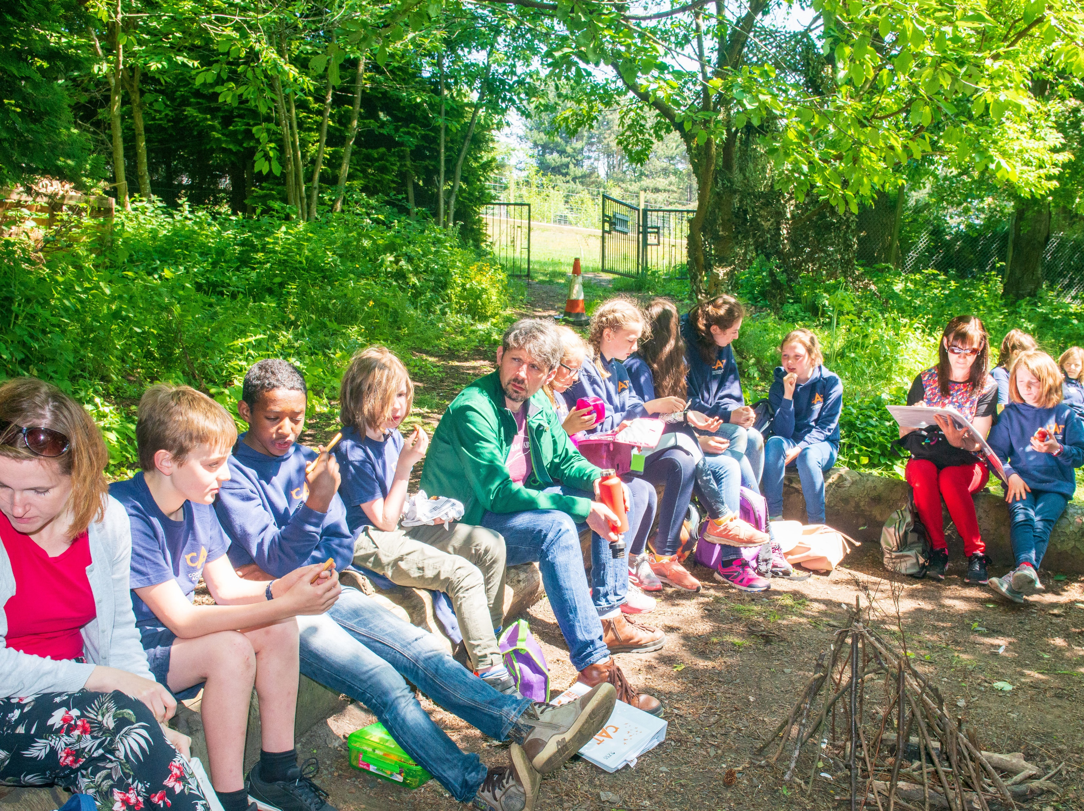
A picnic that is good for you and good for the planet.
Celebrate food and drink that is:
Local
Seasonal
Ethically traded
Organically grown
Uses reduced packaging
Minimises food waste

Slide 10
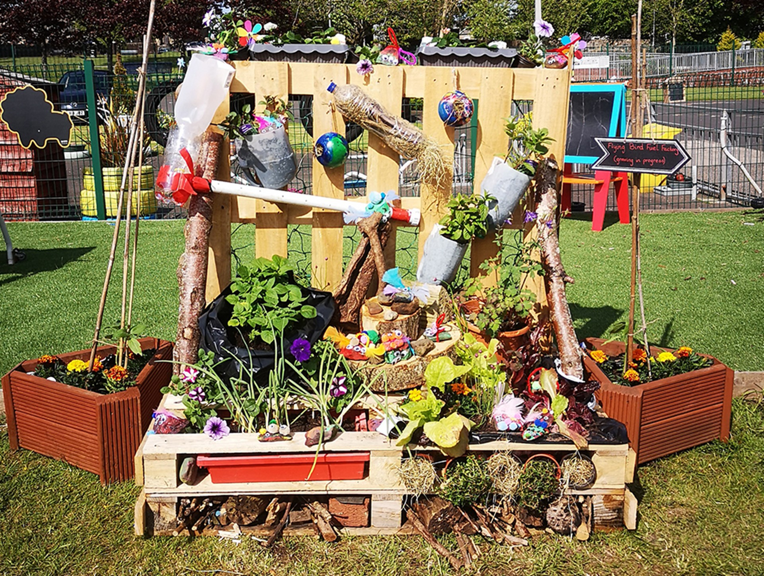
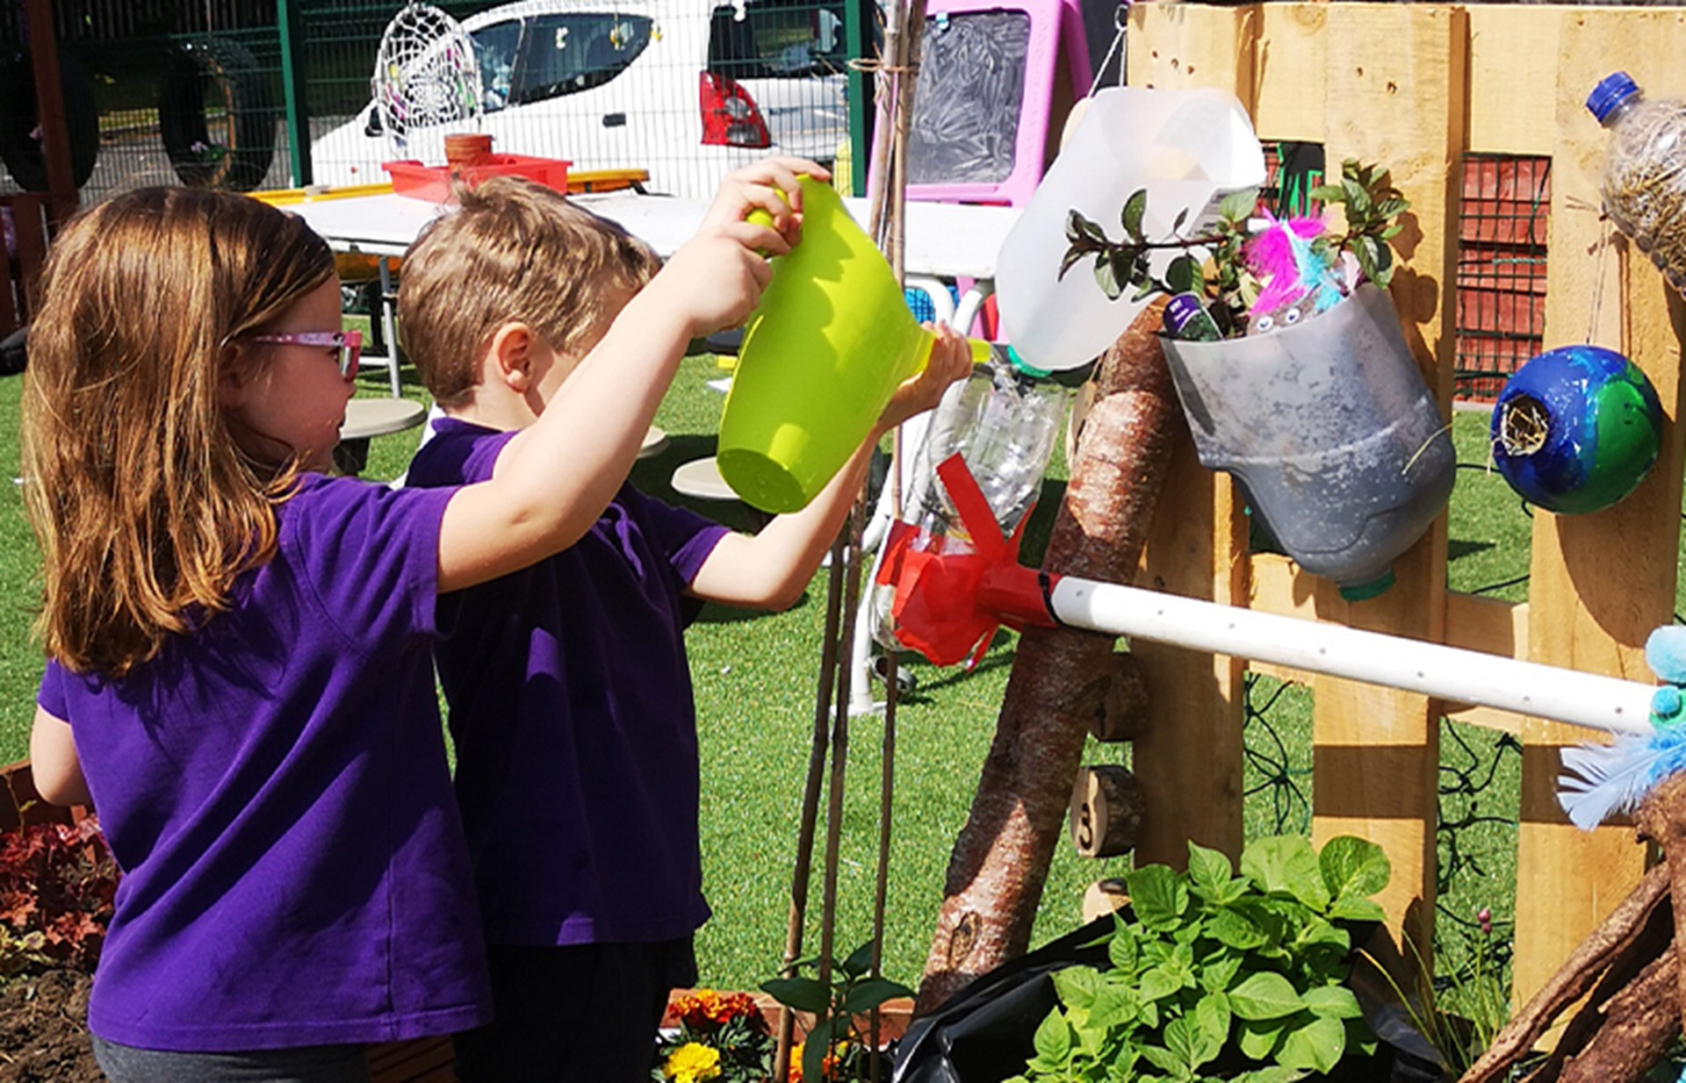
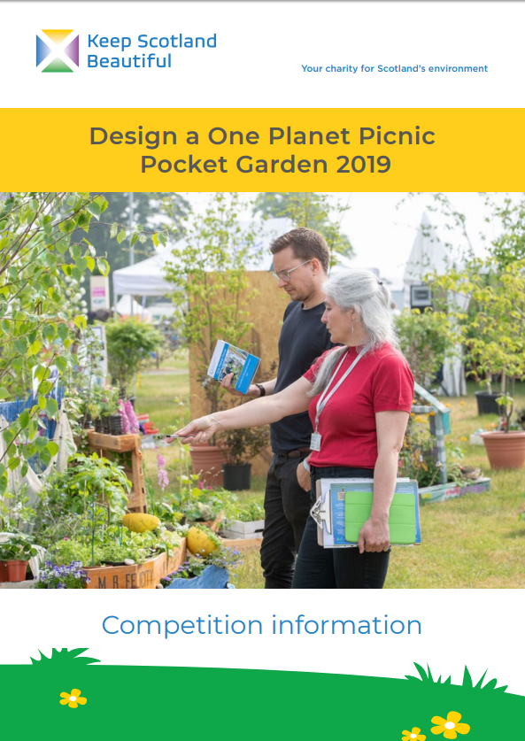
Pocket Gardens
Miniature garden that uses edible plants, plants that attract wildlife, and that reuses something which would otherwise have been thrown away.
Young people from schools across Scotland design colourful and exciting environmentally friendly, pocket-sized garden.
Winning schools build and grow their gardens to display at events.
80% and.

Slide 11
Climate Action Week 2021
During COP 26 in Scotland we offered a week of live sessions for schools - helping learners understand what climate change is, its impacts, how we are contributing to the situation and how we can contribute to its solution.
Over the course of the week we engaged with:
2129 classes
53325 learners
677 educators involved in professional learning activities

Slide 12
A Professional Learning Programme on the journey of litter from Source to Sea
Develops and supports educators’ confidence in:
delivering on each pupil’s entitlement to Learning for Sustainability
building STEM skills through the context of source to sea litter
encouraging skills in enquiry-based learning
creating effective interdisciplinary learning
Replace grey placeholder box with image
.

Slide 13
Replace grey placeholder box with image
Climate Action Schools
Scotland’s Local Authorities are developing their individual Net Zero and Climate Emergency Plans.
They are increasingly recognising the vital role that schools and young people will play in achieving these goals.
Presenting all our education programmes under the Climate Action Schools banner allows us to support Local Authorities to achieve their ambitions through supporting schools and young people to develop an understanding of, and the skills required to take positive action, to tackle the climate crisis as a priority.

Slide 14
#Climate Action Schools
Schools will pledge to become Climate Action Schools through:
Embedding Learning for Sustainability
Taking positive action to tackle the Climate Emergency
Addressing the impact of Biodiversity Loss
Tackling the twin issues of Litter and Pollution
Ensuring Pupils Voice are heard and acted upon

Slide 15
^{Thank you}
Daniel Barrie
T: 01786 471333
E: daniel.barrie@KeepScotlandBeautiful.org
@KSBScotland
@KSBScotland

