Slide 1
Evolving from WSA to WIA
The Eco-Schools Experience

Slide 2
Introduction …
The Whole School Approach is not a destination, but a journey
It is about a systemic anchoring of sustainability values in all areas of the school
This implies collective acceptance of these values
This is the challenge … as ESD is still perceived more of a topic and less than an integral part of quality education

Slide 3
Eco-School’s 7-Step methodology …
Set up a Committee that manages the EkoSkola process
Students carry out an Environmental Review of the school grounds
Draw up an Action Plan
Monitor and evaluate the implementation of the action
Incorporate ESD in curriculum work
Inform and involve parents, local authorities, businesses and the wider community in the EkoSkola process.
Draw up an Eco-Code

Slide 4
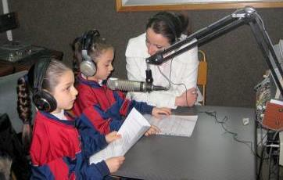
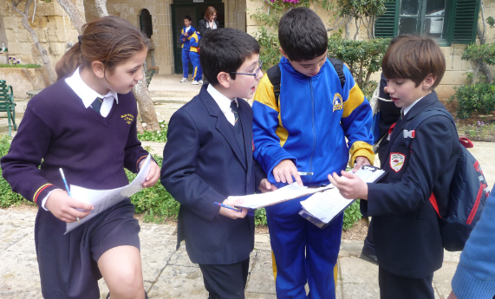
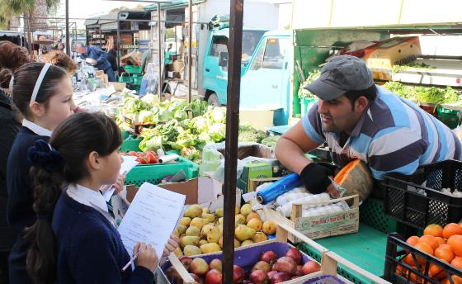
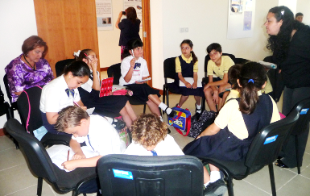
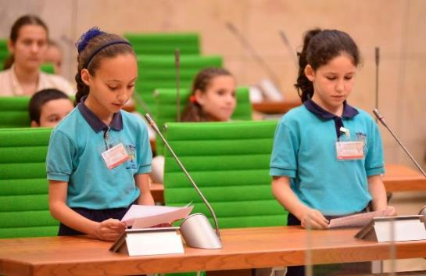
Going beyond the school walls …
Radio and TV Programmes
Audits of Community spaces
Community-based research
Young People’s Summits
Eco-Schools Parliament sessions

Slide 5
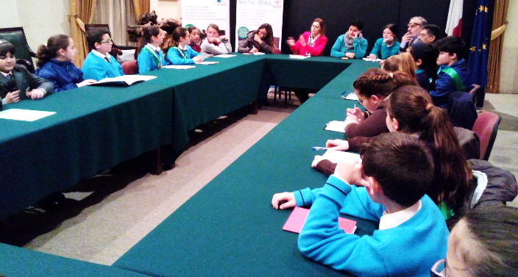
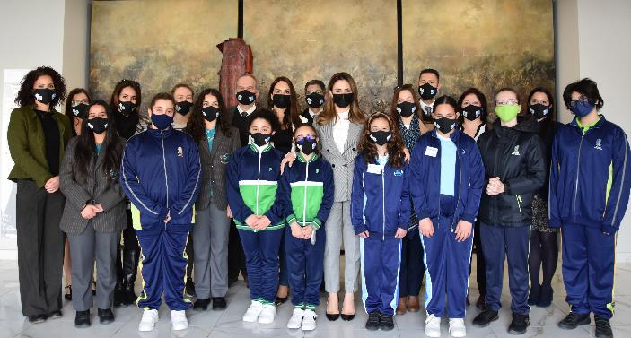
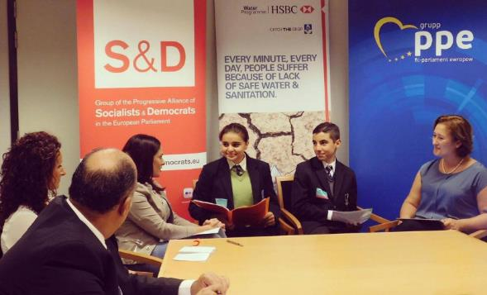
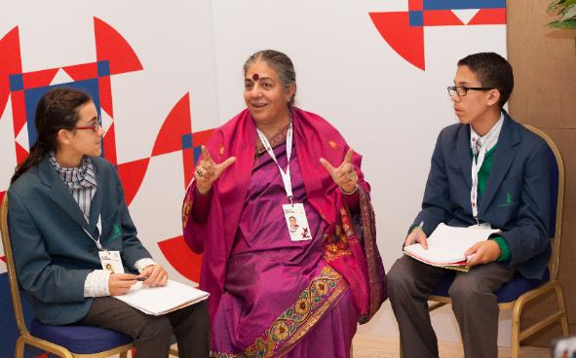
Going beyond the school walls …
Meetings with Ministers
Presenting Electoral Memoradum
Informal Meeting of the EU Environment Council
Meeting with MEPs at the European Parliament
Meeting delegates attending the CHOGM 2015

Slide 6
Lessons learned …
A Whole School Approach is a personal journey that is dependent on:
The social realities and contexts
Resources available
Readiness of the staff and students
Willingness of the Head of School
Support from parents and other stakeholders
Supportive policies by the Education Authorities

Slide 7
Lessons learned …
When evaluating ‘good practice’ beware of green-washing
A WSA should not be an end in itself, but a means to an end
A successful WSA transforms people NOT buildings
A successful WSA transforms individuals for life … skills and values are internalised …
… the Eco-Campus experience

Slide 8
Reflections …
Main challenge: extending the WSA beyond schooling
Traditional settings tend to:
be hierarchical with students (workers) at the bottom
adopt a top-down approach in decision making
prefer the status quo
be afraid of change
The WIA can be seen as a threat to authority … power.

Slide 9
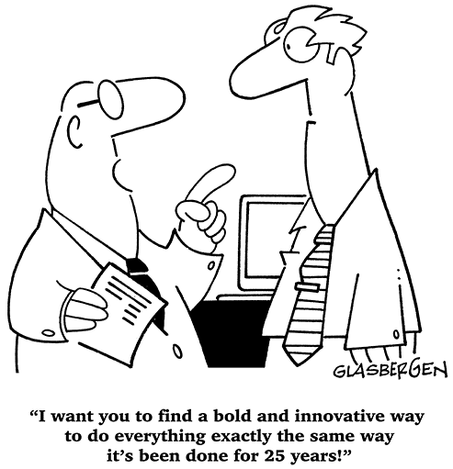

Slide 10
Reflections …
The interdisciplinary nature of ESD,
The need for learner-centred pedagogical approaches,
The need for new assessment approaches
Procedural changes
Partnerships with external educational partners
The establishment of local educational landscapes for sustainable development
… are sources of conflict with established cultures and norms in education.

Slide 11
Reflections …
ESD (and subsequently WSA) still needs to be given currency within educational circles AND beyond
Clear and unequivocal national policies that formally acknowledges ESD’s importance in a learner’s development
Is it time for the EC to move away from recommendations and adopt more assertive actions?
+
Implementation and enforcement of these policies against specific targets
Formal Curriculum Space
ensures
Dedicated Resources
Trained Educators

Slide 12
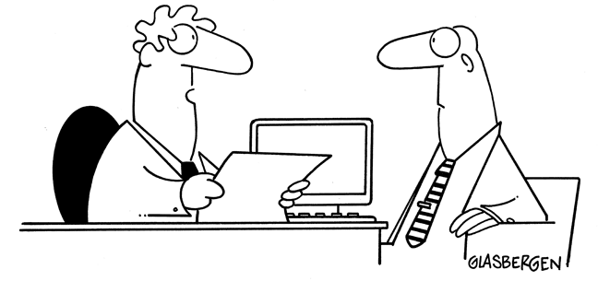
“It’s extremely important that we start adopting a Whole Institution Approach. But there is no budget, no guidelines and no support staff. At last, here’s YOUR chance to really impress everyone!”

Slide 13
Reflections …
Progress is dependent on the use of a common agreed working language (particularly in the context of different national languages and non-academic circles).
Considering how long it’s taking to register significant progress maybe we need to switch emphasis (at least temporarily)
from
Research Informed Practice
to
Practice Informed Research

Slide 14
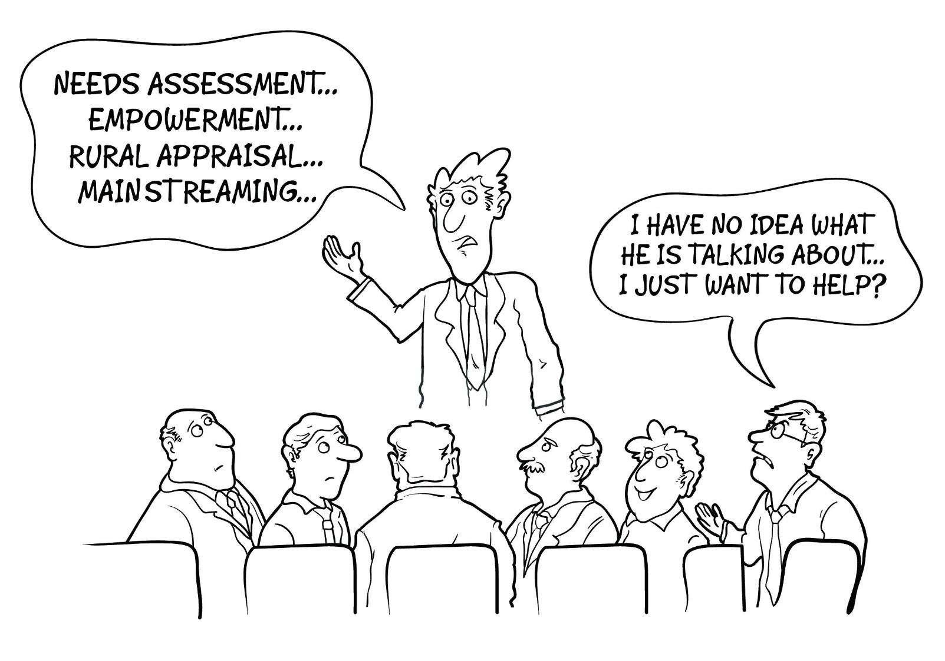

Slide 15
Reflections …
Evolution (ESD) has never been linear
with one ‘new’ phase being considered ‘better’ than and hence replacing the ‘older’ phase
Evolution (ESD) is more like a branching tree
with new forms developing and coexisting happily with other forms, each fitting particular niches in the variety of worldwide (educational) systems.

Slide 16
Thank you
Prof Paul Pace
paul.j.pace@um.edu.mt

