Slide 1
The Dutch Education system and our curriculum ‘under construction’
Sanne Tromp, Director knowledge & innovation
Karianne Djoyoadhiningrat-Hol, Expert nature, science & technology primary education
SLO, the Netherlands institute for curriculum development

Slide 2
Today
Challenges we face
Overview Dutch Education System
Dutch freedom of education
Curriculum & sustainability
Curriculum: a contested concept

Slide 3
Challenges we face

Slide 4
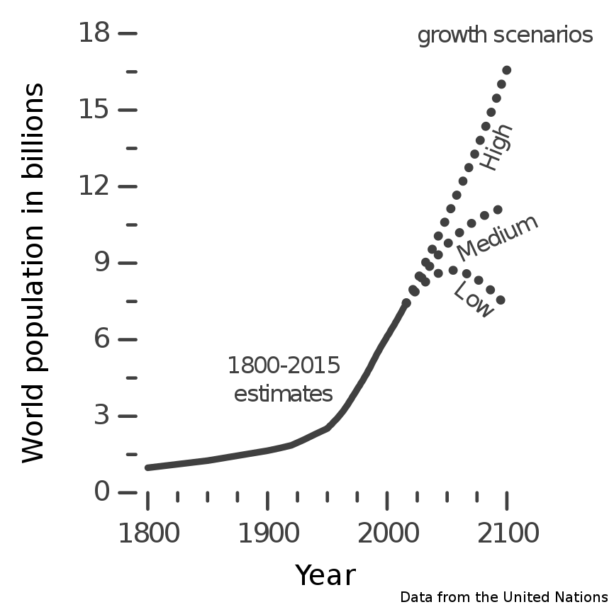
Notes:
\

Slide 5
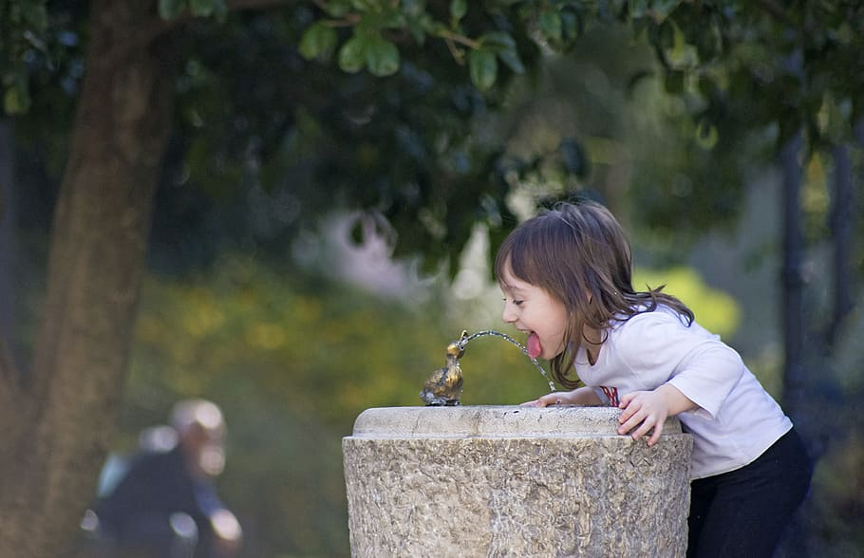

Slide 6
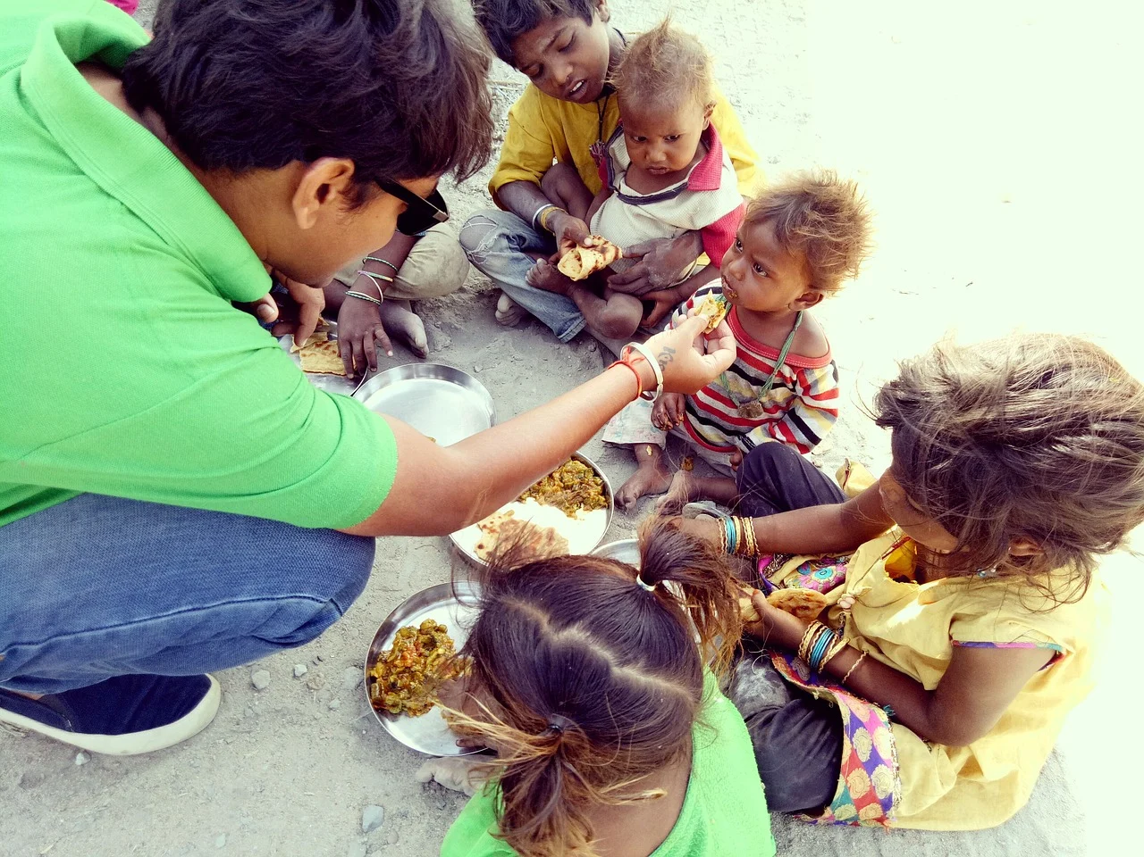

Slide 7
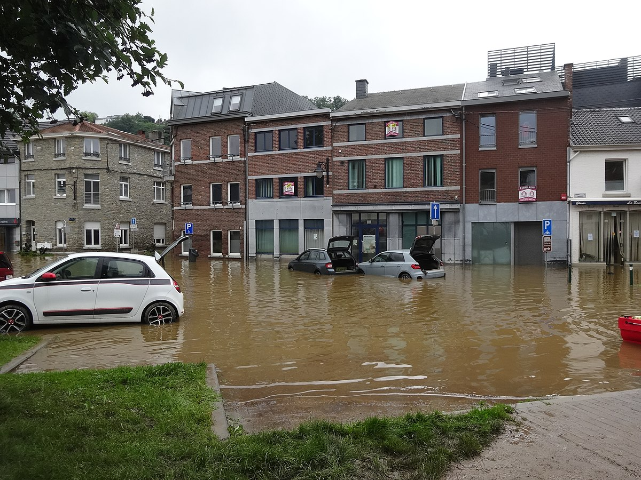

Slide 8
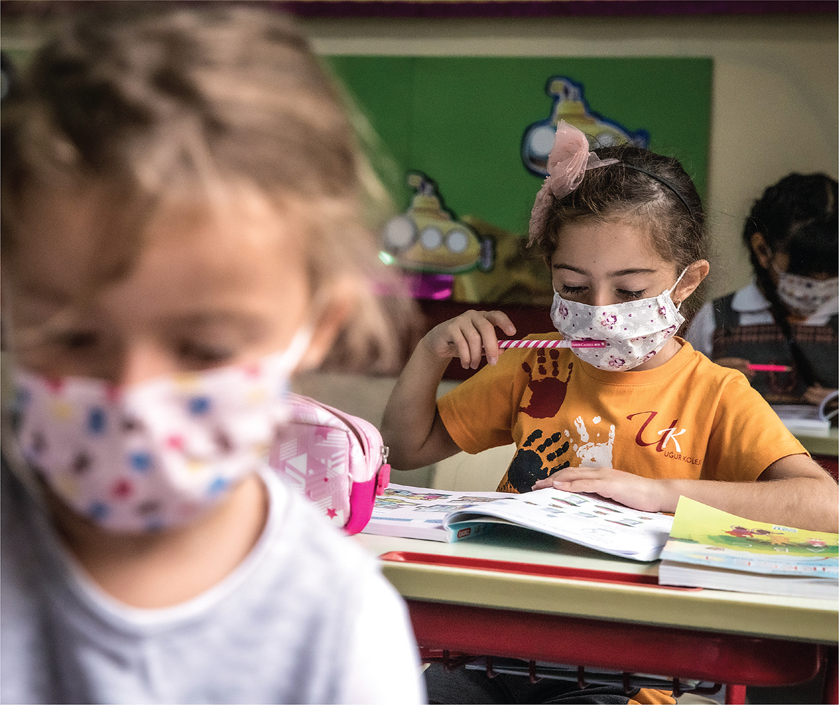

Slide 9
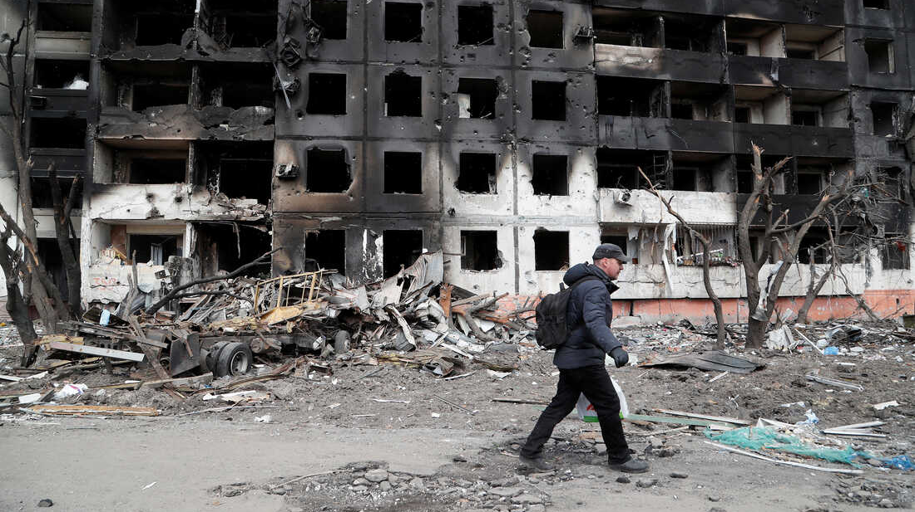

Slide 10
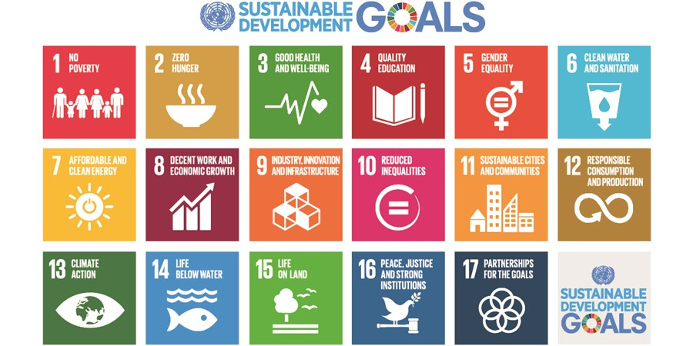
Sustainability more than ecological sustainability

Slide 11
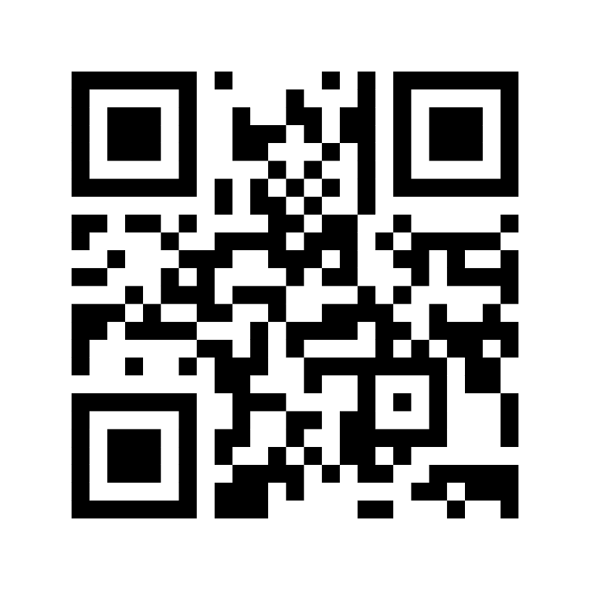
Your view on the role of education
Go to www.menti.com
CODE: 8663 4387
Considering the urgent societal problems …, … and …, I believe that students should learn to …, … and … .

Slide 12
Overview Dutch Education System

Slide 13
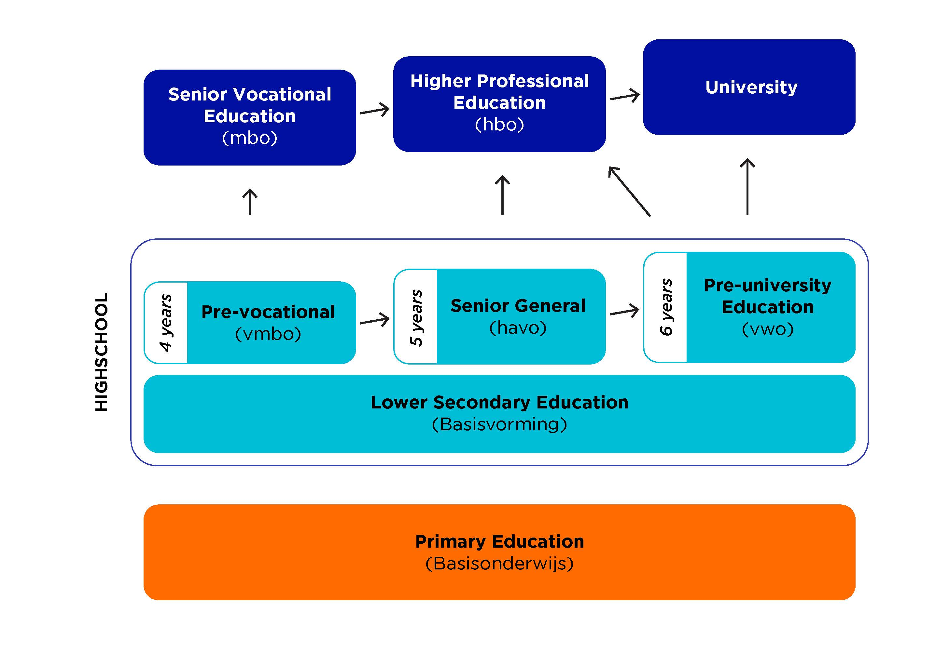
Overview Dutch Education System

Slide 14
Curriculum
documents
Examen programs
per subject
Core objectives
lower secondary
Core objectives
primary education

Slide 15
Role of SLO
National coordination of curriculum development
Analysis, design, validation and evaluation of curricular frameworks and exemplary specifications
Scientific underpinning and international orientation of curriculum development
Advice to and support of the government

Slide 16
Freedom of education
ARTICLE 23 of the Constitution:
Education shall be the constant concern of the Government;
All persons shall be free to provide education, without prejudice to the authorities' right of supervision.

Slide 17
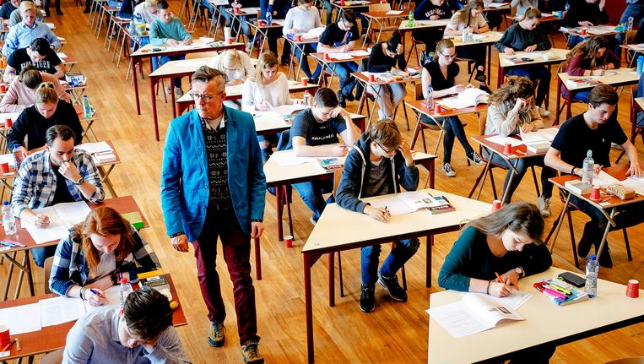
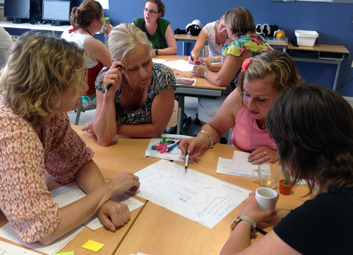
Centralised & de-centralised

Slide 18
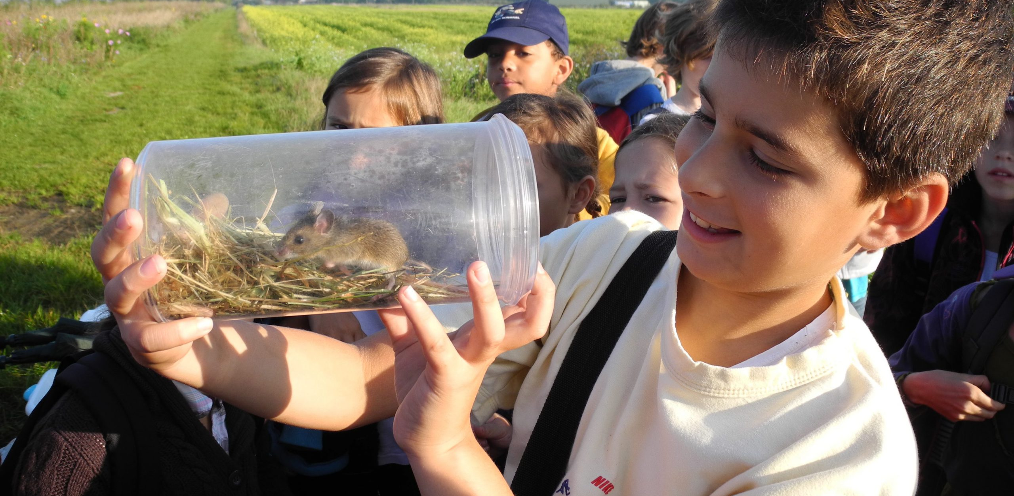
Lessons in nature

Slide 19
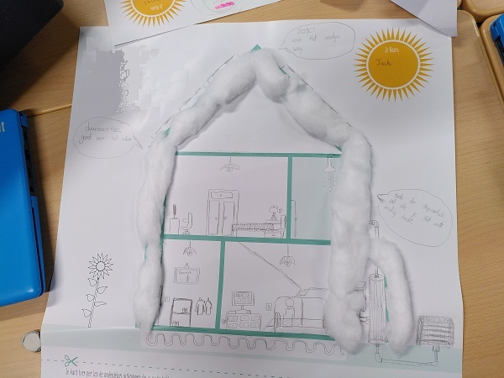
Lessons on energy transition

Slide 20
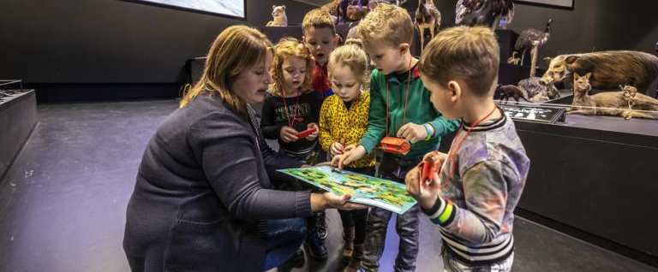
Visiting museums

Slide 21
Current curriculum
Where do we find sustainability in our
current curriculum?

Slide 22
Curriculum
documents
Examen programs
per subject
Core objectives
lower secondary
Core objectives
primary education

Slide 23
Current Curriculum
Core objective 39. Students learn to take care of the environment
Primary school Sustainability can be a subject or theme to work on.
"being a consumer: experiencing the importance of aspects such as health, safety and sturdiness (as well as sustainability) when choosing a product"

Slide 24
Current Curriculum
Core objective 30: The student learns that people, animals and plants interact with each other and their environment (environment), and that technological and scientific applications can influence the sustainable quality thereof both positively and negatively.
Pre-vocational
Ecological footprint/carrying capacity and nature:
- You describe your ecological footprint
- You describe an ecosystem and give an example of an ecosystem.

Slide 25
Current Curriculum
Exam program biology (D, interaction)
Discuss the relationship between population and ecosystems in the context of sustainability and food production.
Pre-university
”Students determine their own ecological footprint and discuss how each one of them can reduce their own footprint "

Slide 26
Curriculum revision
Opportunities for sustainability?

Slide 27
Revision: How?
Desire to revise curriculum
Development teams make proposals
Political debate
Expected start curriculum revision
2014
2017-2019
2020-2021
2022

Slide 28
Where do we see sustainability?
Global Themes:
Sustainability
Globalization
Health
Technology

Slide 29
Where do we see sustainability?
Learning area's
Human & Society
Human & Nature
Citizenship

Slide 30
Curriculum: a contested concept

Slide 32
Claims on Aims
Designing a curriculum is always about scarcity

Slide 33
The function and purpose of education
Qualification
Socialization
Personal development

Slide 35
Questions? s.tromp@slo.nl www.slo.nl

