Slide 1
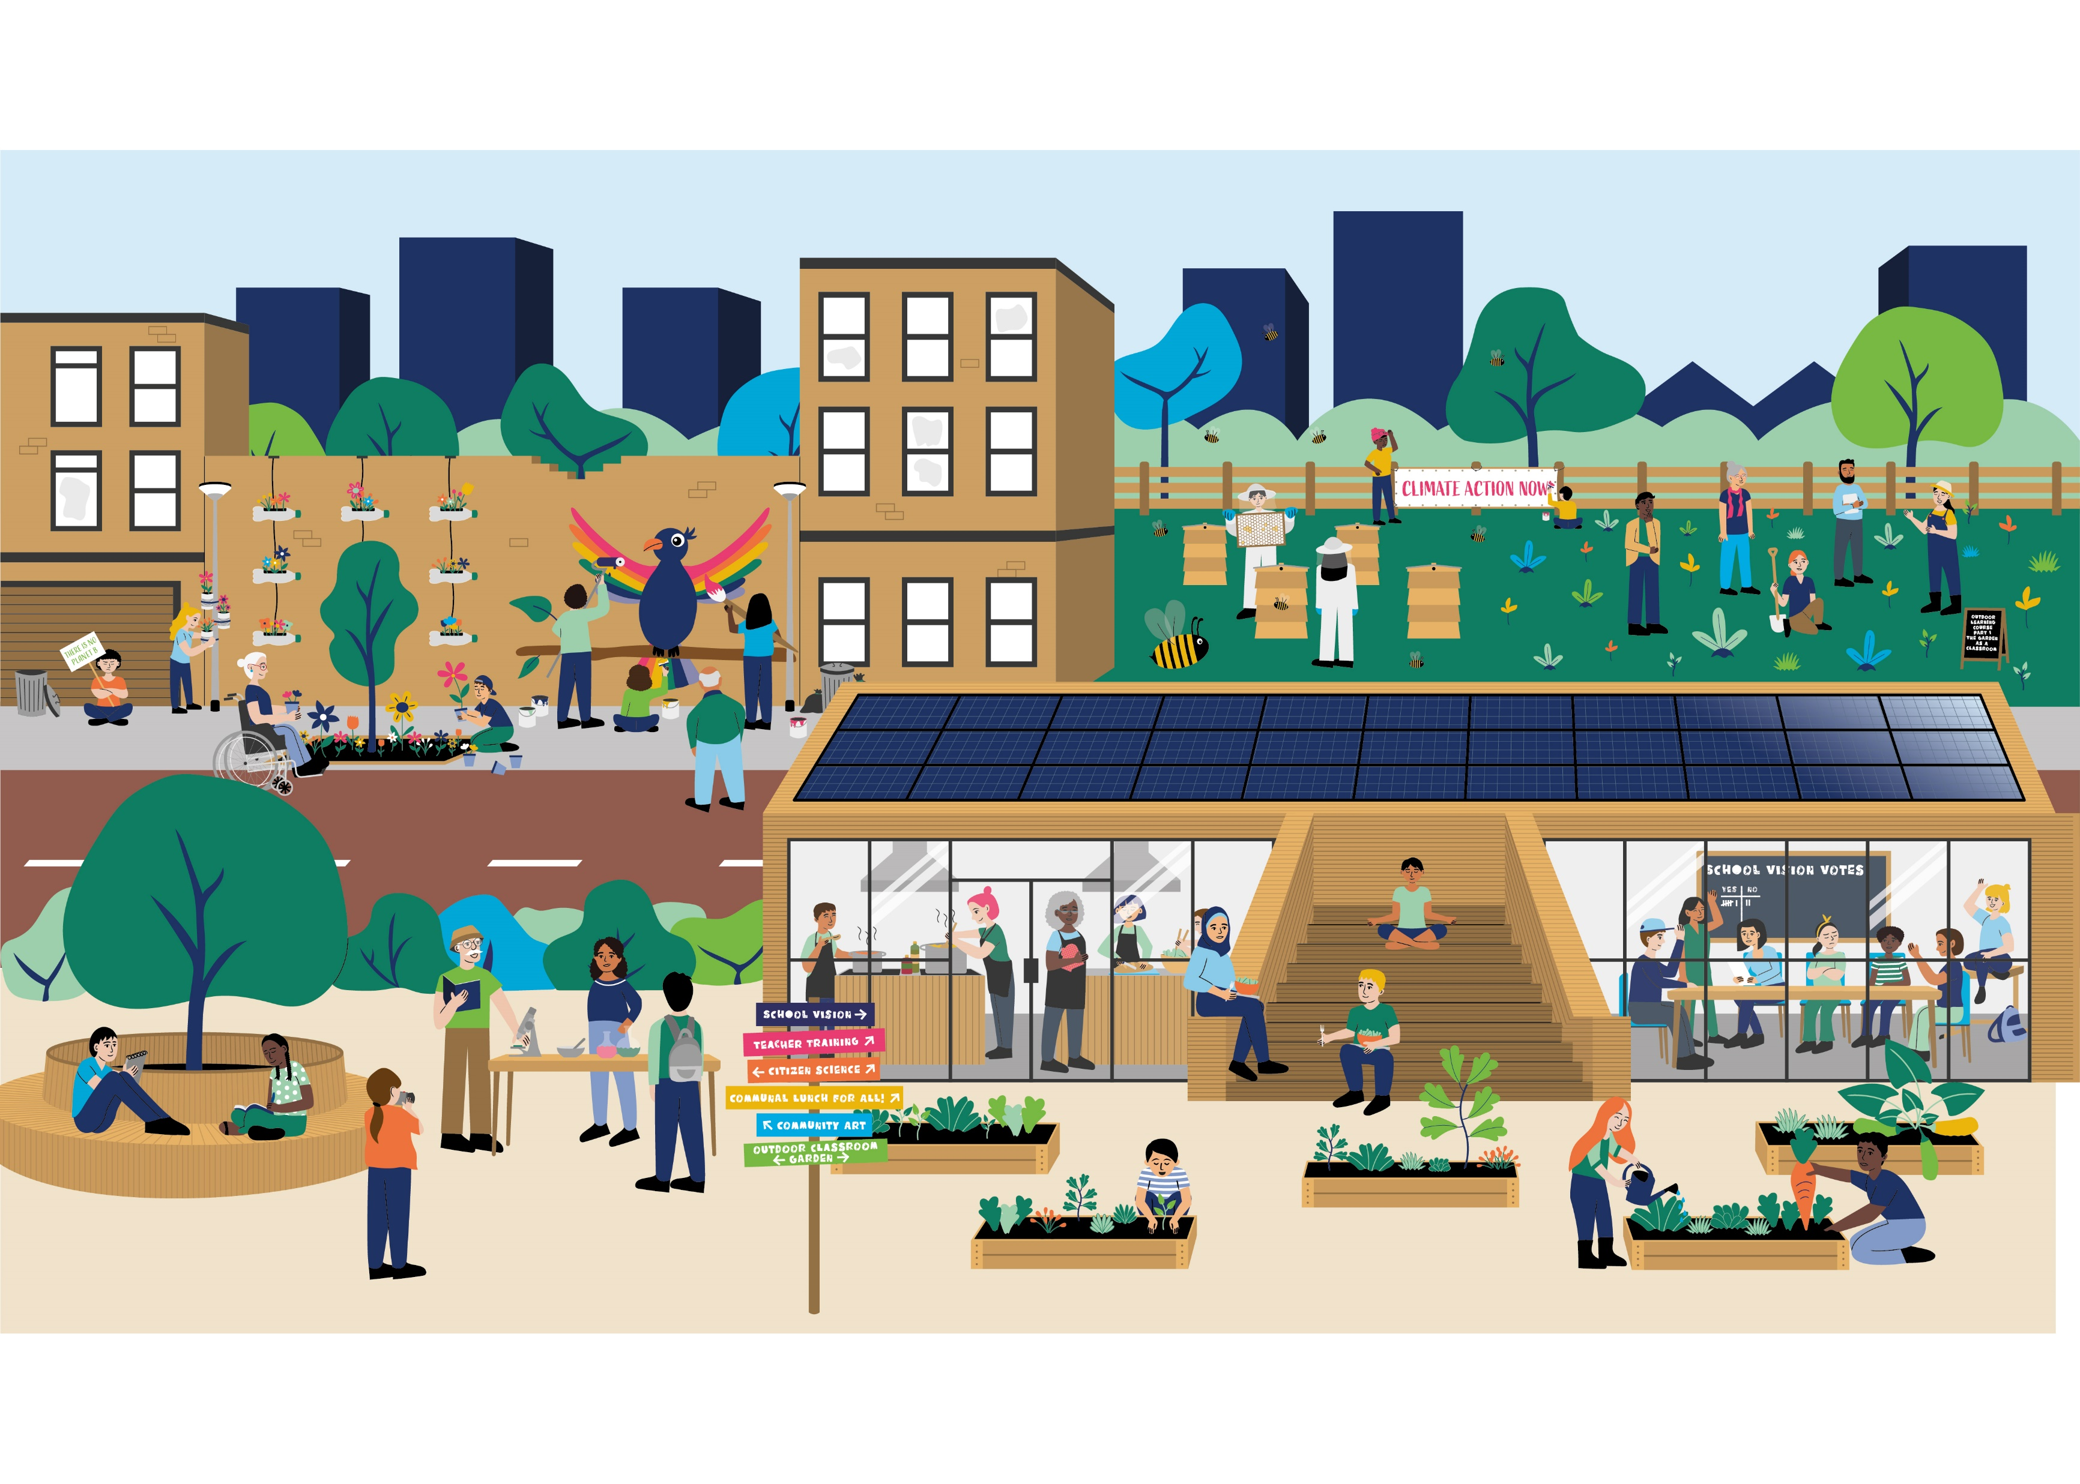

Whole School Approaches to Sustainability
Exemplary practices from around the world

Slide 2
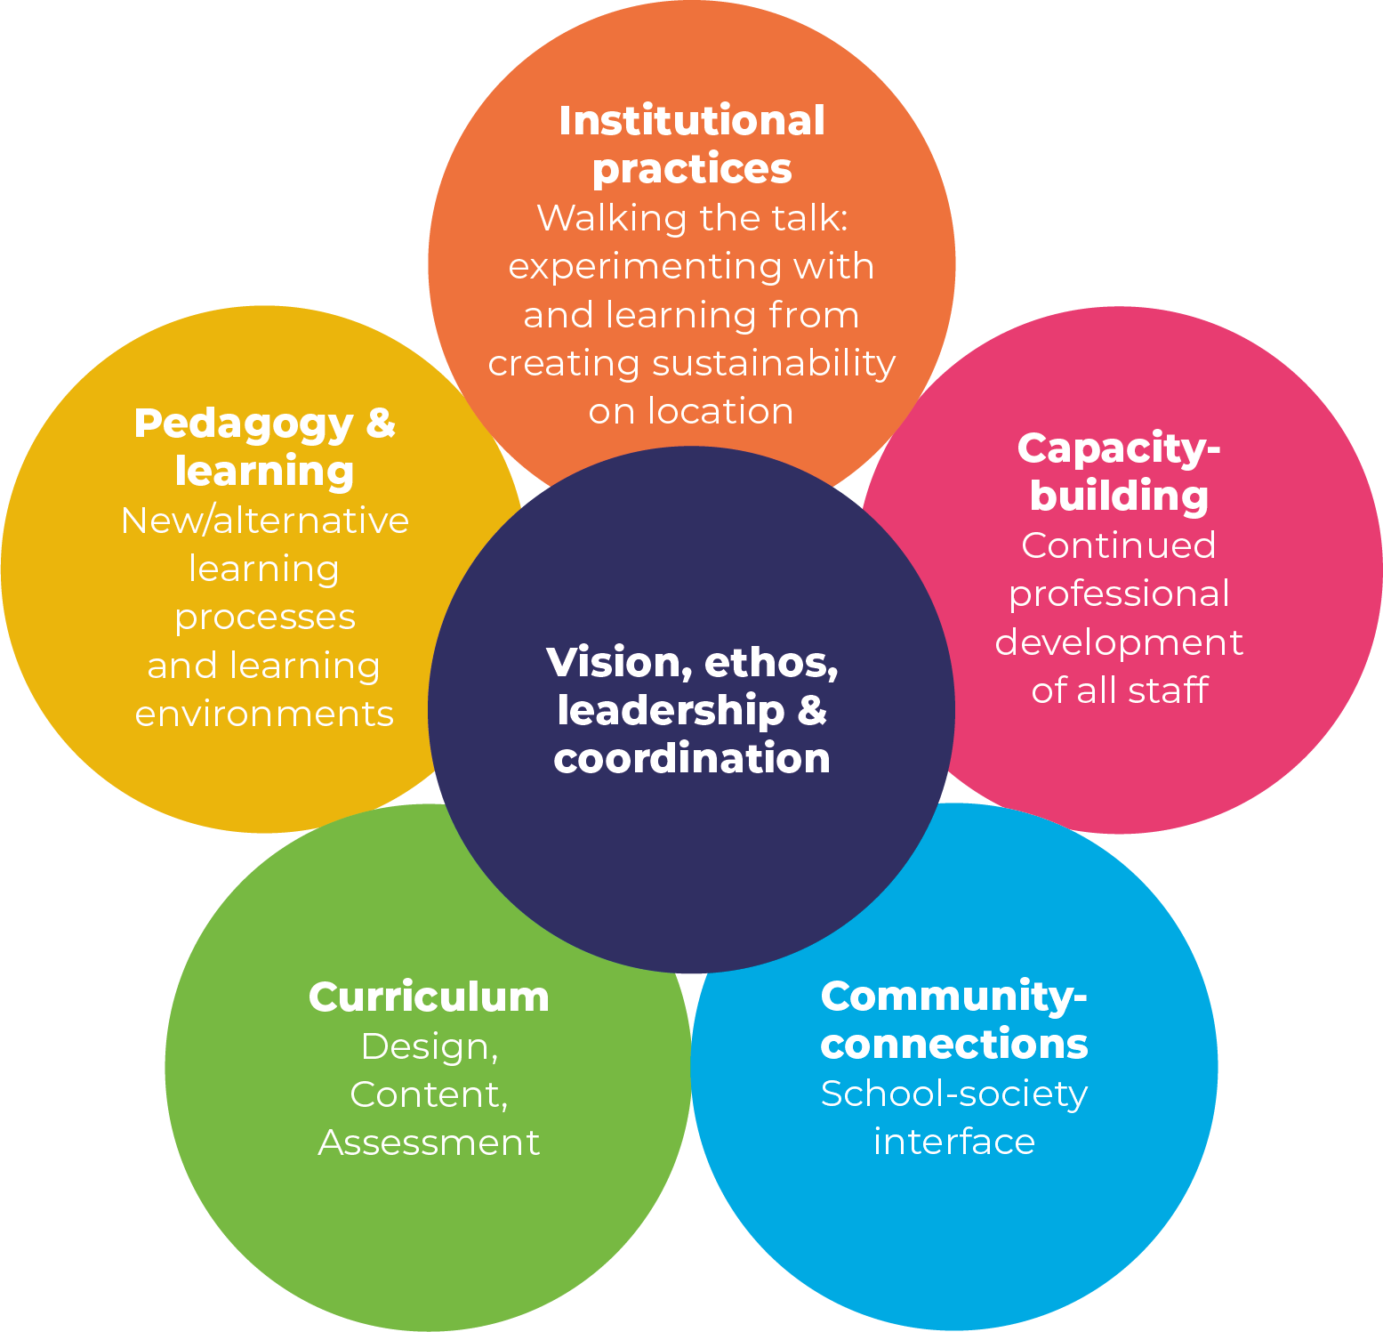

Figure 1: The Whole School Approach Flower Model with its 6 key components (adapted from Wals and Mathie, 2022)
Notes:
Colours have been adapted to match the Dutch flower version…
The WSA model is meant to be used as a thinking tool to initiate and guide an on-going multi-stakeholder dialogue about how sustainability can best unfold in a school setting.
Each of the components of the flower will be briefly described

Slide 3
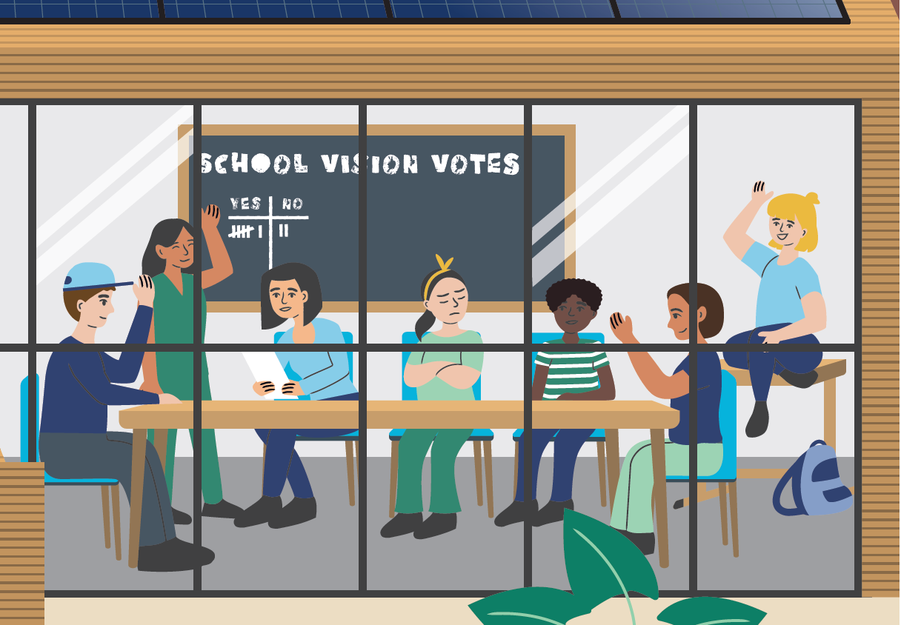
Vision, Ethos, Leadership & Coordination •
All stakeholders in a school are involved in developing a vision
School leadership enables such participation and provides coordination
A school ethos that aligns well with notions of sustainability
Asking questions, including uncomfortable ones is encouraged
Notes:
All stakeholders in a school are involved in developing a vision of what a sustainable school entails and invites
School leadership enables such participation and provides for some coordination as changing an entire system can be complex and messy. The school culture and ethos align with the vision, as consistency between thinking and doing is essential.
Typically, a school ethos that aligns well with notions of sustainability is one that is caring, nurturing, inclusive, open, peaceful, and reflexive.
Asking questions, including uncomfortable ones is encouraged, to foster a willingness to re-think and re-calibrate the school considering new insights and a changing world.

Slide 4
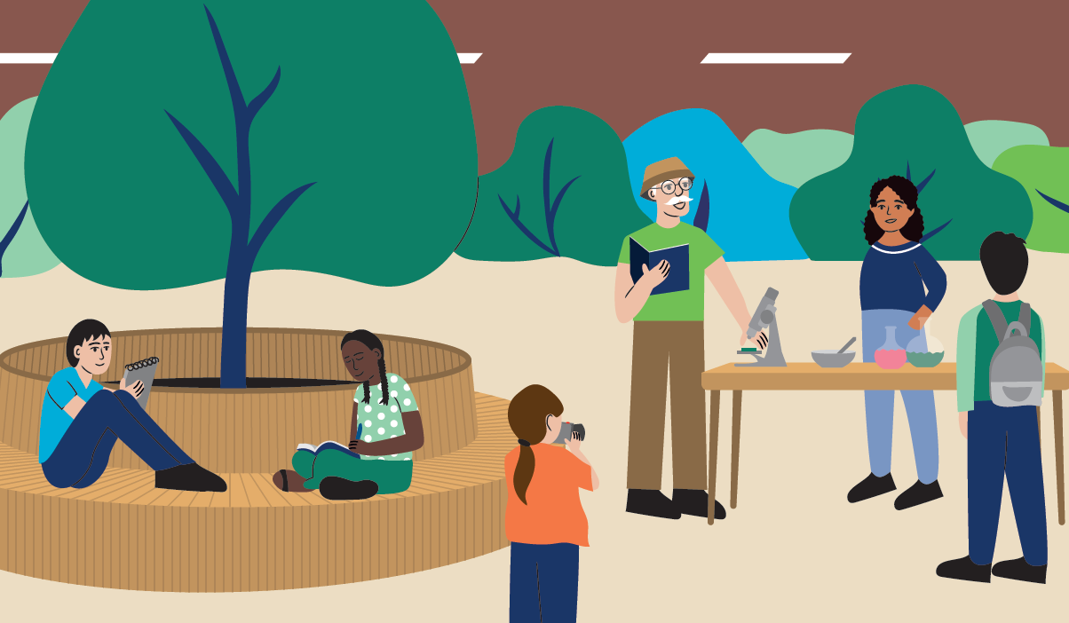
Curriculum •
Schools have a say in the curriculum and can connect with key emerging sustainability topics from disciplinary (the regular subjects) and interdisciplinary vantage points
Space and freedom to create a more localised, place-based and co-created ‘parallel curriculum’
Subject teachers do not dismiss their disciplinary focus, yet still engage in a ‘whole subject approach’
A curriculum that allows for alternative forms of pedagogy and learning to be experimented with
Notes:
Schools have a say in the curriculum and can connect with key emerging sustainability topics from disciplinary (the regular subjects) and interdisciplinary vantage points
Ideally there is space and freedom to create a more localised, place-based and co-created ‘parallel curriculum’ that allows for engagement in and responding to cross-cutting interdisciplinary challenges such as climate urgency
Subject teachers do not dismiss their disciplinary focus, yet still engage in a ‘whole subject approach’ that allows for making links with SD-topics and the inclusion of perspectives from other disciplines
A curriculum that allows for alternative forms of pedagogy and learning to be experimented with is essential

Slide 5
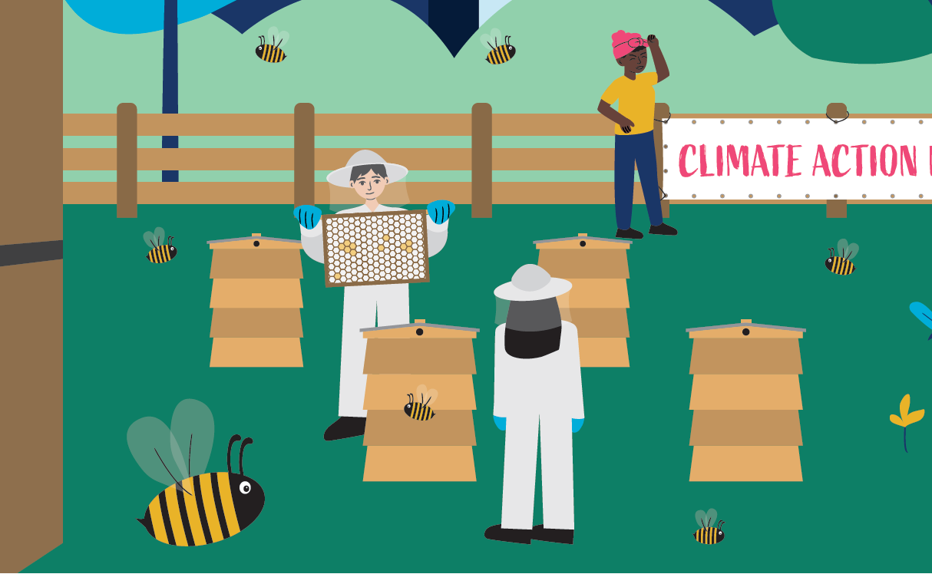
Pedagogy & Learning •
The pedagogies and types of learning are not of a transmissive and singularly cognitive kind, but of a transformative kind affecting mind, body, heart, and soul
Place-based, experiential, inquiry-based, transgressive, and critical, as well as socio-emotional with attention to moral issues, ethics, and values
In a WSA the pedagogical environment that supports trust, curiosity, collaboration, participation, and democracy
Much of the learning does not take place inside the classroom but also in other spaces
Notes:
The pedagogies and types of learning that are most suitable for realising this are not of a transmissive and singularly cognitive kind, but of a transformative kind affecting mind, body, heart, and soul.
Typically, such pedagogies and learning processes are place-based, experiential, inquiry-based, transgressive, and critical, as well as socio-emotional with attention to moral issues, ethics, and values.
In a WSA the pedagogical environment a teacher and the school create tends to be one of trust, curiosity, collaboration, participation, and democracy.
Much of the learning does not take place inside the classroom but also in other spaces in the school building, as well as on the school grounds and in the local community, e.g., in outdoor classrooms, repair cafés, etc.

Slide 6
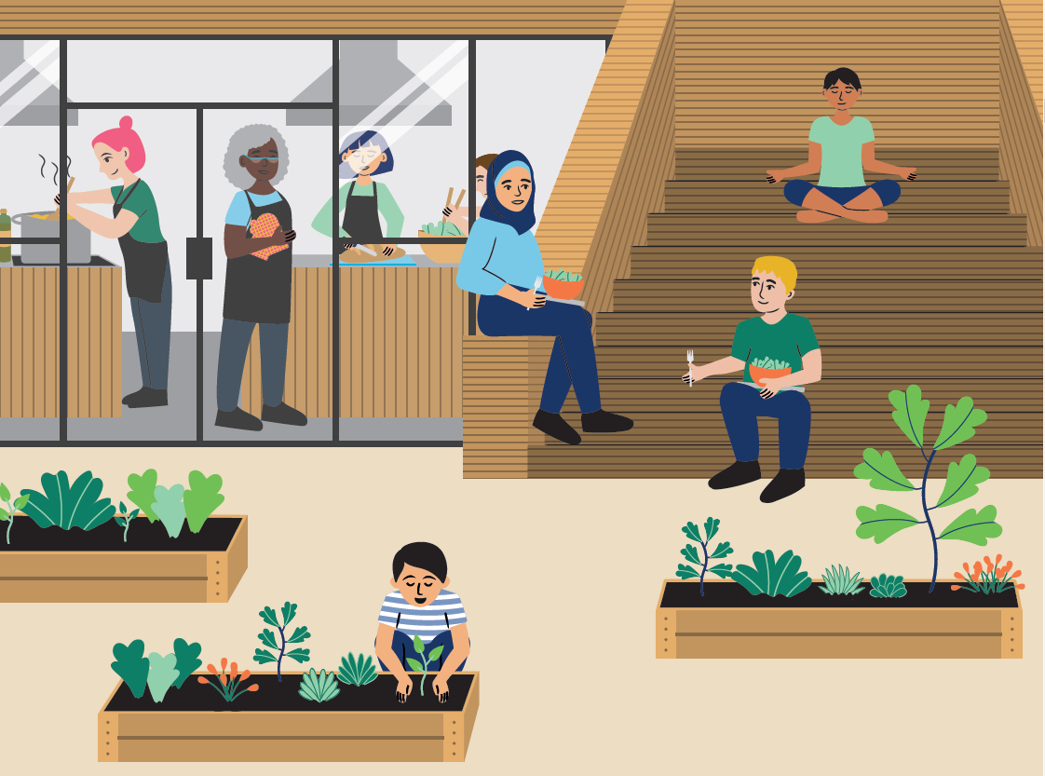
Institutional Practices •
‘Walking the talk’, for example:
  energy and water usage
  the kind of food & nutrition that is offered or nudged
  how biodiverse the school ground is
  what forms of transport students & staff use
  how people deal with conflict, diversity & inequality
Investigative explorations focusing on sustainability issues in and around the school
By interrogating, rethinking, and redesigning institutional practices the ‘hidden curriculum of unsustainability’ that is often present, can also be exposed and addressed
Notes:
‘Walking the talk’ and aligning what we find important and believing in what we do, is critical in creating a culture of sustainability What a school does, what behaviour it invites, or makes difficult, all reflect a school’s intentions and ethos.
For example, energy and water usage, the kind of food and nutrition that is offered or nudged, how biodiverse the school ground is, what forms of transport students and staff use, but also how people deal with conflict, diversity and inequality.
Educational investigative explorations focusing on sustainability issues in and around the school itself provide rich educational opportunities that connect with curriculum, pedagogy, and learning, while at the same time establishing healthy school-community relationships.
By interrogating, rethinking, and redesigning institutional practices the ‘hidden curriculum of unsustainability’ that is often present, can also be exposed and addressed.
(Shallcross et al., 2006). CREATIGN A CULTURE OF SUSTAINABILITY – REF??? – REALISED THIS WAS MISSED AS AN ENDNOTE – ANOTHER THING TO CHANGE…

Slide 7
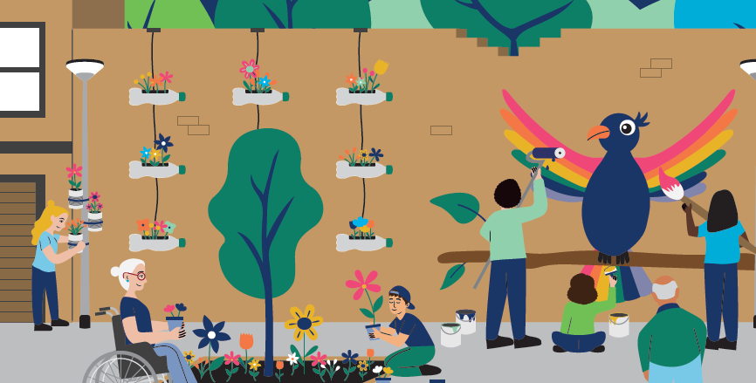
Community-Connections •
A school can be seen as a microcosm of the wider world nested in a community filled with resources for teaching and learning
Both inward and outward looking, to be open and connected to the people and place/land it occupies, and the other species that live there
Establishing good relations with parents, residents, businesses NGO’s, special interest and advocacy groups, as well as with local government, is critical
Community partners can offer insights but can also benefit from students’ attention, cooperative research and creativity
Local community as a living lab or an outdoor classroom
Notes:
A school can be seen as a microcosm of the wider world nested in a community filled with resources for teaching and learning.
To create a healthy habitat that invites and supports sustainability, a school will need to be both inward and outward looking, to be open and connected to the people and place/land it occupies, and the other species that live there.
Establishing good relations with parents, residents, businesses (local farmers, bike [repair]shops, restaurants, etc.), community and cultural hubs (libraries and museums etc.), informal learning spaces and other education institutions, NGO’s, special interest and advocacy groups, as well as with local government, is critical.
The idea is that synergies and mutual learning can occur when students explore issues that are relevant, not only to themselves but also to others, whereby community partners can offer insights but can also benefit from students’ attention, cooperative research and creativity.
By using the local community as a living lab or an outdoor classroom, students also can become more rooted in their own habitat and gain a sense of place and connectedness.

Slide 8
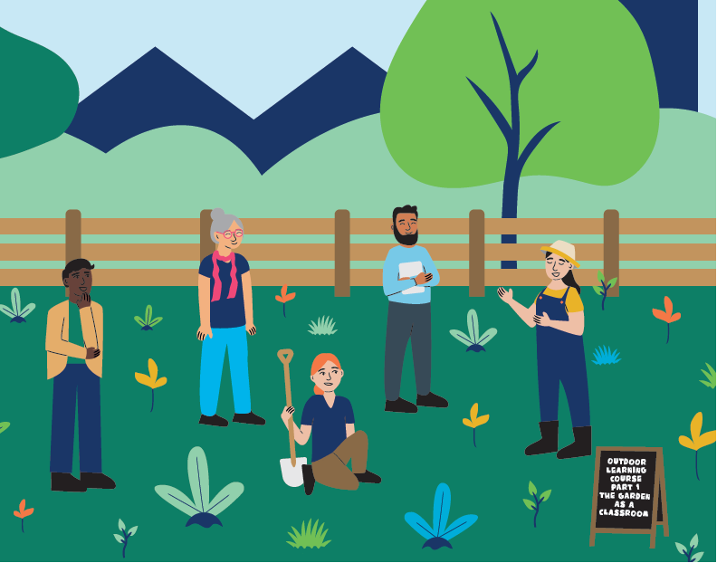
Capacity Building •
All those working in schools, not only teachers, but also those cleaning the building, running the school canteen etc, will need to have the competences needed to support such learning and contribute to the ethos a school aspires to realise
Professional development of teachers remains critical as they will need to:
  be able to work with a more open curriculum
  broker community-school relationships,
  work with a range of disciplinary vantage points alongside their own
Teachers and examiners also will need to become comfortable with alternative forms of assessment that pay attention to socio-emotional and embodied forms of learning
Notes:
A transition in education towards more integrated, existential, and relational forms of teaching and learning also implies that all those working in schools, not only teachers, but also those cleaning the building, running the school canteen, the people maintaining the buildings and the schoolgrounds, etc., will need to have the competences needed to support such learning and contribute to the ethos a school aspires to realise.
Depending on the kind of work staff members do, there will be differences in what these competences entail. Professional development of teachers remains critical as they will need to be able to work with a more open curriculum, broker relationships within the school and with outside partners in the community, and work with a range of disciplinary vantage points alongside their own.
Teachers and examiners also will need to become comfortable with alternative forms of assessment that pay attention to socio-emotional and embodied forms of learning.

Slide 9
Critical case studies
Schools engaging with a WSA from sixteen countries have contributed to the report.
Limitations meant 10 have been included in the printed version – the rest will be published online at www.wur.nl/wholeschoolapproach
Japan
The Netherlands
Mongolia
USA
South Africa
Cyprus
Uruguay
Kazakhstan
Norway
Canada
India
Hongkong
UK
Finland
Turkiye
Nepal
Notes:
For those in the Netherlands you have received a printed version of the report. I hope these different examples of a WSA in action can inspire and inform your discussion at the conference and plans moving forward. In the printed version you will find10 in-depth primary and secondary school case studies from around the world and further mention of an additional 9 school examples that will soon be published online.
One thing is clear that there is a wealth of knowledge out there and schools existing around the world that are committed to developing a WSA. It is important to point out that these holistic integrated approaches to sustainability are not always labelled a WSA. It is also clear different entry points are needed, depending on the local and national context. This is why the cases selected come from a broad range of schools and pedagogical approaches as there is something to learn from these different contexts.
As we address in the report – this was a ‘quick scan’ and the call for contributions was very short and therefore had many limitations. While the writing of this report has officialy finished I feel collating and bringing together schools experiences with working with a WSA in practice could be a worthwhile and full time job! This type of job is also needed in the context of early education and higher education, which this report did not focus on.
For now I will present some examples of the critical cases. I will focus mainly on the cases not included in the printed report as you can read those at your own leisure. As soon as we have the time all the case study’s will be shared online.
Then I’ll hand back to Arjen to discuss the synthesis made after analysing all of the cases together.

Slide 10
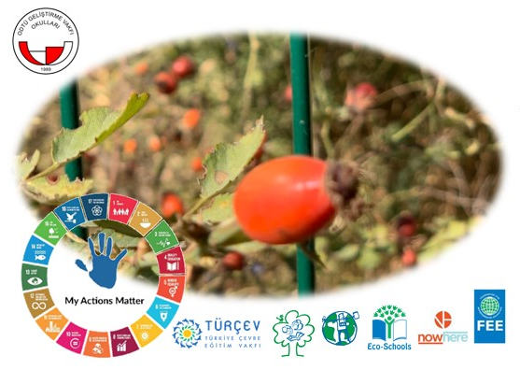
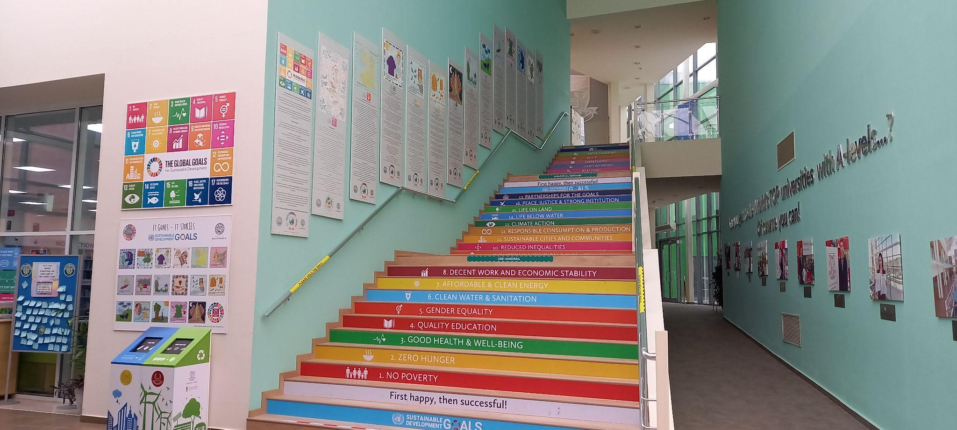
Critical case studies (to be published online)
Türkiye: A Green Flag Eco-School’s Journey towards ESD Practices
Kazakhstan: A Whole School commitment to sustainability - embracing the SDG’s through stories
Green nudges - Scrolls on the walls of Haileybury Almaty primary and secondary school - stories about each of the 17 SDG’s in the Charity Little Hands Design Practical Handbook on Sustainability Education
Example of ODTÜ GV school Action day poster
Notes:
So one wish I personally have for this report is for the school case study’s to be inspiring to other schools.
I know I have been inspired learning about the different practices each school has created at their schools. For example this school in Kazakhstan, Haileybury Almaty has this great display in their hallway - encouraging behavioural changes through green nudges the Scrolls on the wall are from stories about each of the 17 SDG’s that a teacher Astrid Jacoby, through her previous work with her Charity ‘Little Hands Design’, has published in a Practical Handbook on Sustainability Education through Fashion and Textiles.
The Kazakhstan example highlights one school's efforts in making the transition from a small, dedicated group of teachers pioneering Education for Sustainability (ESD) at the school, to a whole school effort. It is a work in progress but they are on their way!
The Turkish example, written by Guliz Semiz gives an example of what a primary and secondary school has learned and created after a decade of being an Eco-School – they also present how the sustainable development goals are becoming part of the school culture step by step.

Slide 11
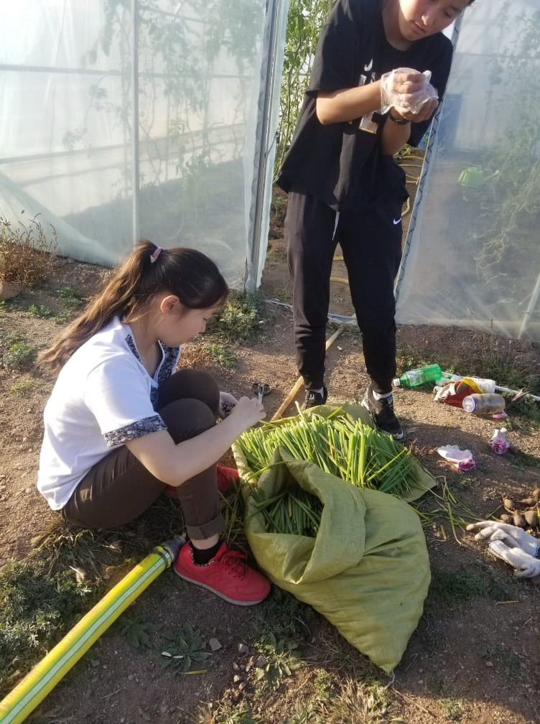
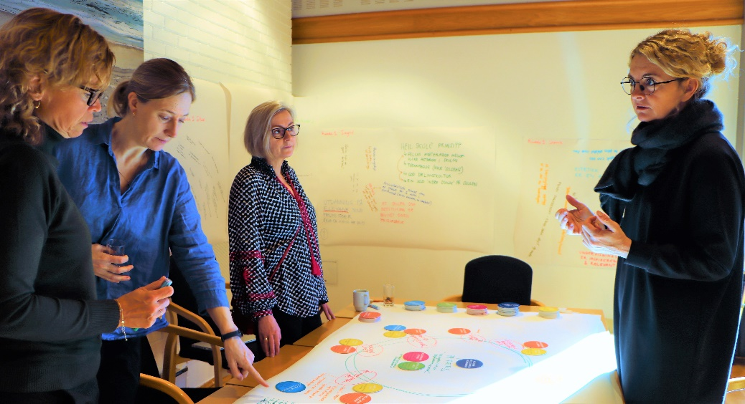
Critical case studies (to be published online)
Mongolia: A nation’s response to mainstreaming ESD practices utilising a WSA
Norway: A university-school partnership on ESD in practice
WSA Professional Development Workshop for School Leaders and teachers
Students at work at the - Healthy Food – Peace – Life garden
Notes:
Mongolia I am pleased to see the opportunity to learn more about this example later this afternoon at 16:30 – The case study is especially interesting as it gives experiences not just from one school, but from a Government led pilot study involving 30 schools that are utilising a WSA as a framework both to asses their schools and to develop new practices.
The Norway case is from the research Arjen and I are part of – It provides an example of how long-term multistakeholder partnerships can be established and support a WSA to be utilised as a thinking tool for educational innovation on multiple levels.
There is also another example from Norway in the printed version.

Slide 12
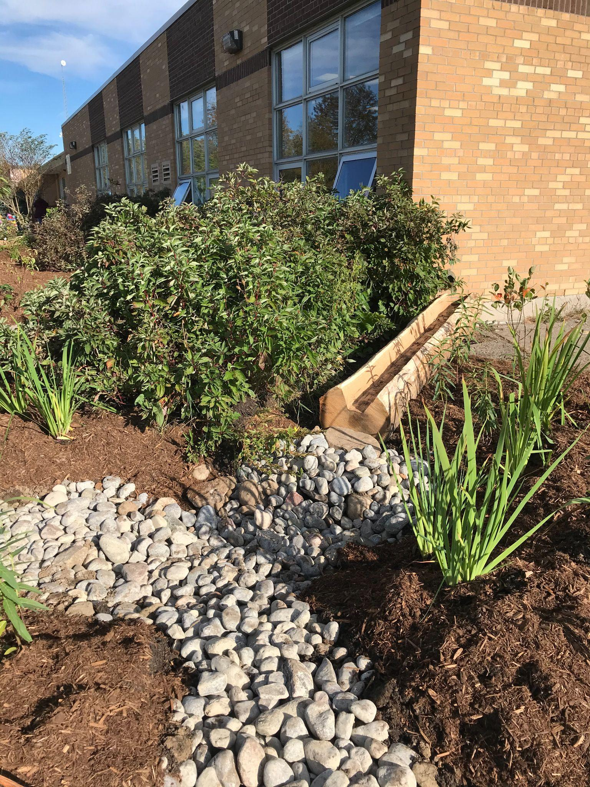
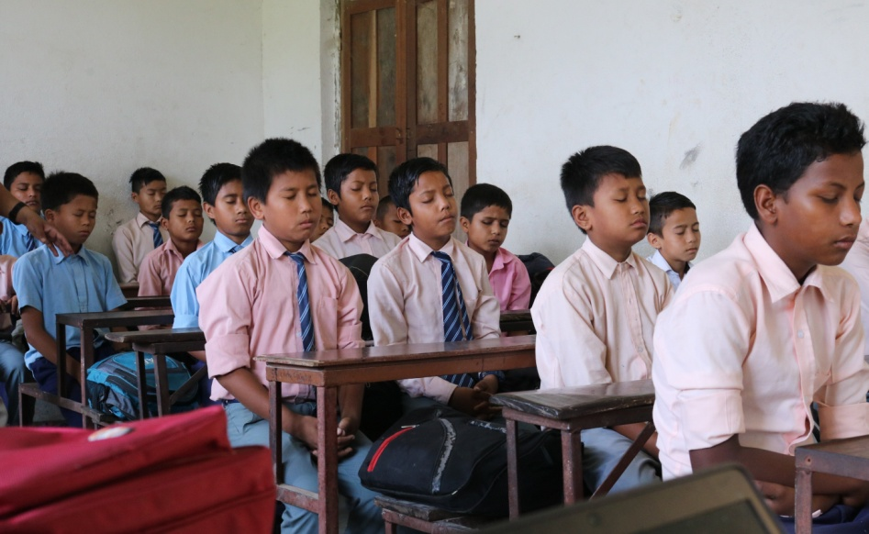
Critical case studies (to be published online)
Canada: Belfountain ‘Learning for a Sustainable Future School’
Nepal: Rupantaran whole school community research and development partnership
The schools rain garden designed by students for stormwater management. SDG # 6, 9,11, 17
Jana Jiwan Secondary School - 10 minutes for Meditation and Yoga in the morning
Notes:
Canada: Belfountain ‘Learning for a Sustainable Future School’. Is A primary school that share a really inspiring 15-year journey with sustainability education. This case exemplifies how a small group of committed teachers can grow their efforts into a whole-school approach. This case is closely connected to the work of Learning for a Sustainable Future a Canadian charity that has been working for over 30 years to integrate sustainability education into Canada’s school system.
This school gives lots of practical examples of how they connect the SDGs into their lessons and how they use the outdoors as a classroom. For example, this is a picture of the schools rain garden designed by students for stormwater management and through this design how the whole school learns about numerous of the SDGs.
The example from Nepal, is a bit like the Norway example, it gives details about Rupantaran, a whole school community research and development partnership. A Participatory collaboration between schools and universities, unique in its focus on ‘quality education’ (SDG4), innovative teaching, and community social enterprises.

Slide 13
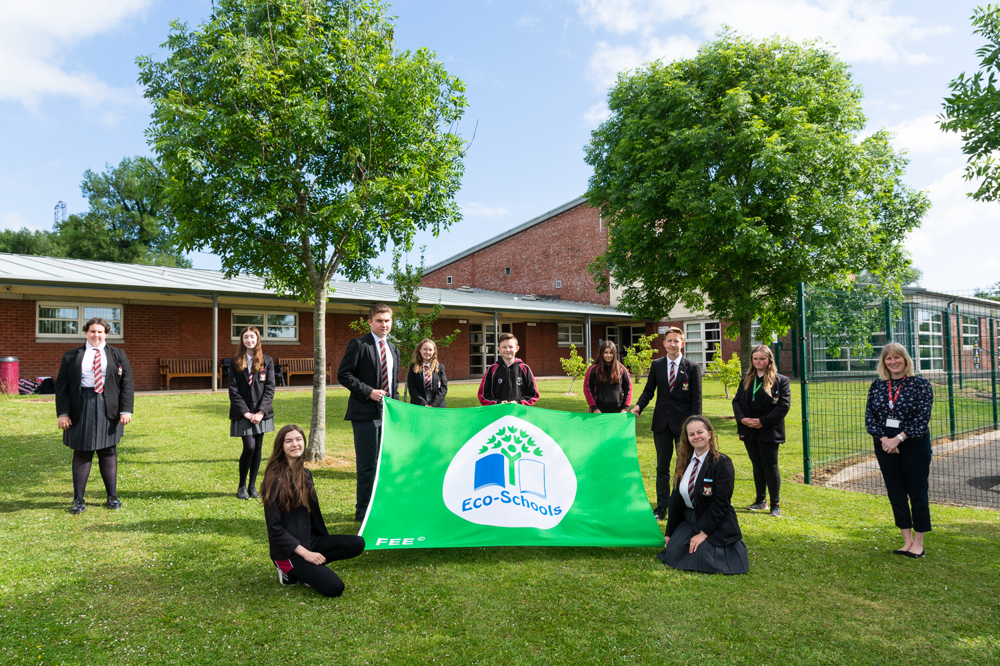
Critical case studies (to be published online)
Northern Ireland: School community partnerships in action
South Africa: Longstanding Eco-School members.
Additional case study school - Amanzimtoti primary
school celebrates a diamond decade of being an Eco-
School
India: ‘Quality Education’ as an enabler for the SDG’s.
Additional case study school - Dehli Public School share
their whole school commitment to the SDG’s
Eco-School committee gather at Ulidia Integrated secondary school
Notes:
We also have an inspiring example from Northern Ireland: It is an example of another long term Eco-School member who share various examples of School-community partnerships in action, including a long term partnership about sustainable transport and carbon footprints with TransLink, and an Eco-code mentoring model that connects and shares the schools sustainability work with other schools and community groups.
Both South African and India, while included in the printed report, also will have 2 additional school examples shared online. One from the Dehli public school in India
Also in South Africa, Amanzimtoti primary school again shares their experiences after a decade of being an eco-School.

Slide 14
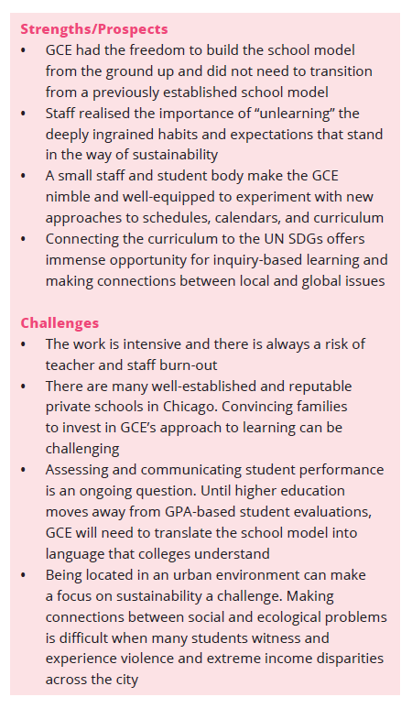
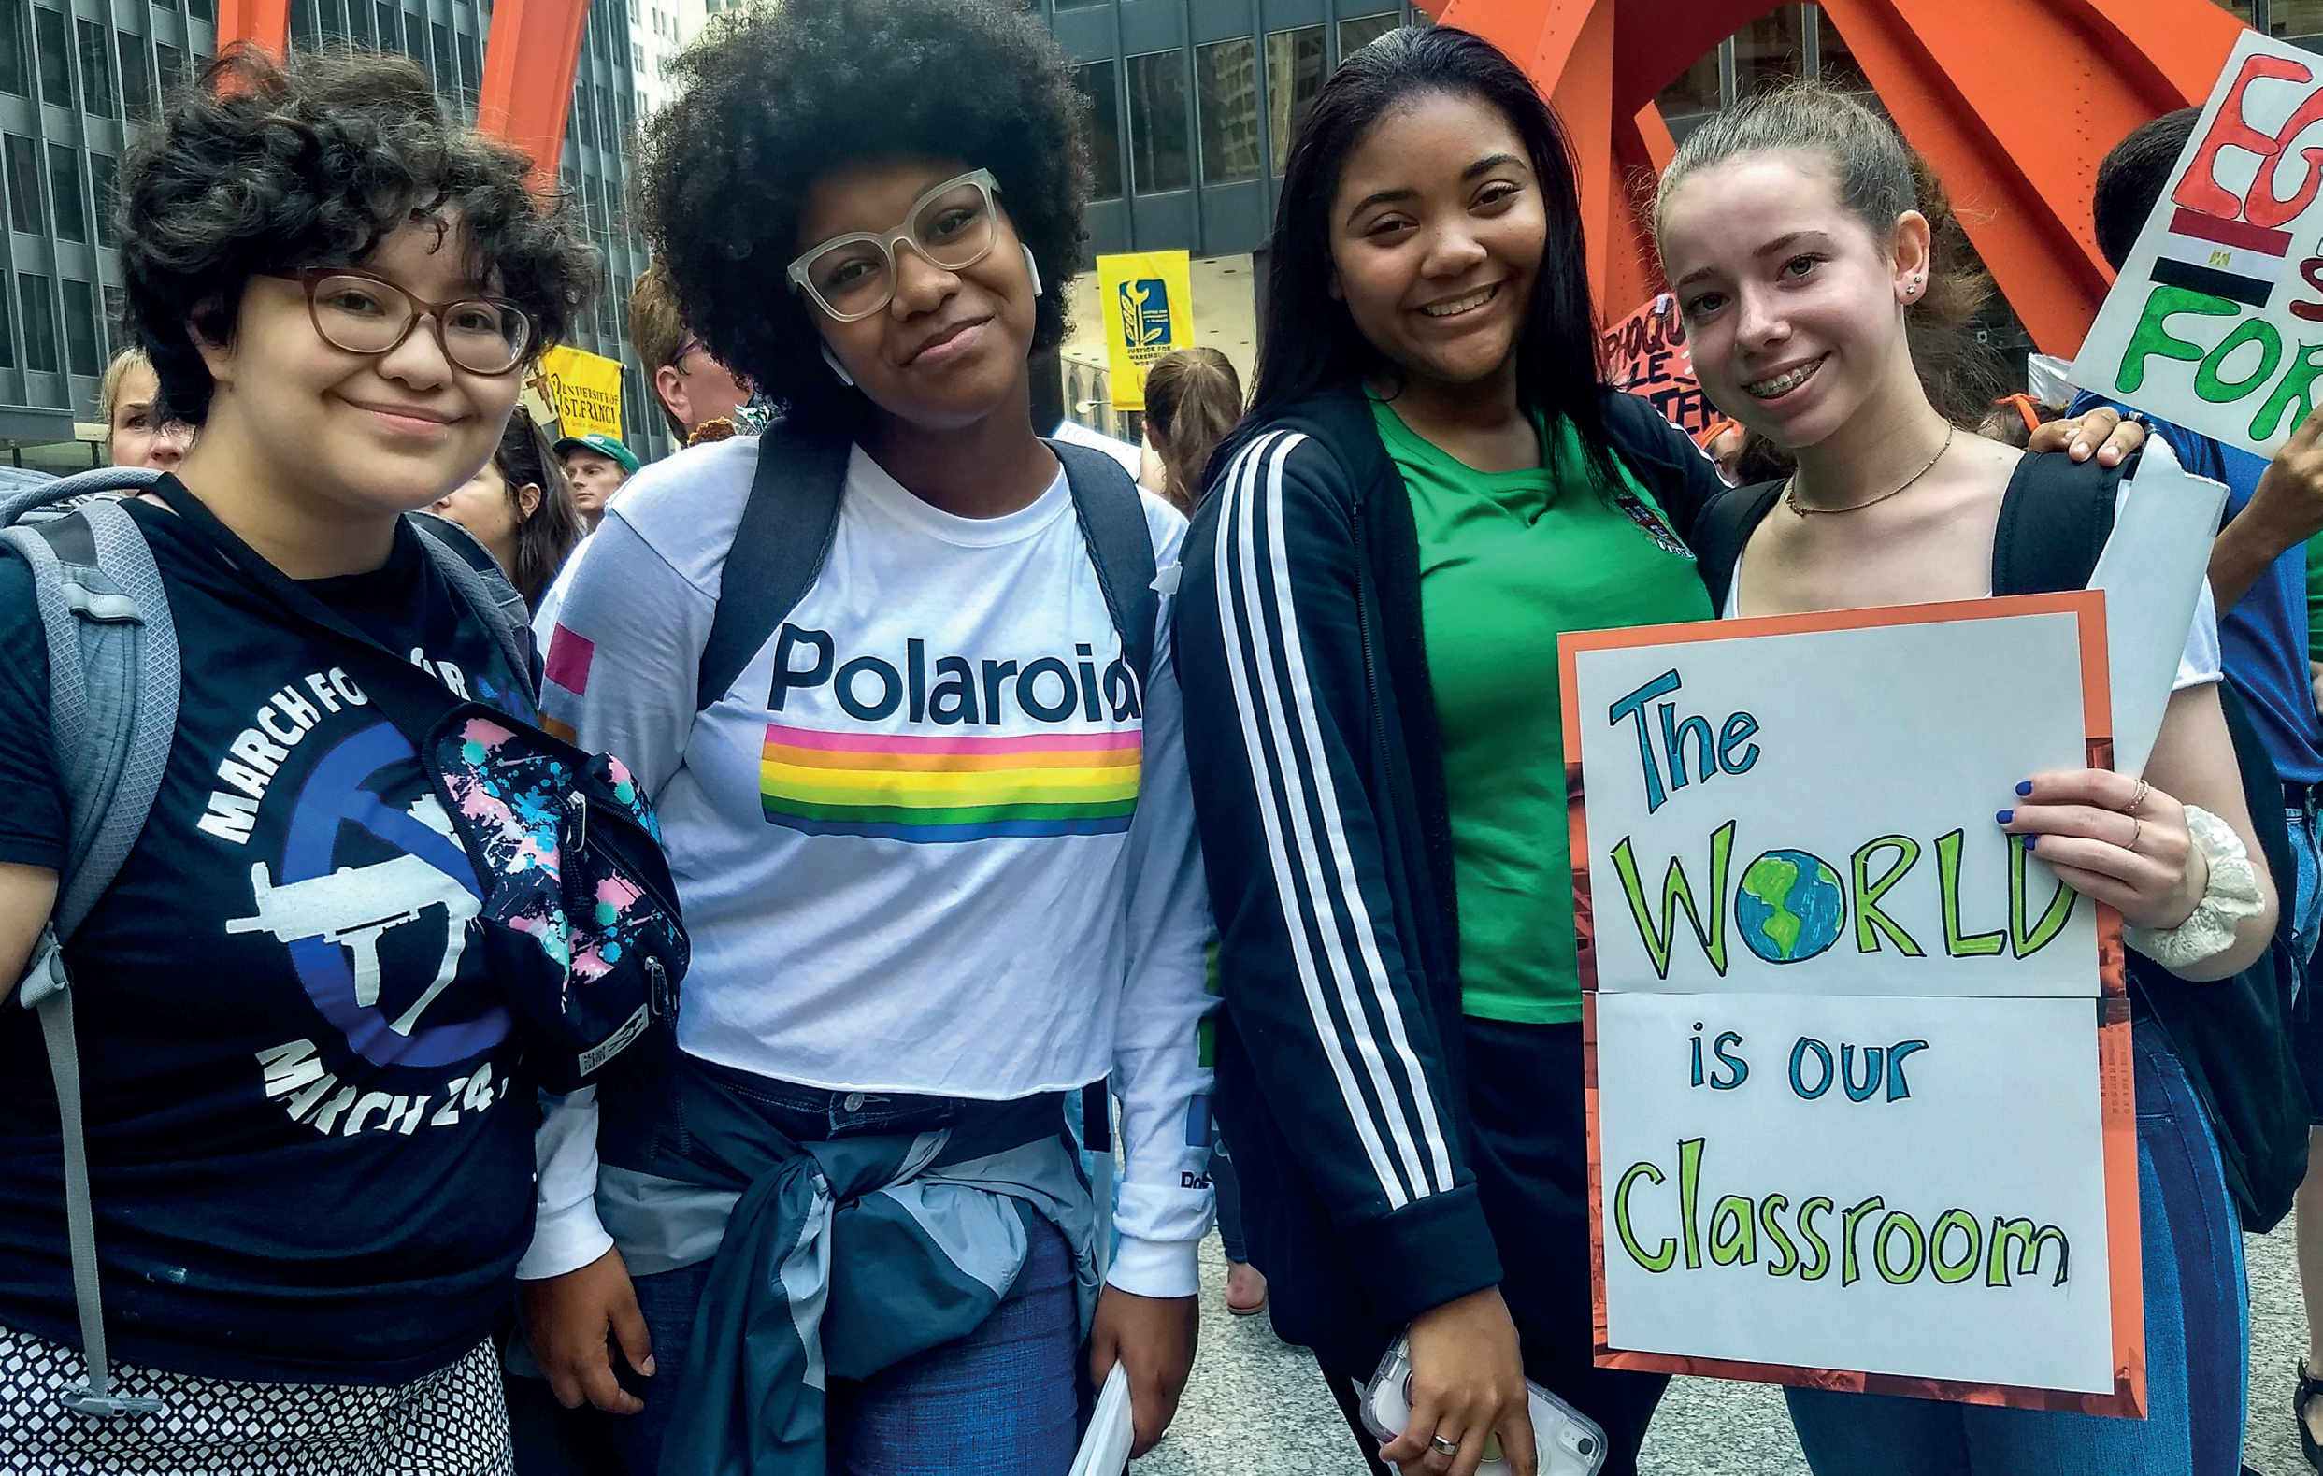
Critical case studies
(report layout)
GCE Lab Schools students participating in the Global Climate Strike in Chicago
Notes:
Lastly I wanted to point out the layout. Each case can be read in detail, but also at a glance can be read through seeing the boxes (like the one this slide shows from the American case study from the Global Citizenship Experience Lab School based in Chicago) that summarise each case. For example the box that contains a summary of the strengths and prospects of each case ,as well as a critical reflection of the challenges each school has or is, experiencing.

Slide 15
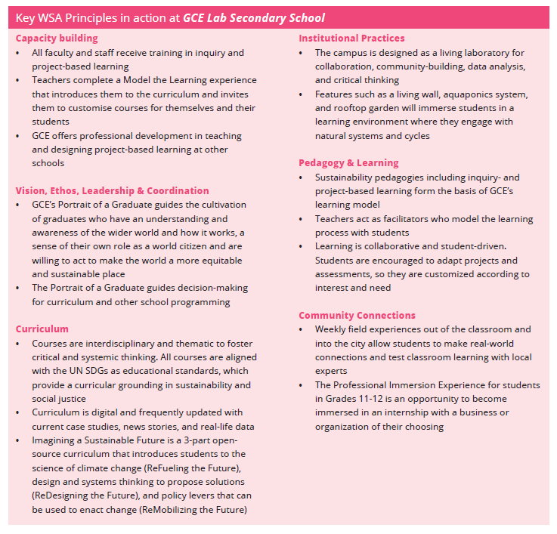
Notes:
Then each case also has a summary of Key WSA principles in action in each school.

Slide 16
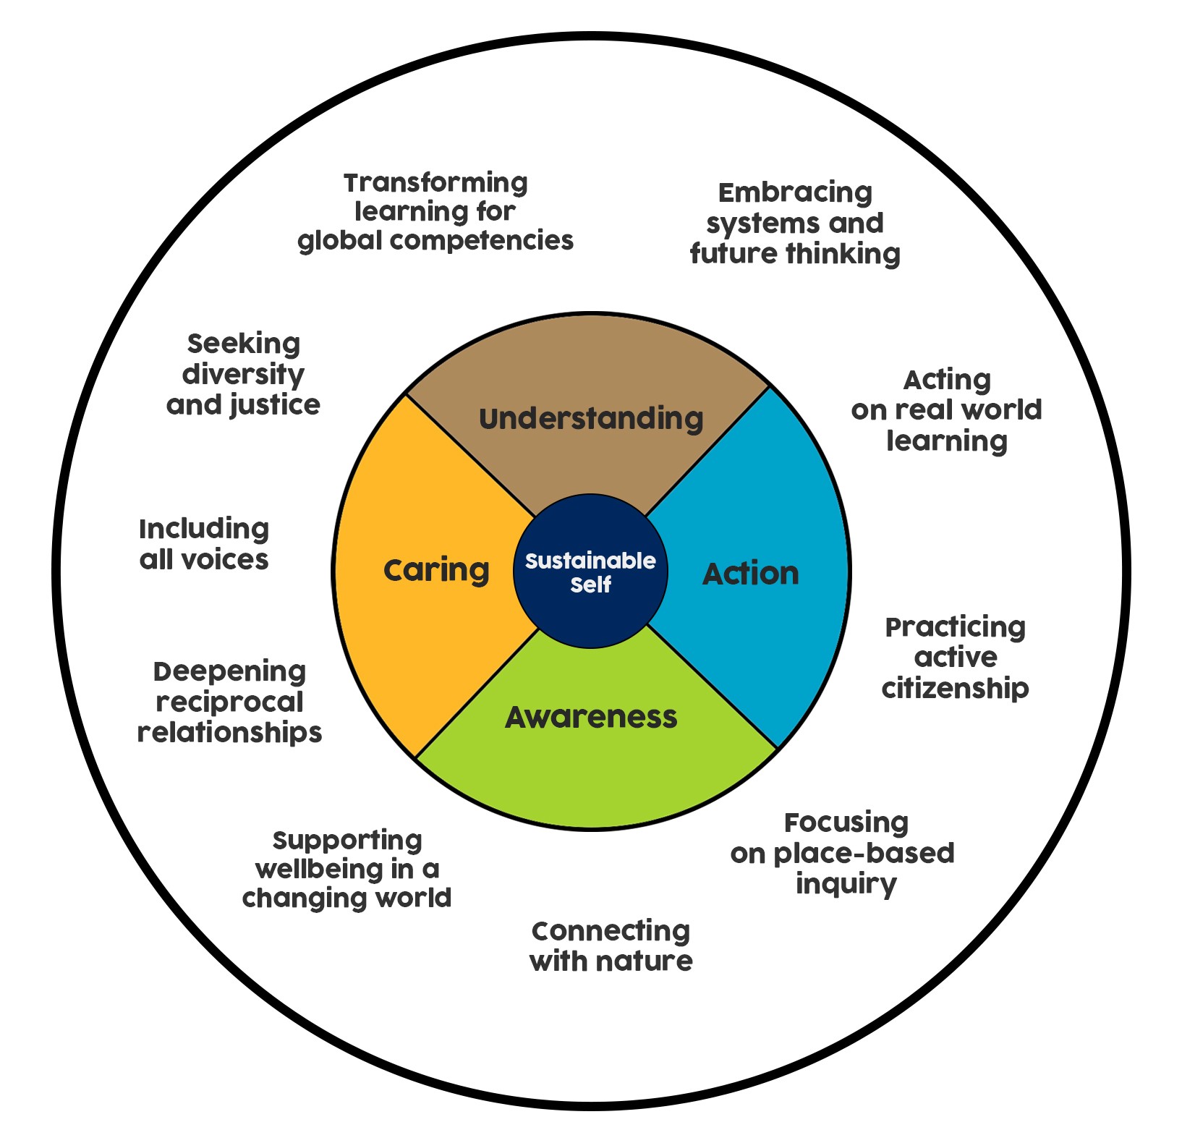
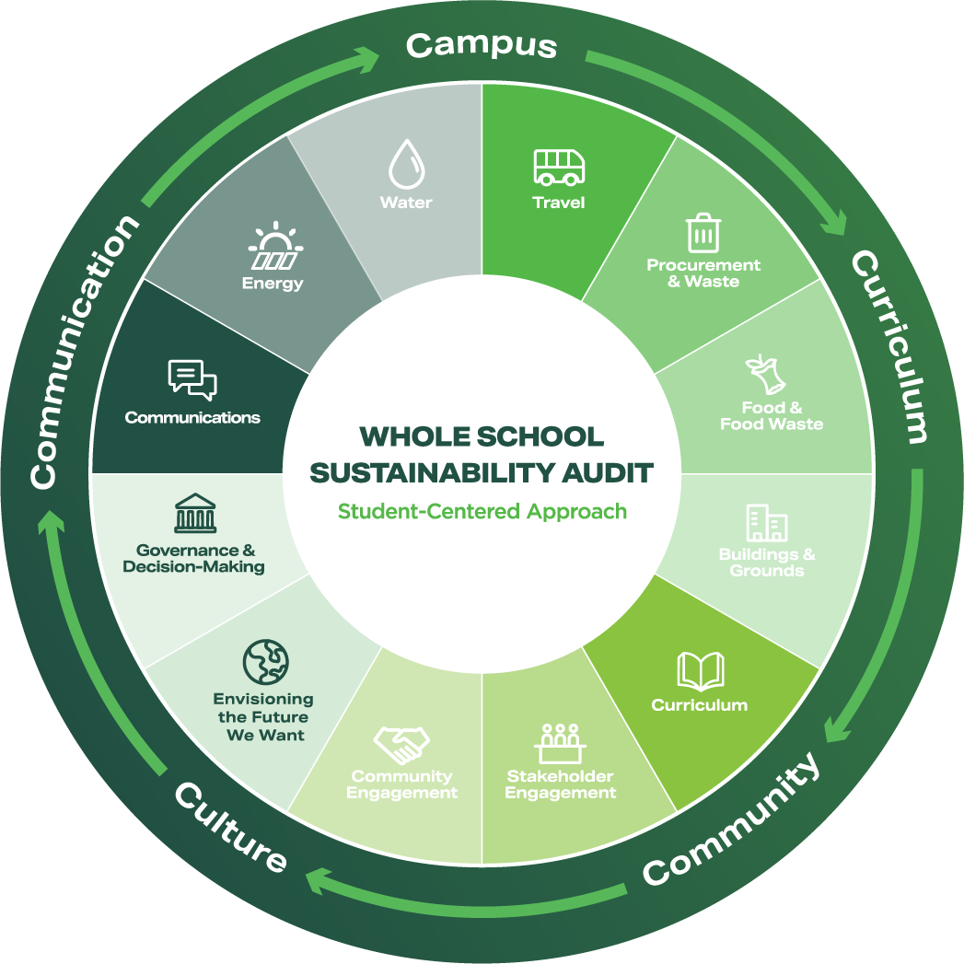
Examples of key resources and references in the report
LSF’s Sustainable Future Schools Framework
Metanoia’s Whole School Sustainability Audit
Notes:
Lastly, the case studies are all full of interesting and what I believe are resources all schools can learn from. For example, the Canadian charities Sustainable futures school framework, and in the Hong Kong example you will learn more about Metanoias Whole School sustainability audit which tomorrow there will also be a workshop about this sustainability assessment model
Anyway, I could talk for hours about each case, but I’ll leave it at that and hand over to Arjen now who will take you through our analysis and lessons learned and questions that arose from collating all these case-studies
Thank you.

Slide 17
Synthesis of the critical case studies

Slide 18
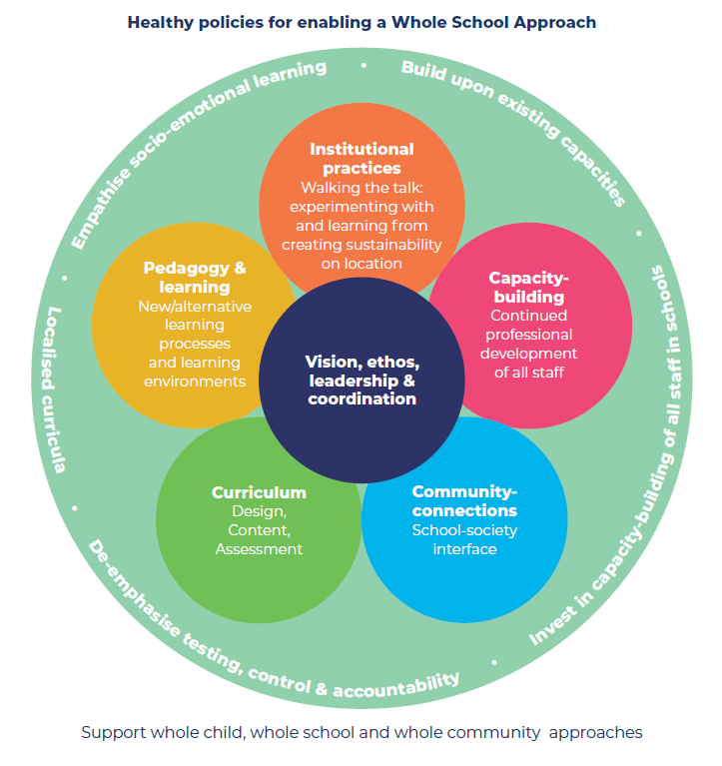
Figure 2: Healthy policies for enabling a Whole School Approach, adapted from Wals & Mathie (2022)
Notes:
Will you summarise each strand of the WSA flower using this slide? I’ll leave it up t you Arjen to do this bit but I haven’t added any more slides as think this one could be used

Slide 19
Synthesis of the critical case studies
The WSA seems to be moving from the margins to the mainstream of education.
These cases represent niches that, when combined, can become a movement which can transform the wider education system.

Slide 20
Synthesis – critical questions
In synthesising the exemplary school cases we asked four critical questions:
1. How do we ensure a WSA is inclusive and not off-putting in its scale, while still instilling the complexity of moving towards a ‘whole system re-design’?
2. What can we learn from different schools’ experiences with engaging in holistic integrated sustainability-education?

Slide 21
Synthesis – critical questions
3. While a lot remains contextual, what similarities/ trends can we see emerging and how can this influence shifts in top-down school policy?
4. How can the wider policy contexts and frameworks in which the cases are nested support a WSA?

Slide 22

Thank you!

