Slide 1
COLLABORATIVE INITIATIVE AND PARTNERSHIP FOR EDUCATION FOR SUSTAINABLE DEVELOPMENT
Mongolian institute for Education Research
Mongolian Education Agency
General Agency for Specialized Inspection
Mongolian National University of Education
Center for educational evaluation
Fresh Water Resources and Nature Conservation Center

Slide 2
Piloting The Whole School Approach in Mongolia : The Maturity Model
Speakers:
Shinestsetseg Erdenebayar,
Executive director, Information and training center for nature and environment, FEE Mongolia,
ESD-II project local implementing organization
Mita Nangia Goswami,
International Expert , ESD-II Project
INTERNATIONAL CONFERENCE ON IMPLEMENTATION OF THE WSA
2022.03.28-30
Lunteren, Netherland

Slide 3
Population 3.4 mil (21% secondary school)
SDC funding for Eco-schools programme since 2007
848 Schools (80% Public)
35,110 Teachers (20% Male)
712,400 Students (49.8% Female)
Total Spending on Education:
5% of GDP, 15.3% of Government expenditure
30 pilot WSA schools
SDC funding for ESD project since 2015
Notes:
In phase 2 in order to operationalize ESD we are working to nurture 30 pilot ESD schools who are using a WSA. The project is also building the capacity of the national institutions of the education and environment sectors while developing teaching and learning resources .
Taking into consideration the prevailing conditions in the Education sector we tweaked the WSA to address our unique needs- in the area of school management , teacher capacities and learning materials for example. We began our work with a rigorous self-assessment process so that schools could design their action plans to become good examples of centers of sustainability education.

Slide 4
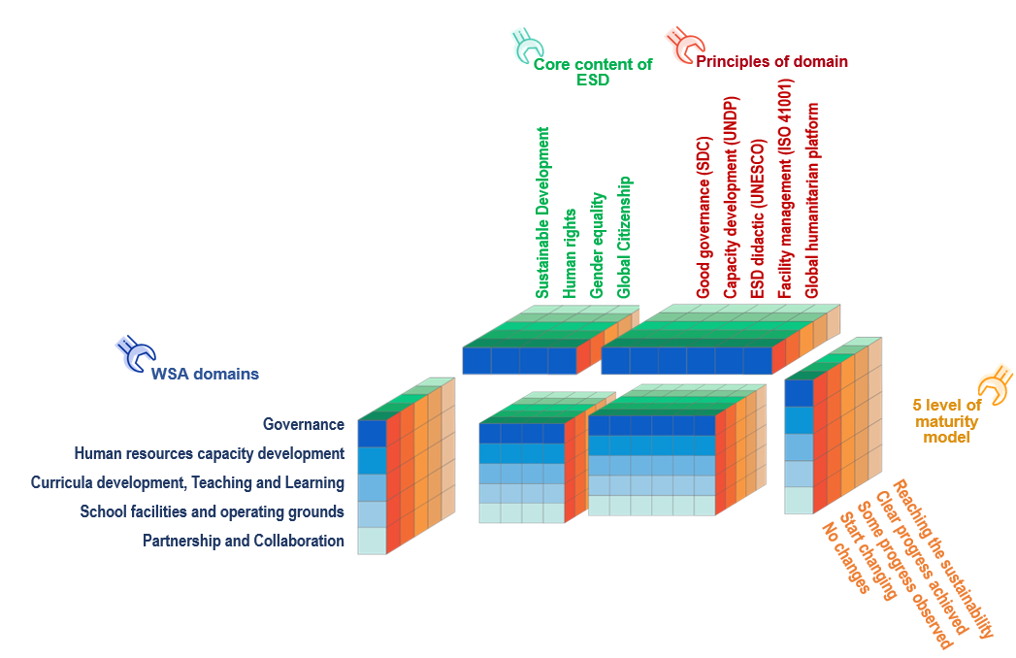
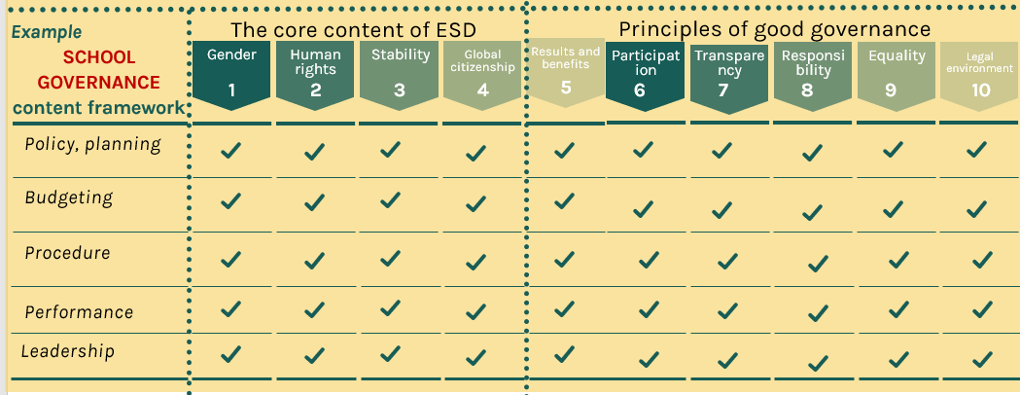
WSA maturity model Mongolia
Maturity level | Meaning | Point
Level 1 | No changes | 1.0-1.8
Level 2 | Start changing | 1.9-2.6
Level 3 | Some progress observed | 2.7-3.4
Level 4 | Clear progress achieved | 3.5-4.2
Level 5 | Reaching the sustainability | 4.3-5.0
Notes:
Phase1: 2014-2018
Phase 2: 2019-2022
Building on the results until 2018:
1. ESD is integrated in core curriculum of all secondary schools;
2. National and local capacities for ESD are built;
3. Awareness increased on ESD among adults, parents, communities and private & public organisations;
TO Embed the ESD into national systems and
WSA encompasses 5 domains of sustainability competencies
Each domain covers 24 sub-topics under 4 core themes of ESD:
Each domain has 6 sustainability competencies and maturity or growth is reflected in 5 steps of maturity
TO Empower the schools to become the change agents in the communities using WSA

Slide 5
“Quality assurance for WSA self assessment” research results
Service beneficiary is students, parents and communities
85%
GENERAL AVERAGE
2.56
REGULATORY level 2
15062
1.44-1.74-------3.8-3.14
Respondent
Constructive and cognitive learning processes is at the 2nd level of HRD
The lowest scores went to- the aspects on integrating sustainable development principles into school facility, land use and protection and introducing innovative financial mechanisms
Governance sub-component on leadership were the most prioritized (2.81) followed by the budgeting processes (2.57).
The state of skills and experience, approaches on SD integration into the curriculum were at the lowest at 2.37
28
Schools
8
Provinces
SCHOOL GOVERNANCE
2.52
HUMAN CAPACITY DEVELOPMENT 2.62
TEACHING, LEARNING AND CURRICULUM
2.61
SCHOOL GROUND
2.68
PARTNERSHIP 2.46

Slide 6
CONCLUSION
The survey for the QA of the WSA Self-Assessment Checklist has shown that the Checklist provides an evidence based strong foundation for the 28 Schools to navigate their path to transform into models of sustainability.

Slide 7
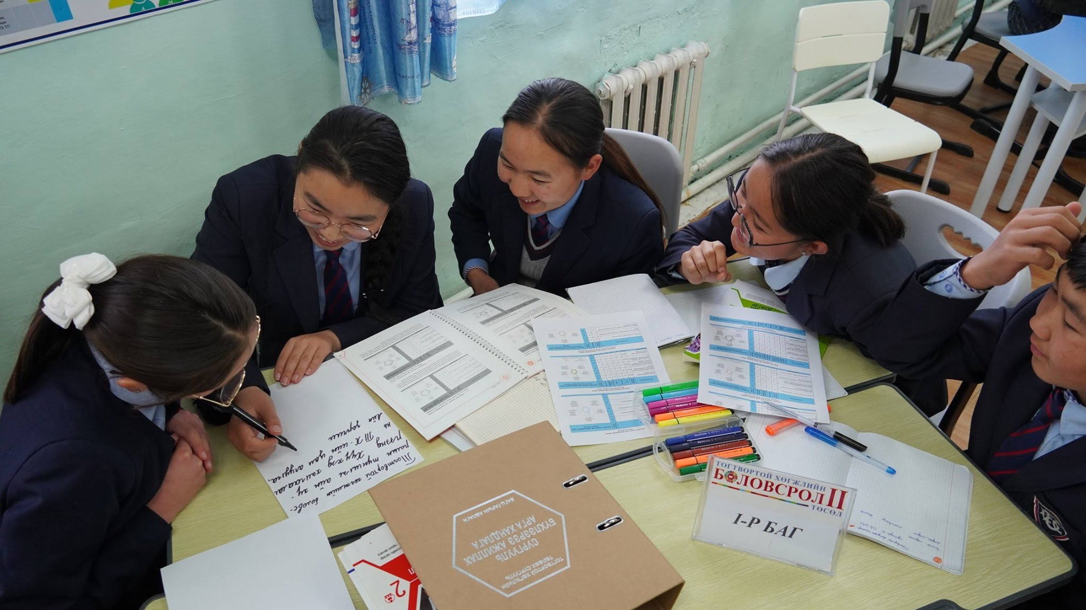
Deepening the understanding of the holistic approach of ESD amongst all stakeholders
Multi-stakeholder engagement and coordination for effective partnerships
Dissemination and sharing of lessons learned and successes amongst schools
Empowering and supporting teachers
Communication between the macro level and the grass roots
WHAT IS NEEDED FOR SUCCESS
Notes:
Talk about Sub-TACG – we have hence looked at building capacity not only at the Macro level but right down to the aimag and soum levels . Also, the macro level has been actively mentoring the meso and micro levels
Robust collaboration at the school level- with the local authorities, community and parents
Sharing amongst schools is very crucial, since it inspires and brings about collaboration rather than competition , which is such a need of the hour
Teachers are the real foot soldiers on the ground and they need all the support that we can render – providing them with conceptual clarity about ESD and enabling cross learning, sharing amongst them .
The policy makers at the national level need to keep up a healthy communication with the schools so that they get feedback and use evidence from the ground to make policy decisions regarding school management, curriculum, teacher training (both pre and in service).

Slide 8
